Slide 1


Unit 2. PVA Workbooks
Lesson 1. ~ Part 1.
Intro to Purchase vs. Allowance Inventory Systems Workbook (PVAISW)
Note: Audio should start automatically within 15 seconds.
If volume is too low, close session, increase volume setting on your computer or Bluetooth stereo, and reopen session to start again.
Go to next slide
Notes:
HELLO AND WELCOME TO UNIT 2, PVA WORKBOOKS.
My name is Senior Chief Anthony Ciurlino with the Food Service Assistance and Training Team here at Training Center Petaluma. I WILL BE YOUR INSTRUCTOR FOR THIS LESSON.
THIS FIRST LESSON IN UNIT 2 IS “INTRODUCTION TO THE PURCHASE VERSE ALLOWANCE INVENTORY SYSTEMS WORKBOOK. LESSON 1 PROVIDES KNOWLEDGE AND A FOUNDATIONAL UNDERSTANDING OF THE PVA WORKBOOK. The goal of this lesson is to ensure every FSO attending this course has foundational knowledge critical to success in later, more complex lessons.

Slide 2
Lesson 1. Part 1.
Topics
Click on a bar (below) to begin topic.
Getting Started
What is the PVAISW?
What is BDFA?
How to Navigate a Form PVAISW?

Slide 3
Getting Started
Objective(s):
After completing Lesson 1, you should be able to:
Describe the purpose of the PVAISW.
Identify the Basic Daily Food Allowance value per your unit class (Ashore/Afloat).
Identify the PVAISW’s forms.
Recognize the purpose of each PVAISW form.
The prerequisite knowledge you will learn in this Lesson 1 will prepare you for more complex lessons in this course.
Notes:
AFTER completing this lesson, you should be able to…. (read objectives on slide)

Slide 4
Getting Started, Continued
You will need:
  Paper-based “FSO-PVA Forms Packet” included in your course materials.
    Your “FSO-PVA Forms Packet” has the PVAISW.
Your paper PVAISW should have these forms:
COAST GUARD DINING FACILITY OPERATING STATEMENT (CG-2576)
RATION MEMORANDUM (CG-3123)
DAILY RATION COST RECORD (CG-3471)
ISSUE/SALES SLIP - SALE OF STORES (CG-2581)
ISSUE/SALES SLIP - TRANSFER OF STORES (CG-2581)
CASH LOG
MEAL SIGN-IN SHEET (CG-4901)
MEAL SIGN-IN DATA ENTRY SHEET
Notes:
BEFORE YOU BEGIN THIS LESSON, PLEASE HAVE IN FRONT OF YOU THE PAPER-BASED “FSO-PVA FORMS PACKET” THAT YOU RECEIVED AS PART OF YOUR COURSE MATERIALS.
THIS PAPER-BASED FSO-PVA FORMS PACKET CONTAINS THE PVAISW FORMS LISTED ON THIS SLIDE, IN ADDITION TO OTHER WORKBOOK FORMS WE WILL COVER IN LATER LESSONS IN UNIT 2.
WE RECOMMEND THAT YOU USE THE PAPER COPIES OF THE PVAISW SO YOU CAN TAKE NOTES DIRECTLY ON THESE FORMS AS WE DISCUSS THEM IN THIS LESSON AS WELL AS FOR USE IN FUTURE LESSONS.
THE FORMS WE WILL BE COVERING ARE THE:

Slide 5
Congratulations!
Return to Home Page
You have finished “Getting Started”.
Accomplished:
You have secured your paper PVAISW containing all valid forms,
You know the foundational skills (objectives) this course will develop.
Continue to next topic, “What is PVAISW?”

Slide 6
What is the PVAISW?
“PVAISW” stands for Purchase vs. Allowance Inventory Systems Workbook.
PVAISW Purpose: To provide an FSO with forms that manage and track Coast Guard Dining Facility Operations (CGDFO).
Use: An FSO sets up a new PVAISW at the beginning of each month.
Notes:
READ SLIDE AND PREPARE TO INTRODUCE BDFS on NEXT SLIDE

Slide 7
Knowledge Check: What is the PVAISW?
Instructions: Click on the answer you believe is correct.
1. PVAISW stands for:
A. Purchase vs. Allowance Inventory Solutions Workbook
B. Purchase vs. Allowance Inventory Systems Workbook
C. Purchase vs. Allowance Inventory Strategic Workbook
2. The purpose of the PVAISW is to:
A. Provide FSO subordinates with forms to track inventory.
B. Provide multiple forms to generate Stock Cards.
C. Provide FSOs with forms to track/manage dining facility operations.

Slide 8
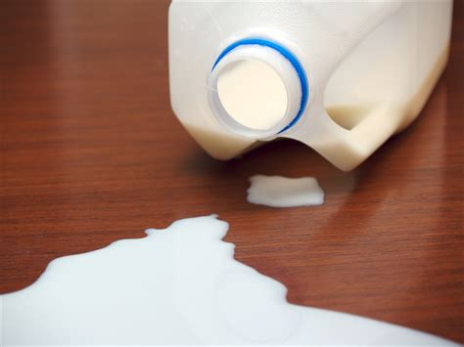
That is not correct.
Please try again.
Try again…

Slide 9

That’s right!
Congratulations! !
Return to complete the Knowledge Check

Slide 10

Yes, that’s right!
An FSO uses PVAISW forms to manage and track Coast Guard Dining Facility Operations.

Slide 11
Congratulations!
Return to Home Page
You have finished “What is the PVAISW”.
Accomplishments:
You identified the purpose of a PVAISW
Continue to next topic, “What is BDFA?”

Slide 12
BDFA
Basic Daily Food Allowance (BDFA) pays for 1 ration.
1 ration = 3 meals/day for 1 person (breakfast, lunch, dinner.)
FSO uses BDFA to calculate daily food budget.
Meal | Portion of Cost | Example: If BDFA = $12.27/person (ration)
Breakfast | .2 (20%) | $2.45 (20% of $12.27)
Lunch | .4 (40%) | $4.91 (40% of $12.27)
Dinner | .4 (40%) | $4.91 (40% of $12.27)
If cutter has 10 people, $12.27 x 10 = $122.70 (FSO’s max daily food budget)
Notes:
BDFA is the amount of money allocated to fund one ration.
One ration equals three meals a day (breakfast, lunch, dinner) for one person.
THE TABLE ON THIS SLIDE SHOWS HOW EACH MEAL REPRESENTS A PORTION PERCENTAGE OF THE BDFA COST.
THE PORTION OF COST WILL ALWAYS BE:
Breakfast = .2 (20%)
Lunch = .4 (40%)
Dinner = .4 (40%)
NEXT, THE TABLE OFFERS AN EXAMPLE OF HOW THIS BDFA PERCENTAGE IS APPLIED.
IN THIS EXAMPLE, BDFA IS $12.21.
What does this mean?
Following our “portion of cost” ratio, it means that:
Breakfast = .2, so its cost is $2.44, or 20% of $12.21.
Lunch = .4, so its cost is $4.89, or 40% of $12.21.
Dinner = .4, so its cost is also $4.89 of $12.21.
An FSO uses the BDFA rate to calculate the maximum amount of money they can spend daily on food items.

Slide 13
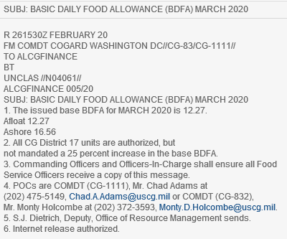
Who Sets BDFA?
Department of Defense (DoD) sets the BDFA rate cost of each meal.
Every Month, CG-1111 distributes a BDFA Message that issues the BDFA rates for Ashore and Afloat (see below)
BDFA MESSAGE
(Example)
Notes:
Who sets BDFA? The USCG Financial Center (FINCEN) sets the BDFA rate cost of each meal is based on a percentage of the BDFA The BDFA rate is set by the USCG Finance Center (FINCEN.) FINCEN distributes a BDFA memorandum once a year with the BDFA rates for ashore and afloat (see sample below)

Slide 14
Knowledge Check: What is BDFA?
Instructions: Click on the answer you believe is correct.
BDFA is the amount of money allocated to fund 1 ration.
What does 1 ration consist of?
A. 1 ration = 3 meals/day (breakfast, lunch, dinner) for one person.
B. 1 ration = one meal for one week per person.
C. 1 ration = All meals allocated per person for one full month.
2. BDFA rations represent what percentage of each meal?
A. Breakfast = 40%, Lunch = 30%, Dinner = 30%
B. Breakfast = 30%, Lunch = 30%, Dinner = 45%
C. Breakfast = 20%, Lunch = 40%, Dinner = 40%
3. You are an FSO on a cutter with 12 people and a BDFA
of $12.25. What is your maximum daily food budget?
A. $122.50
B. $147
C. $1,470

Slide 15

That is not correct.
Please try again.
Try again…

Slide 16

That’s right!
BDFA is the amount of money allocated to fund ONE RATION, and ONE RATION consists of 3 meals a day (breakfast, lunch, dinner) for one person.
Return to complete the Knowledge Check

Slide 17

That’s right!
YES, BDFA rations represent a certain percentage of each meal, which is:
Breakfast = 20% (.2)
Lunch = 40% (.4)
Dinner = 40% (.4)
Formula Reminder:
If your BDFA is $12, then….
Breakfast = .2 x 12.00 = $2.40
Lunch = .4 x 12.00 = $4.80
Dinner = .4 x 12.00 = $4.80
Return to complete the Knowledge Check

Slide 18

Yes, that’s right!
If you have 12 people on your cutter and your BDFA is $12.25, then your daily food budget is $147.
Formula for Answer:
12 x 12.25 = $147 BDFA.

Slide 19
Congratulations!
Return to Home Page
You have finished “What is the BDFA”.
Accomplishments:
You identified the purpose of BDFA and identified the calculation an FSO performs to determine their unit’s maximum daily food budget.
Continue to next topic, “Navigating a PISW Form”

Slide 20
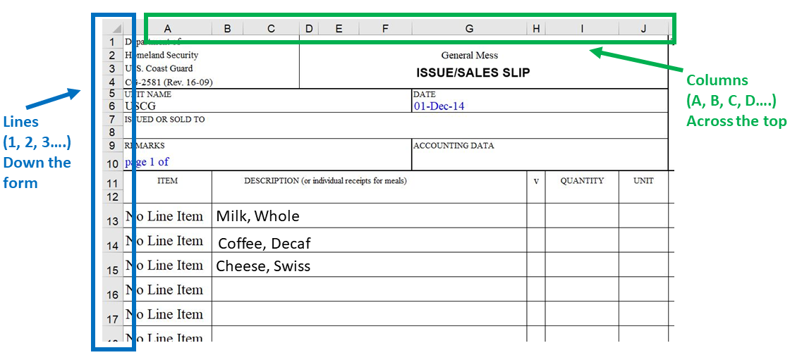
Navigating a PVAISW Form
Knowledge Check: BDFA
Instructions: Click on the right answer
1. How would you describe the location of MILK, WHOLE?
A. 15-BG
B. B13
C. H14
D. D9
Notes:
BEFORE WE CONTINUE, ANOTHER PREREQUISITE SKILL IS YOUR ABILITY TO NAVIGATE A PVAISW FORM.
You can skip this portion of the video if you already know how to navigate a PVAISW form.
How do we navigate PVAISW forms?
PVAISW FORMS ARE PRESENTED IN EXCEL SPREADSHEETS.
EXCEL PRESENTS DATA IN COLUMNS, ROWS, AND LINES.
IN THIS SLIDE, YOU CAN SEE THAT AT THE FAR LEFT THE ROWS ARE REPRESENTED BY NUMBERS
AND ACROSS THE TOP YOU CAN SEE THE COLUMNS ARE REPRESENTED BY LETTERS
THEN WITHIN THE BODY OF THE FORM ITSELF, WE HAVE LINE NUMBERS.
I HAVE A QUICK QUIZ FOR YOU.
CLICK –HOW WOULD YOU DESCRIBE THE LOCATION OF THE NUMBER 8?
CLICK – YOU WOULD SAY THAT THE NUMBER 8 IS LOCATED IN COLUMN B, LINE 2, ROW 13….or you could just say B2 or B13.
HERE’S ANOTHER QUIZ.
CLICK –HOW WOULD YOU DESCRIBE THE LOCATION OF THE NUMBER 10?
CLICK – YOU WOULD SAY THE NUMBER 10 IS LOCATED IN COLUMN F, LINE 3, ROW 14…..or you could just say F3 or F14.

Slide 21

Oops.
That answer does not line up “MILK, WHOLE” with the Columns and Lines on the sample PISW excel sheet.
Try again…

Slide 22
That’s Right!
Column B
Line 13
The intersection of Column B and Line 13 on the sample PISW excel form (above) brings you to “MILK, WHOLE.”
Note: We typically state the Column (B) first followed by the Line (13), such that we’d say “B13” rather than 13B.

Slide 23
Congratulations!
You have completed PART 1 of Lesson 1. “Intro to PVAISW”
Instructions:
Return to the milSuite folder for Unit 2. Lesson 1 to complete PART 2.

