Slide 1


Unit 2. Workbooks
Lesson 1. ~ Part 3.
Intro to Purchase vs. Allowance Inventory Systems Workbook (PVAISW)
Notes:
HELLO AND WELCOME TO UNIT 2, PVA WORKBOOKS.
My name is Senior Chief Anthony Ciurlino with the Food Service Assistance and Training Team here at Training Center Petaluma. I WILL BE YOUR INSTRUCTOR FOR THIS LESSON.
THIS FIRST LESSON IN UNIT 2 IS “INTRODUCTION TO THE PURCHASE VERSE ALLOWANCE INVENTORY SYSTEMS WORKBOOK. LESSON 1 PROVIDES KNOWLEDGE AND A FOUNDATIONAL UNDERSTANDING OF THE PVA WORKBOOK. The goal of this lesson is to ensure every FSO attending this course has foundational knowledge critical to success in later, more complex lessons.

Slide 2
Lesson 1. Part 3 Topics
Click on bar (right) to begin topic.
Recommend you refer to paper “FSO-PVA Form Packet” during this lecture.
“Ration Memorandum” Form CG-3123
“Daily Ration Cost Record” CG-3471
    Form CG-2581
    “Sale of Stores” CG-2581
    “Transfer of Stores” CG-2581
Cash Log
    Form CG-4901
  “Meal Sign-In Printable” CG-2581
  “Meal Sign In – Data Entry” CG-2581

Slide 3
PVAISW Form: CG-3123
“Ration Memorandum”
Daily “Ration Memorandum” Form CG-3123
Summary “Ration Memorandum” Form CG-3123 (Entire Month)
Recommended : Refer to your paper FSO-PVA Forms Packet and turn to Form CG-3123 “Ration Memorandum”.
Notes:
Refer to your PVAISW Packet for form CG-3123

Slide 4
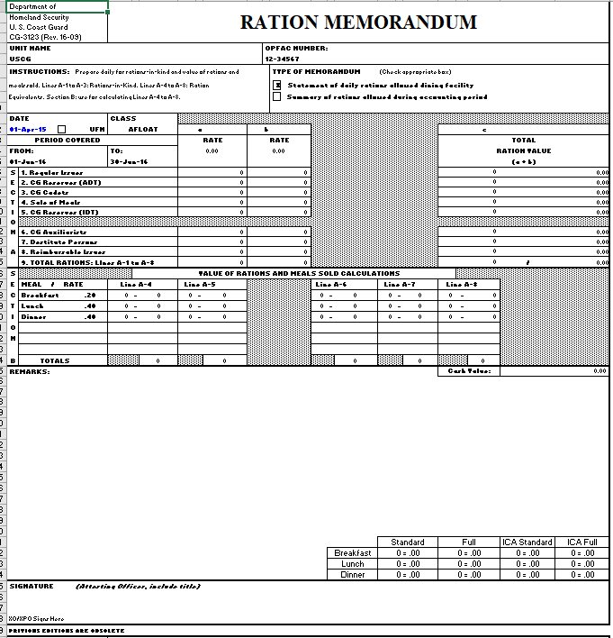
Form CG-3123: Ration Memorandum
Checkbox:
“Daily”
CG-3123
“Daily”CG-3123 has “Daily” box checked.
It provides a snapshot of patrons who ate in galley for that DAY.
Checkbox:
“Summary” CG-3123
“Summary” CG-3123 has “Summary” box checked.
It provides a snapshot of patrons who ate in your galley for that MONTH.
Signature?
Only XO signs SUMMARY CG-3123.
XO or Designated Personnel Officer signs DAILY CG-3123
Notes:
An FSO uses the CG-3123 daily to document the category and meal rate of people who ate at your dining facility that day (e.g., civilians, contractors, reserves, etc.) and the compensation the CGDF received.
The CG-3123 calculates monthly allowances that justify or support issues from inventory.
In summary, the CG-3123:
Tracks information about people who eat at your dining facility each day.
Summarizes this information at the end of the month for reporting purposes.
When you purchase food for your CGDF inventory, the food is not charged against your monthly allowance until the food is issued for patrons’ meals. The Executive Officer (XO) signs the CG-3123.
Reminder: BDFA is the monetary allowance that provides one person breakfast, lunch, and dinner in one day.
Form CG-3123 uses BDFA to calculate daily and monthly allowances.

Slide 5
Knowledge Check: Form CG-3123
Instructions: Click on the Best Answer
Next Topic
1. What are the two types of uses for the CG-3123?
A. Daily Only
B. Daily and Monthly
2. Who signs the summary “Ration Memorandum” CG-3123?
A. Only Executive Officer (XO)
B. XO or Designated Personnel Officer
3. Who signs the daily “Ration Memorandum” CG-3123?
A. Only Executive Officer (XO)
B. XO or Designated Personnel Officer
4. What does the CG-3123 use to calculate both daily and monthly allowances other than number of meals sold?
A. Number of patrons buying meals.
B. BDFA
Skip to Next topic
Notes:
Before we move on to the next form, here’s a brief quiz.
Instructor --- read #1, then click to reveal the answer. Next, read #2, then click to reveal the answer. Finally, read #3 and then click to reveal the answer.

Slide 6

That answer is incorrect. Please Try again.
Try again…

Slide 7

That’s right!
Yes, the CG-3123 “Ration Memorandum” form is used to calculate both daily and monthly allowances.
Return to complete the Knowledge Check
Notes:
An FSO uses the CG-3123 daily to document the category and meal rate of people who ate at your dining facility that day (e.g., civilians, contractors, reserves, etc.) and the compensation the CGDF received.
The CG-3123 calculates monthly allowances that justify or support issues from inventory.
In summary, the CG-3123:
Tracks information about people who eat at your dining facility each day.
Summarizes this information at the end of the month for reporting purposes.
When you purchase food for your CGDF inventory, the food is not charged against your monthly allowance until the food is issued for patrons’ meals. The Executive Officer (XO) signs the CG-3123.
Reminder: BDFA is the monetary allowance that provides one person breakfast, lunch, and dinner in one day.
Form CG-3123 uses BDFA to calculate daily and monthly allowances.

Slide 8

Yes, that’s right!
Yes, ONLY the Executive Officer (XO) signs the SUMMARY CG-33123.
Return to complete the Knowledge Check

Slide 9

Yes, that’s right!
Yes, EITHER the Executive Officer (XO) OR the Designated Personnel Officer can sign the DAILY CG-3123.
Return to complete the Knowledge Check

Slide 10
Yes, that’s right!
Yes, the CG-3123 “Ration Memorandum” form uses both the number of meals sold AND the BDFA (Basic Daily Food Allowance) to calculate daily and monthly allowances.
Continue to next topic, “CG-3471”

Slide 11
PVAISW Form: CG-3471
Daily Ration Cost Record
Recommended : Refer to paper FSO-PVA Forms Packet and turn to Form CG-3471 “Daily Ration Cost Record”.
Notes:
Refer to your PVAISW Packet for Form CG-3471

Slide 12
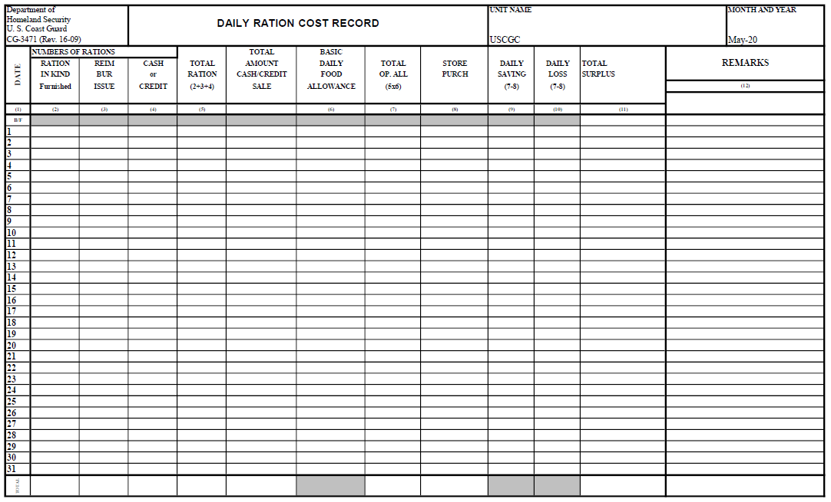
CG-3471: Daily Ration Cost Record
FSO can view CG-3471 form to see where the Dining Facilities’ finances stand.
Form does not include end-of-month inventory. You will learn how to use this form in future lessons.
Notes:
CG-3471 is the unit’s operating allowance balance ledger.
The CG-3471 compares the rations claimed by the Dining Facility, which represent money taken it, to food Stores Purchased. It can be viewed on any given day to see where the Dining Facilities finances stand. The only thing the CG-3471 does not account for is end-of-the month inventory.

Slide 13
PVAISW Form: CG-2581
CG-2581: Sale of Stores
CG-2581: Transfer of Stores
Recommended: Refer to paper FSO-PVA Forms Packet and turn to Form CG-2581 Sale of Stores and Form CG-2581 Transfer of Stores.
Notes:
Refer to your PVAISW Packet and you will notice you have two CG-2581 forms.
One CG-2581 is for SALE OF STORES.
The other CG-2581 is for TRANSFER OF STORES.

Slide 14
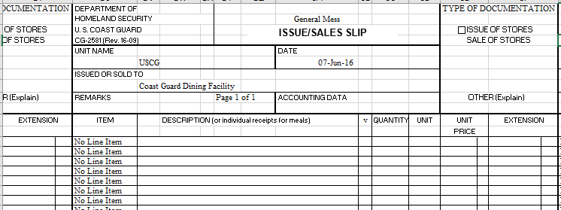
CG-2581: Issue / Sales Slip
Sale of Stores
Raw inventory items sold to an approved purchaser
Transfer of Stores
Raw inventory items transferred to another CG dining facility (no money exchanged)
Notes:
The only difference in these 2 forms is the “TYPE OF DOCUMENTATION” selected within the form (See slide.)
Sale of Stores: The “sale of Stores” box will be checked, designating this CG-2581 is for Sale of Stores. This CG-2581 documents food items sold from your unit’s inventory to another entity, e.g., a morale event or a change of watch.
Transfer of Stores: The “transfer of Stores” box will be checked, designating this CG-2581 is for TRANSFER of Stores. This CG-2581 documents food items transferred from inventory to another CG dining facility.

Slide 15
PVAISW Form: Cash Log
Cash Log
Cash Log Instructions
Recommended: Refer to paper FSO-PVA Forms Packet and turn to CASH LOG and also CASH LOG Instructions.
Notes:
Refer to the form in your PVAISW titled CASH LOG

Slide 16
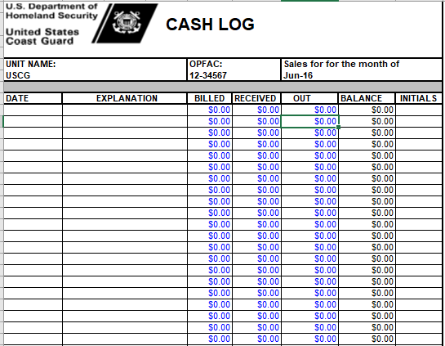
Cash Log
The Cash Log tracks cash, checks, and Money Orders.
The Cash Log also tracks ICAs (Individual Credit Accounts) if the patron pays their ICA with cash at the end of month.
In future lessons you will learn how to use the Cash Log. You will also learn about Pay.Gov transactions. Pay.gov transactions are tracked in the PAY.GOV LOG --- NOT the Cash Log.
Notes:
The FSO uses the Cash Log to track all cash transactions, including cash, checks, and money orders.
Note: Pay.gov payments are tracked in the pay.gov log, not the Cash Log.
Each month’s Cash Log supports billing and collections performed for that specific month’s sale of meals.
Key points:
Recording Cash Payments: If the FSO issues a bill for meals sold in January, and that bill is paid (money is collected) in March, then the cash collected in March for January’s bill is entered into March’s Cash Log (not January’s Cash Log.)
Change fund: When beginning a Cash Log at the beginning of the month, it is important to document any authorized change fund. A change fund is money set aside (e.g., $50) to make change when selling meals with cash purchases.

Slide 17
PVAISW Form: CG-4901
CG-4901: Meal Sign-In Sheet
Meal Sign In - Data Entry
Recommended : Refer to paper FSO-PVA Forms Packet and turn to form CG-4901 “Meal Sign-In Sheet” AND form “Meal Sign In – Data Entry”
Notes:
These forms are used to record meals sold by your Dining Facility.

Slide 18
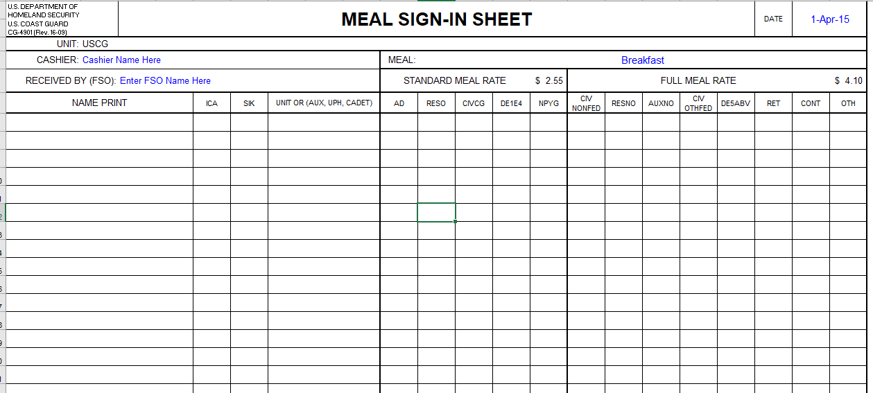
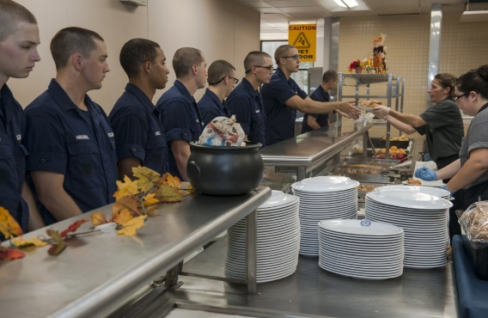
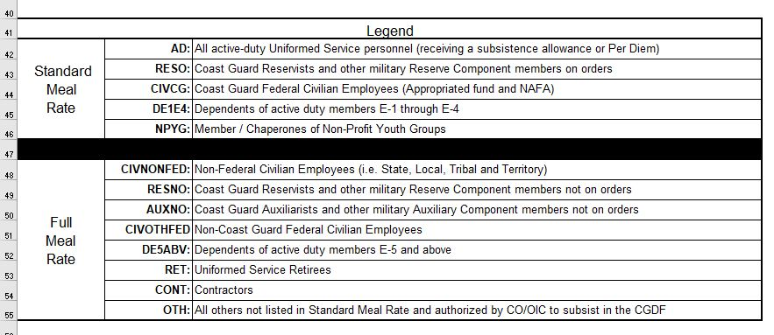
CG-4901: Meal Sign-In Sheet
Galley patrons purchasing meals must sign-in using this form at the cash register.
Terry Wang
USCGC Tide
1
Standard Meal Rate Column:
Patron Examples:
Active Duty
Reservists
FULL Meal Rate Column
Patron Examples:
Non-Federal Employees
Retirees
Non-Federal Employees
This LEGEND at bottom of paper “Meal Sign-In Sheet” lists Patron Categories for Standard vs. Full Meal Rate
Notes:
The FSO prints a paper copy of the CG-4901 and provides it to patrons to fill out prior to purchasing meals at the DF.
The FSO and/or cashier guides patrons when they sign-in to ensure accurate CG-4901 completion.
At the bottom of the “Meal Sign-In – Printable” is a legend identifying the different types of patrons (e.g., civilians, reserves, etc.) and their corresponding meal rate. There are two meals rates: Standard and Full.

Slide 19
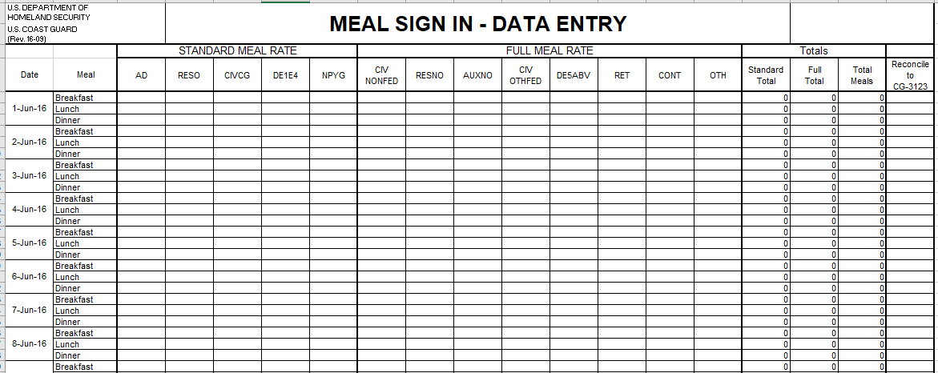
Meal Sign In – Data Entry Sheet
10
200
10
10
Y
200
200
N
This “Meal Sign In – Data Entry Sheet” is the DIGITAL (online) version of the paper Meal Sign-In Sheet that patrons used to sign-in when purchasing meals.
At the end of each day, the FSO copies the numbers from the paper Meal Sign-In Sheet CG-4901 onto this digital (online) “Meal Sign In – DATA ENTRY SHEET”. The numbers on this digital form must match the numbers on the paper Meal Sign-In Sheet Form CG-4901.
Notes:
This Meal Sign In – Data Entry form should be considered the “electronic” extension of the CG-4901.
After meals have been served for the day, the FSO refers to the paper copy CG-4901 (containing patron sign-in data and meal rates) and manually enters that data into the online Meal Sign In DATA ENTRY form.
The totals entered into the Meal Sign In - Data Entry form will be reconciled on the CG- 3123 (the Ration Memorandum documenting all patron types and meal rates paid.)
The data entered into the Meal Sign In – Data Entry form will be cross-referenced against the data you entered into the CG-3123. These forms should show the same number of meals issued or sold. In this way, you could view the Meal Sign In – Data Entry Form as part of the CG-3123.

Slide 20
Knowledge Check: Lesson 1
Instructions: Click on the Best Answer
1. What is the purpose of the PVAISW?
A. PVAISW provides forms to evaluate galley staff.
B. PVAISW provides CO with forms to oversee all unit operations on a daily and monthly basis.
C. PVAISW forms enable FSO to manage and track Dining Facility Operations.
What types of forms might you find in the PVAISW?
A. Cash Log, CG-2576, CG-3123, CG-4901, and Stock Cards
B. CG-2576, CG-4901, CG-3123, Cash Log, CG-2581
C. Procurement Request 1501, Stock Cards, CG-2576, Cash Log.
Notes:
Here is one last quiz to assess your knowledge of the forms in the PVAISW.

Slide 21

Incorrect.
Please try again.
Try again…

Slide 22
That’s right!
Yes, the PVAISW provides the FSO with forms needed to manage and track Dining Facility Operations.
Return to complete the Knowledge Check
Notes:
An FSO uses the CG-3123 daily to document the category and meal rate of people who ate at your dining facility that day (e.g., civilians, contractors, reserves, etc.) and the compensation the CGDF received.
The CG-3123 calculates monthly allowances that justify or support issues from inventory.
In summary, the CG-3123:
Tracks information about people who eat at your dining facility each day.
Summarizes this information at the end of the month for reporting purposes.
When you purchase food for your CGDF inventory, the food is not charged against your monthly allowance until the food is issued for patrons’ meals. The Executive Officer (XO) signs the CG-3123.
Reminder: BDFA is the monetary allowance that provides one person breakfast, lunch, and dinner in one day.
Form CG-3123 uses BDFA to calculate daily and monthly allowances.

Slide 23
Wrap up Lesson 1!
Yes, that’s right!
The PVAISW has many forms that enable an FSO to efficiently manage their CGDFO.
You received a brief overview of these forms in this lesson.
In future FSO-PVA lessons, you will learn how to use these forms.

Slide 24
Next Steps: Lesson 2!
Summary
You have completed Lesson 1. “Introduction to PVAISW.”
Please email any questions to your instructor.
(User Guide has instructor emails)
This lesson’s 3-part interactive lecture series helped you develop these objectives:
Identify BDFA value per your unit class (Ashore/Afloat)
Describe the PVAISW.
Identify the PVAISW’s forms.
Recognize the purpose of each PVAISW form.
Notes:
This concludes Lesson 1, Introduction to PVAISW.
Congratulations for completing this lesson.
You are now ready to complete Lesson 2. PVAISW Set Up, which will show you how to set up a PVAISW at the beginning of a new month.

Slide 25
Congratulations!
You have completed Lesson 1. Intro to PVAISW!
Instructions:
Refer to your User Guide for instructions on how to complete your next Unit 2 lesson, which will be Lesson 2. “Set Up PVAISW for a New Month”.

