Slide 1


Unit 2. PVA Workbooks
Lesson 1. Part 2
Intro to Purchase vs. Allowance Inventory Systems Workbook (PVAISW)
Note: Audio should start automatically within 15 seconds.
If volume is too low, close session, increase volume setting on your computer or Bluetooth stereo, and reopen session to start again.
Notes:
HELLO AND WELCOME TO UNIT 2, PVA WORKBOOKS.
My name is Senior Chief Anthony Ciurlino with the Food Service Assistance and Training Team here at Training Center Petaluma. I WILL BE YOUR INSTRUCTOR FOR THIS LESSON.
THIS FIRST LESSON IN UNIT 2 IS “INTRODUCTION TO THE PURCHASE VERSE ALLOWANCE INVENTORY SYSTEMS WORKBOOK. LESSON 1 PROVIDES KNOWLEDGE AND A FOUNDATIONAL UNDERSTANDING OF THE PVA WORKBOOK. The goal of this lesson is to ensure every FSO attending this course has foundational knowledge critical to success in later, more complex lessons.

Slide 2
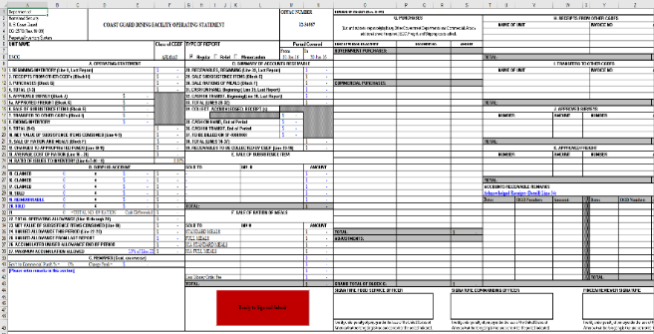
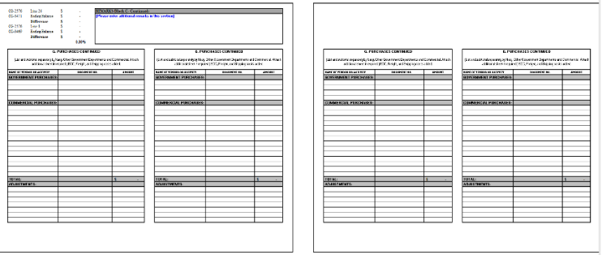
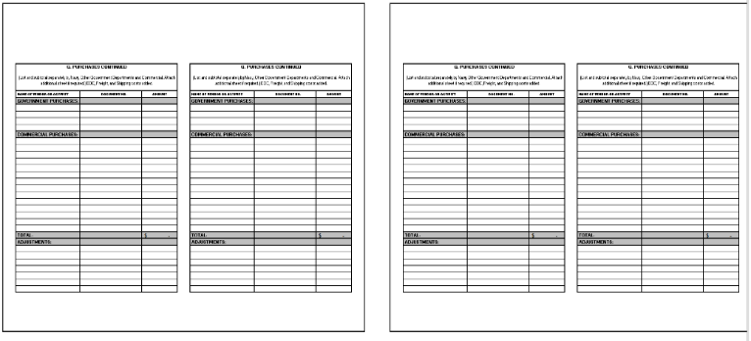
Part 2. Lecture for Lesson 1
Form CG-2576 “Coast Guard Dining Facility Operating Statement” (CGDFOS)
CG-2576 summarizes the financial condition of your CG Dining Facility
Notes:
Refer to your PVAISW Packet for form CG-2576.
This is the FIRST PVAISW FORM WE WILL DISCUSS.
The CG-2576 is the COAST GUARD DINING FACILITY OPERATING STATEMENT, OR THE CGDFOS.
The CG-2576 summarizes the financial condition of a CGDF.
THE CG-2576 CONSISTS OF SEVERAL BLOCKS.
THE NEXT FEW SLIDES WILL FOCUS ON EACH BLOCK AND PROVIDE A BRIEF EXPLANATION OF THE BLOCK’S PURPOSE.

Slide 3
Lesson 1 Lecture, Part 2. Form CG-2576
TOPICS
This table lists the Blocks in
Form CG-2576.
Click on any bar (at right) to learn about its blocks.
Recommended:
Refer to your paper CG-2576 to locate each block as you learn about the block’s purpose.
Learn about:
Block A “Operating Statement”
Block B, “Surplus Accounts”
Block C, “Remarks”
Learn about:
Block D “Summary of Accounts Receivable”
Block E, “Sale of Subsistence Items”
Block F, “Sale of Ration Meals”
Learn about:
Block G “Purchases”
Block H, “Receipts from Other CGDFs”
Block I, “Transfers to Other CGDFs”
Learn about:
Block J “Approved Surveys”
Block K, “Approved Freight”
Block, “Accounts Received Remarks”
Block, “Signatures”
Block, “Testing Procedures”

Slide 4
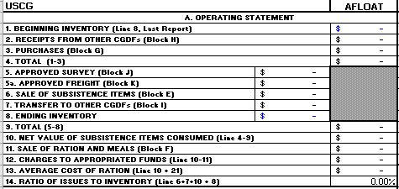
Form CG-2576: CGDFOS
Block A. Operating Statement (Column A, Row 9)
Notes:
Block A’s Purpose:
Block A shows, in dollar values, the food inventory coming in and going out of your dining facility.

Slide 5
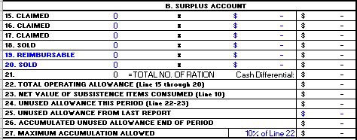
Form CG-2576: CGDFOS, Continued
Block B. Surplus Account (Column A, Row 25)
Notes:
Block B’s Purpose:
Block B documents the amount of money (allowances) the Coast Guard gives your Dining Facility for the month based on meals claimed and meals sold.

Slide 6
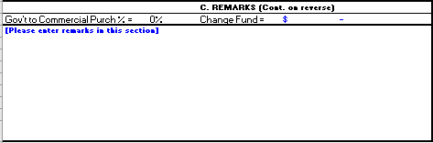
Form CG-2576: CGDFOS , Continued
Block C. REMARKS (Column A, Row 39)
Examples of Remarks (FSO comments about the CG-2576 data) include:
Block B “Surplus Account” Information
Cash on Hand, Cash in Transit
Receivables to be Collected
Whether this coincided with an FSO Relief or Annual Audit
Helpful explanations for the FINCEN examiner reviewing this CG-2576 form.
Notes:
Block C’s Purpose:
The FSO-PVA uses Block C to document any useful tracking details about CGDF operations for that month. Examples of remarks could include an FSO relief, audit, etc.
FSO remarks in Block C help the FINCEN Examiner who reviews the CG-2576.
TO INCLUDE LINES 15-20 OF BLOCK B, NUMBERS LISTED IN BLOCK D,

Slide 7
Knowledge Check: CG-2576 Blocks A, B, and C
Instructions: Click on the answer you believe is correct.
Block A “Operating Statement” records….
A. FSO comments about a pending FSO relief.
B. Only cash on hand.
C. Your beginning Inventory and your ending Inventory for the month.
2. Block B “Surplus Accounts” lets an FSO know the….
A. …date and time of this year’s annual audit.
B. …food items your galley sold to an authorized purchaser.
C. …amount of an unused allowance you might have for this month.
3. Block C “Remarks” provides a place where an FSO…
A. …might include comments useful to the FINCEN examiner reviewing your CG-2576.
B. …calculates the BDFA rate for active duty.
C. …lists all subsistence in kind (SIK) rations.

Slide 8

That is incorrect.
Please try again.
Try again…

Slide 9
That’s right!
Block A is the “Operating Statement” section of your CG-2576. Block A shows your BEGINNING inventory and your ENDING inventory.
Return to complete the Knowledge Check

Slide 10
Yes, that’s right!
Block B “Surplus Accounts” in the CG-2576 documents the amount of money (allowances) the Coast Guard gives your Dining Facility for the month based on meals claimed and meals sold. Block B tells you the amount of any unused allowance or an excess deficit for the month.
Return to complete the Knowledge Check

Slide 11
Yes, that’s right!
In the Block C “Remarks” section of the CG-2576, an FSO may add any details explaining unique elements of that month’s CG-2576.
Finish this Topic

Slide 12
Congratulations!
Return to Home Page
You have finished learning about Blocks A, B, and C in the CG-2576
Next Topics:
Block D “Summary of Accounts Receivable”
Block E “Sale of Subsistence Items”
Block F “Sale of Ration Meals”
Begin next topics

Slide 13
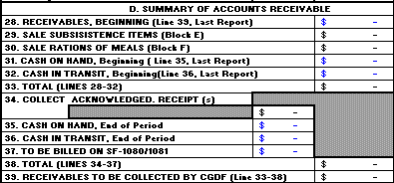
Form CG-2576: CGDFOS , Continued
Block D. Summary of Accounts Receivable
(Column G, Row 9)
Notes:
Block D’s Purpose:
Block D tracks monetary transactions - all the funds (cash, check, money orders, pay.gov payments) flowing in and out of your Unit’s Dining Facility.

Slide 14
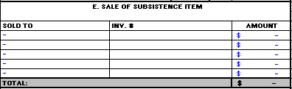
Form CG-2576: CGDFOS , Continued
Block E. Sale of Subsistence Item
(Column G, Row 23)
Notes:
Block E’s Purpose:
Block E shows the dollar value of authorized food items you sell that are not to be used in a meal. Examples include coffee mess, Morale events.
THIS IS WHERE THE FSO WOULD RECORD SELLING INVENTORY ITEMS TO AN AUTHORIZED PURCHASER.

Slide 15
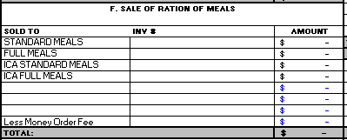
Form CG-2576: CGDFOS , Continued
Block F. Sale of Ration Meals (Column G, Row 32)
Standard Meal Rates paid by Active Duty, etc.
Full Meal Rates paid by non-federal employees, etc.
Paid cash or immediate payment sale
ICA = Charged to a credit account and billed at month’s end
ICA = Individual Credit Account
Notes:
Block F’s Purpose:
Block F contains information about your sale of meals, including money order fees, standard and full rates, and reimbursable rations.
Block F data is populated from or supported by other forms and worksheets.

Slide 16
Knowledge Check: CG-2576 Blocks D, E, and F
Instructions: Click on the answer you believe is correct.
Block D “Summary of Accounts Receivable”:
A. Tracks only individual credit accounts at your Dining Facility (DF).
B. Tracks monetary transactions; all money flowing in and out of your unit’s DF.
Block E “Sale of Subsistence Items” notes items sold to an
authorized purchaser that were not part of a meal, for example:
A. Breakfast, lunch, or dinner, plus snacks in-between formal meals.
B. Food items used for Coffee Mess, Change of Watch, morale events, etc.
3. Block F “Sale of Ration Meals” features information about your sale
of meals, such as:
A. Remarks helpful to the FINCEN examiner auditing your CG-2576.
B. Standard and full rates, money order fees, and reimbursable rations.
Notes:
Block F contains information about your sale of meals, including money order fees, standard and full rates, and reimbursable rations.
Block F data is populated from or supported by other forms and worksheets.

Slide 17
That answer is not correct. Please try again.
Try again…

Slide 18
That’s right!
Block D is “Summary of Accounts Receivables”, and it tracks monetary transactions - all the funds (cash, check, money orders, pay.gov payments) flowing in and out of your Unit’s Dining Facility.
Return to complete the Knowledge Check

Slide 19

Yes, that’s right!
Block E shows the dollar value of food items you sell to an authorized purchaser who does not use these food items for a meal. Examples of use include coffee mess, Morale events, Change of Watch, etc.
Return to complete the Knowledge Check

Slide 20
Yes, that’s right!
Block F “Sale of Ration Meals” features information about your sale of meals, such as standard and full rates, money order fees, and reimbursable rations.
Finish this topic.

Slide 21
Congratulations!
Return to Home Page
You have finished learning about Blocks D, E, and F in the CG-2576
Next Topics:
Block G “Purchases”
Block H “Receipts from Other CGDFs”
Block I “Transfers to Other CGDFs”
Begin next topic

Slide 22
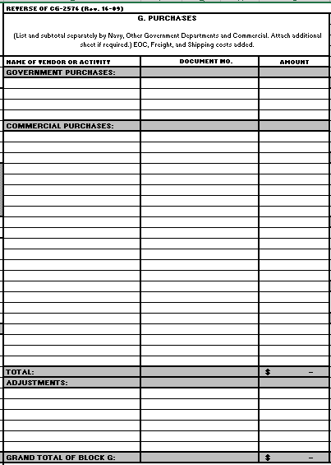
Form CG-2576: CGDFOS , Continued
Block G. Purchases (Column O, Row 2)
A list of all Government Purchases
Purchased from DLA = Defense Logistics Agency
A list of all Commercial Purchases
Commercial Purchases made with a Purchase Card.
Notes:
Block G’s Purpose:
Block G contains a list of all food purchased locally (commercially) and from government sources.
This includes vendor names and the dollar values of these purchases.
Block G is one of more important blocks on your Form CG-2576 and has to be actively managed. If you run out of space in Block G, you will find a continuation of Block G on page 3 of your CG-2576.
Remember that blue font means you will be entering data into that field. In future lessons you will learn about what data you will be entering in Block D of your CG-2576.

Slide 23

Form CG-2576: CGDFOS , Continued
Block H. Receipts from Other CGDFs
(Column T, Row 2)
Notes:
Block H’s Purpose:
Block H contains a record of stores (food items) received from other CGDFs that have transferred stores (food items) to your CGDF.
The CGDF transferring stores to your unit will give you a CG-2581, and you will pull data from the other CGDF’s CG-2581 to enter into your CG-2576 Block H. (Later in this course, we will revisit this process.)

Slide 24

Form CG-2576: CGDFOS , Continued
Block I. Transfers to Other CGDFs
(Column T, Row 9)
Notes:
Block I’s Purpose:
Block I contains records of food items you have transferred to other CGDF units.

Slide 25
Knowledge Check: CG-2576 Blocks G, H, I
Instructions: Click on the answer you believe is correct.
1. Block G “Purchases” provides a list of:
A. Only government purchases made with a purchase card.
B. Both government purchases and commercial purchases.
2. Block H “Receipts from Other CGDFs” tracks:
A. Food items that other dining facilities have transferred to your dining facility.
B. Receipts documenting food items you sold to other units.
3. Block I “Transfers to Other CGDFs” tracks:
A. Food items you bought from authorized purchasers.
B. Food items you have transferred to other CGDFs.
Notes:
Block H contains a record of stores (food items) received from other CGDFs that have transferred stores (food items) to your CGDF.
The CGDF transferring stores to your unit will give you a CG-2581, and you will pull data from the other CGDF’s CG-2581 to enter into your CG-2576 Block H. (Later in this course, we will revisit this process.)

Slide 26

That answer is not correct. Please try again.
Try again…

Slide 27
Yes, that’s right!
Block G “Purchases” section records Government purchases bought through DLA and also provides a section for Commercial purchases.
Return to complete the Knowledge Check

Slide 28
Yes, that’s right!
Block H “Receipts from Other CGDFs” tracks food items that other dining facilities have transferred to your dining facility.
Return to complete the Knowledge Check

Slide 29
Yes, that’s right!
Block I “Transfers to Other CGDFs” tracks food items you have transferred to other CGDFs.
Note that when transferring stores (food items) to another CGDF, no money is exchanged. You are transferring these food items, not selling them.
Go to next topic, “CG-2576 Blocks K, K, L”

Slide 30
Congratulations!
You have finished learning about
Blocks G, H, and I in the CG-2576.
Final CG-2576 Topics:
Block J “Purchases”
Block K “Receipts from Other CGDFs”
“Accounts Receivables Remarks”
“Signatures”
“Testing Procedures”
Go to next topics

Slide 31


Form CG-2576: CGDFOS , Continued
Block J. Approved Surveys (Column T, Row 16)
A “survey” is a claim for losses (like an insurance claim).
Example: Fridge broke and food spoiled
Notes:
Block J’s Purpose:
A survey is a claim for losses, like an insurance claim. If FINCEN approves a survey for reimbursement, you document it here in Block J.
Examples of survey reimbursement include lost food due to broken refrigerator or other lost food due to circumstances beyond your control.

Slide 32

Form CG-2576: CGDFOS , Continued
Block K. Approved Freight (Column T, Row 22)
Notes:
Block K’s Purpose:
Block K contains a record of any approved monetary compensation for freight that you received.
This Block is especially important for FSO’s stationed or operating in D17 (Alaska).

Slide 33
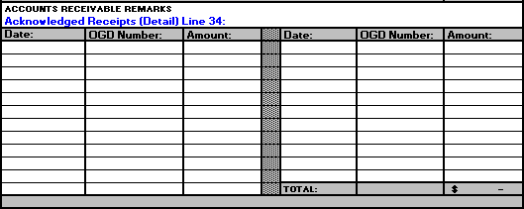
Form CG-2576: CGDFOS , Continued
Accounts Receivable Remarks (Column T, Row 28)
Notes:
Purpose of Accounts Receivable Remarks:
In Block K, document OGD receipts received from FINCEN.
FINCEN generates OGD receipts based on your records of:
money you transmitted (mailed out) to lockbox for FINCEN,
receipts from pay.gov transactions (automatically sent to FINCEN as well), and
funds you transmitted to a bank (not via mail, but via OTC NET), which also automatically sends a record to FINCEN.

Slide 34

Form CG-2576: CGDFOS , Continued
Signatures (Column O, Row 44)
CO/OIC returns to FSO (after signing)
1. FSO Digital Signature
2. CO/OIC Digital Signature
3. FINCEN Reviewer’s Digital Signature following audit review….
FSO
CO/OIC
FINCEN
After FSO secures CO/OIC Digital Signature,
FSO sends to FINCEN for audit review and FINCEN signature
FINCEN returns audited CG-2576 to FSO
Notes:
“Signatures” Purpose:
Record signatures from:
FSO
Commanding Officer
FINCEN Examiner who reviews your CG-2576.

Slide 35
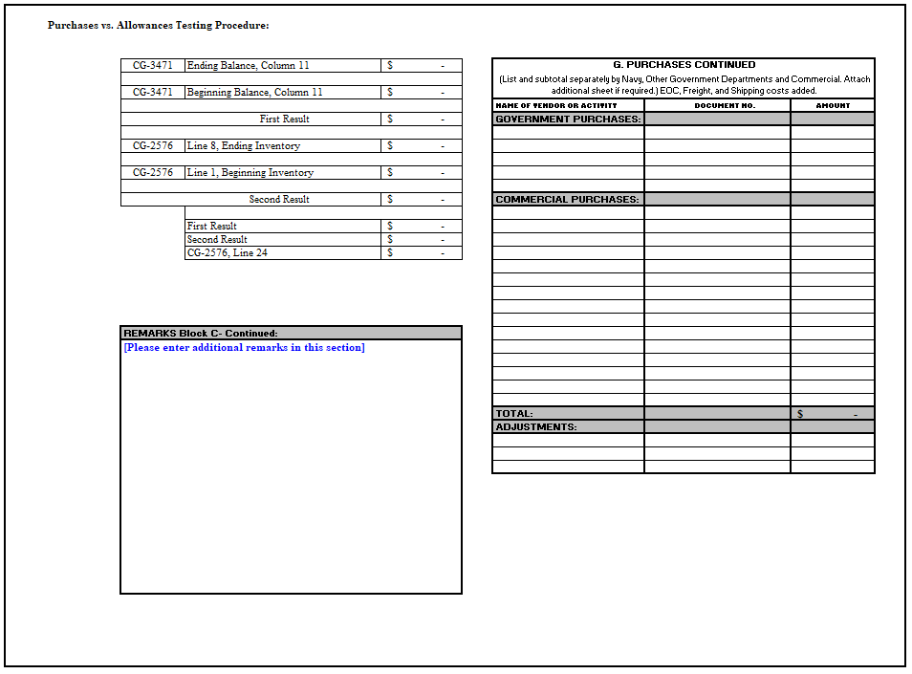
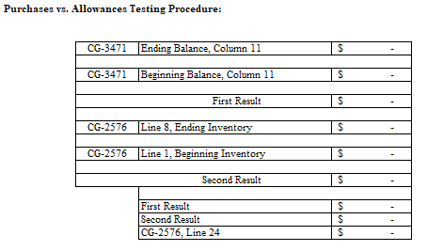
Form CG-2576: CGDFOS , Continued
Testing Procedures (Column AD, Row 2)
Notes:
“Testing Procedures” Purpose:
The “Testing Procedures” block is not labeled. It contains data auto-populated from other forms to assure your CGDF report’s accuracy.

Slide 36
Knowledge Check: CG-2576 Blocks J, K, Signature
Instructions: Click on the answer you believe is correct.
Block J “Approved Surveys” documents:
A. Losses that occurred in your CGDF that were beyond your control.
B. A list of results from a survey of unit personnel about the galley.
2. Block K “Approved Freight” contains:
A. A record of sale of ration of meals transferred from another CGDF.
B. A record of approved monetary compensation for freight you received.
3. The “Signatures” block on the CG-2576 requires:
A. Wet signature of FSO, CO/OIC, and FINCEN Reviewer.
B. Digital signature of FSO, CO/OIC, and FINCEN Reviewer.
Notes:
Block K contains a record of any approved monetary compensation for freight that you received.
This Block is especially important for FSO’s stationed or operating in D17 (Alaska).

Slide 37
That answer is not correct.
Try again…

Slide 38
That’s right!
Yes, Block J is “Record of Surveys”, and provides a section to record any losses incurred that were beyond the FSO’s control.
Return to complete the Knowledge Check

Slide 39
Yes, that’s right!
Block K “Approved Freight” contains a record of approved monetary compensation for freight you received.
Return to complete the Knowledge Check

Slide 40
Yes, that’s right!
Yes, the “Signatures” block requires a DIGITAL signature from the FSO, who then sends the CG-2576 to the CO/OIC for digital signature. Next the FSO forwards the CG-2576 to the FINCEN Reviewer.
After the FINCEN Reviewer signs the CG-2576 with their digital signature, they send the signed, verified CG-2576 back to the FSO for record-keeping.
Finish Part 2

Slide 41
Congratulations!
You have completed PART 2 of Lesson 1. “Intro to PVAISW”
Instructions:
Return to the milSuite folder for Unit 2. Lesson 1 to complete the last lecture ~ PART 3.

