Slide 1

Unit 4: Culinary Plan
Lesson 1.
Cycle Menu Development
“How to Complete a CGDF Cycle Menu”
Part 2
Notes:
HELLO AND WELCOME TO UNIT 4, Culinary Plan.
My name is Senior Chief Adam Shelton with the Food Service Assistance and Training Team here at Training Center Petaluma. I WILL BE YOUR INSTRUCTOR FOR THIS LESSON.
THIS FIRST LESSON IN UNIT 4 IS “Cycle Menu Development, How to Complete a CGDF Cycle Menu”. LESSON 1 PROVIDES KNOWLEDGE AND A FOUNDATIONAL UNDERSTANDING OF CYCLE MENUS. The goal of this lesson is to ensure every FSO attending this course has foundational knowledge critical to completing cycle menus for their dining facility.
ONCE THIS LESSON IS COMPLETE, YOU WILL PERFORM A PRACTICE IN WHICH YOU COMPLETE A CYCLE MENU FOR SUBMISSION TO YOUR CO/OIC, FOLLOWED BY AN ASSESSMENT WHERE YOU WILL ONCE AGAIN COMPLETE A DIFFERENT CYCLE MENU FOR SUBMISSION TO YOUR COMMAND FOR APPROVAL. SUCCESSFUL COMPLETION OF THE ASSESSMENT CYCLE MENU WILL RESULT IN YOU RECEIVING A “GO” FOR YOUR PERFOMANCE TEST CHEKCLIST OR PTC.

Slide 2

Choosing Foods to Serve
Take into consideration:
  Coast Guard Menu Policies
  Crew food allergies
  Crew Likes / Dislikes
Notes:
When you’re selecting different foods for your menu there are even more things to keep in mind:
The first is the Coast Guard Menu Policies – we’ll talk about those in a minute
You also have to pay attention to any food allergies that may affect your crew – along with their Likes and Dislikes

Slide 3



Menu Advisory Board Meeting
Collect Unit Specific requirements for menus.
  You learn what your crew:
Will
eat
Won’t
eat
Can’t
eat
Notes:
One way to find out about your crew’s food needs and preferences is a Menu Advisory Board. You can have these informally or schedule one with department representatives quarterly.

Slide 4
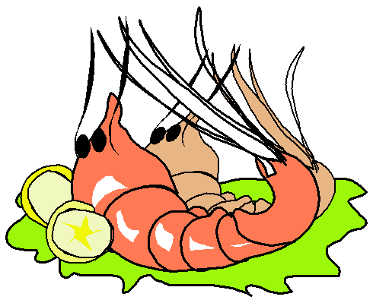
Common Food Allergies
Milk
Eggs
Fish
Crustacean shellfish
Tree nuts
Wheat
Peanuts
Soybeans
Notes:
Here is a list of common allergies that many suffer from. You may need to consider these when drafting your menus.

Slide 5
Coast Guard Menu Policies
CG Protein policy
CG Food groups policy
  Healthy eating considerations
Artistic considerations
Notes:
READ SLIDE: Artistic Considerations; be descriptive in your menu items…..maybe the method of preparation, roasted or grilled asparagus….or the region from where the dish originates, such as Tuscan chicken. These small tips can make your menu more appealing to your crew.

Slide 6
Coast Guard Protein Policy
Entrée Type | Limitations | Cell Color
Beef (lamb and game) | Maximum of 4 times per week Try to serve steak at least three times per month | red
Pork | Maximum of 2 times per week | pink
Poultry | At least 4 times per week | yellow
Seafood | At least 2 times per week (ensure one is a fish fillet) | green
Serve deep fried foods a maximum of 3 times per week.
Notes:
Ensure you adhere to the CG Protein Policy when drafting your menus.

Slide 7
Lunch and Dinner Food Groups
Soup
Main entrée
Carbohydrate (potato, pasta, or rice)
Vegetable
Salad (tossed or mixed)
Bread
Dessert
Beverage
Soup and dessert are not always required
Notes:
Here is a list of lunch and dinner food groups. Keep in mind that soup and dessert are not always served. Also, salad and bread may be optional depending on your crews preference.

Slide 8
Mission Type and Calories
Strenuous mission = more calories
  Tending buoys in Tennessee burns more calories than sitting at a desk in Petaluma
Notes:
Keep in mind the mission of your unit. If you’re going to be underway performing ATON or boardings, you may want to increase your menus calories to account for the strenuous work of the mission. Do this in moderation and always refer to choosemyplate.gov and the USDA guidelines for assistance.

Slide 9

Selecting Healthy Foods
Rely on:
  Fruits and Vegetables
  Lean meats
  Whole grains when possible
  Low-fat or fat-free milk products
Limit added sugar and sodium
Offer no artificial trans fats
Notes:
When selecting healthy foods for your menus, READ SLIDE:

Slide 10

Breakfast Food Requirements
Eggs
  Eggs to order every breakfast
  Include omelets (either as an egg-to-order or as an entrée at least twice per week)
Meat (can be pork more than 2 times per week)
Starch (usu. Potatoes – e.g., hash browns or home fries)\
Plus:
Assorted Hot and/or Dry Cereal
Assorted breads
Fresh Fruit
Coffee, Tea, Juice, Milk
Notes:
Breakfast typically consist of the following items: Eggs, Meat, Starch plus the additional items listed on the slide. The pork protein plan does not apply to breakfast as most breakfast meats are pork base. While these are breakfast staples, you can always mix things up by adding breakfast burritos, biscuits and gravy or fruit smoothies to name a few.

Slide 11

Menu Artistry Considerations
Three different colors on plate
Three different food textures
Best quality food available
Mix savory and sweet
Avoid repeating entrée items
Be creative!
Be both informative and descriptive with the names of your dishes.
Notes:
Menu Artistry Considerations; READ SLIDE……

Slide 12
Continued in Part 3
Please close this PowerPoint
Open Part 3 of the Cycle Menu Lesson

