Slide 1

Unit 4: Culinary Plan
Lesson 1.
Cycle Menu Development
“How to Complete a CGDF Cycle Menu”
Part 3
Notes:
HELLO AND WELCOME TO UNIT 4, Culinary Plan.
My name is Senior Chief Adam Shelton with the Food Service Assistance and Training Team here at Training Center Petaluma. I WILL BE YOUR INSTRUCTOR FOR THIS LESSON.
THIS FIRST LESSON IN UNIT 4 IS “Cycle Menu Development, How to Complete a CGDF Cycle Menu”. LESSON 1 PROVIDES KNOWLEDGE AND A FOUNDATIONAL UNDERSTANDING OF CYCLE MENUS. The goal of this lesson is to ensure every FSO attending this course has foundational knowledge critical to completing cycle menus for their dining facility.
ONCE THIS LESSON IS COMPLETE, YOU WILL PERFORM A PRACTICE IN WHICH YOU COMPLETE A CYCLE MENU FOR SUBMISSION TO YOUR CO/OIC, FOLLOWED BY AN ASSESSMENT WHERE YOU WILL ONCE AGAIN COMPLETE A DIFFERENT CYCLE MENU FOR SUBMISSION TO YOUR COMMAND FOR APPROVAL. SUCCESSFUL COMPLETION OF THE ASSESSMENT CYCLE MENU WILL RESULT IN YOU RECEIVING A “GO” FOR YOUR PERFOMANCE TEST CHEKCLIST OR PTC.

Slide 2
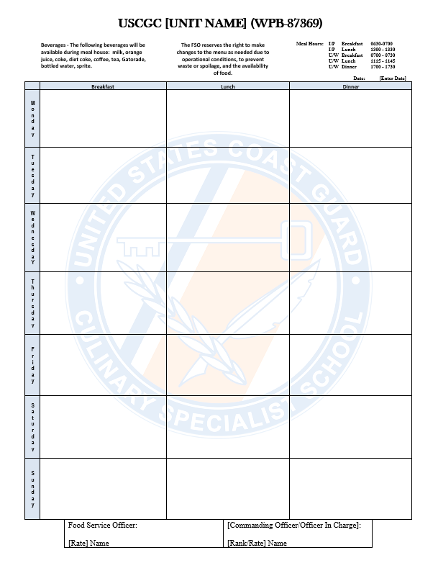

Documenting your Cycle Menu
Required:
  Unit Name
  Dates
  Meals
  Signatures
Notes:
Unit name must appear at the Top
Dates must be clear IE: 01May20-07May1420 or week of May 1 2020
Drafter name is whoever drafted the menu IE: CS2 Smith
Approval Names FSO and CO names must be at the bottom as well as signatures
Verification of the following week’s menu must be approved by CO/OIC by Wed of the week prior
Post in the CGDF entrance and the Galley
Can add a column for drinks

Slide 3
Finalizing A Menu
FSO Signs Menu
FSO routes to CO/OIC for approval
CO/OIC Signs Menu
  If not approved: revise, sign, resubmit
  Resubmit if approved items are replaced
File
  Monthly folder: right side
Post
  CGDF Entrance; other appropriate places
Notes:
Finalizing the menu; here lists the overall process of finalizing your menu. Once drafted and signed, you will submit to your CO/OIC for approval, file and post accordingly.

Slide 4
Summary and Review
Good Food Choices
Coast Guard Policies
Practical Considerations
Finalizing your cycle menu
Notes:
In this lesson we discussed components that:
make up a good menu,
the Coast Guard policies that affect food choices,
the practical considerations you’ll need to keep in mind when creating your menu.
As well as the steps you need to take to get your menu approved and posted.

Slide 5
Questions?
If you need clarification on this lesson, direct your questions to your instructor, CSCS Adam Shelton at TRACEN Petaluma.
  Email: Adam.C.Shelton @uscg.mil
Notes:
please direct any questions you may have to your instructors for further clarification.

