Slide 1


Unit 4: Culinary Plan
Lesson 2. Open Galley Menu
Notes:
HELLO AND WELCOME TO UNIT 4, Culinary Plan.
My name is Senior Chief Adam Shelton with the Food Service Assistance and Training Team here at Training Center Petaluma. I WILL BE YOUR INSTRUCTOR FOR THIS LESSON.
THE SECOND LESSON IN UNIT 4 IS “Open Galley Menu”. LESSON 2 PROVIDES KNOWLEDGE AND A FOUNDATIONAL UNDERSTANDING OF OPEN GALLEY MENUS. The goal of this lesson is to ensure every FSO attending this course has foundational knowledge critical to completing an open galley menu for their dining facility.
ONCE THIS LESSON IS COMPLETE, YOU WILL PERFORM A PRACTICE IN WHICH YOU COMPLETE AN OPEN GALLEY MENU FOR SUBMISSION TO YOUR CO/OIC, FOLLOWED BY AN ASSESSMENT WHERE YOU WILL ONCE AGAIN COMPLETE A DIFFERENT OPEN GALLEY MENU FOR SUBMISSION TO YOUR COMMAND FOR APPROVAL. SUCCESSFUL COMPLETION OF THE ASSESSMENT OPEN GALLEY MENU WILL RESULT IN YOU RECEIVING A “GO” FOR YOUR PERFOMANCE TEST CHEKCLIST OR PTC.

Slide 2
Objectives
Given an inventory of subsistence items on hand, access to recipes, a computer with access to the CS Portal, milSuite and DCS, all appropriate references and a menu template, COMPLETE an Open Galley menu IAW the Food Service Manual and the Coast Guard Food Service Practical Handbook COMDTPUB P4061.4 (series) with 100% accuracy.
Notes:
AFTER completing this lesson, you should be able to complete the following…. (read objective on slide

Slide 3
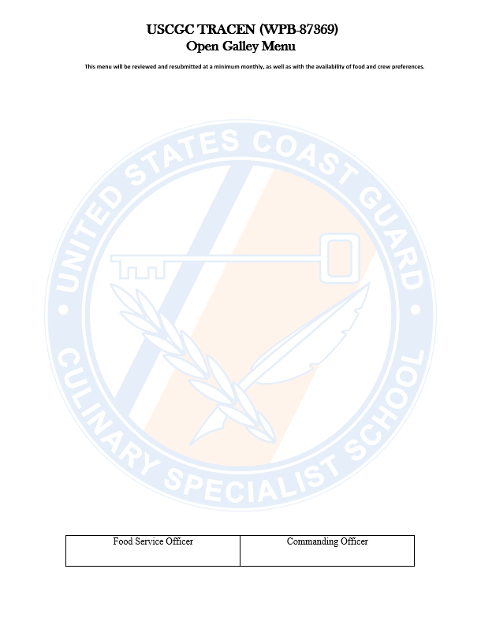
Open Galley Menu
  What is it?
    List of menu items available to the crew when the FSO is not present
      Should not be pre-prepared items such as “take-out” or “to-go” foods
      Can be anything from chicken breast to frozen pizza
      Be sure to budget for open galley menu items
Notes:
OPEN GALEY MNEU……Detailed list of available items for crew members to prepare their own meals in the FSOs absence.
While the cycle menu guideline of protein plan or food groups don’t necessarily apply…..FSOs shall do everything in their power to ensure members are provided nutritious, delicious menu items
Items should not be pre-prepared such as “take-out” or “to-go” items…..however, anything from chicken breast to frozen pizza is fair game
The list is all encompassing so you can have things on the list that you don’t have in stock, but having said that you should keep it as up to date as possible
Open galley menu runs almost, if not everyday for FSO-PVA....especially if you’re the only CS. You’re not cooking every meal every day, hence the need for open galley.
Lastly, if you utilize an open galley menu, be sure to make that part of your overall budgeting for menus.

Slide 4
Open Galley Menu cont.
  Provide details
    Burritos?
    “Baja Café Egg & Cheese Burritos!”
    Assorted Pizzas or Supreme/Pepperoni & Chicken Pizzas?
    “Tony’s Supreme Pizza, Tombstone Pepperoni Pizza & CPKs Thai Chicken Pizza!”
Notes:
ALSO, when you’re writing your open galley menu, be informative and descriptive with the names of your dishes. Don’t just write “burritos” – make it “Baja Café Egg & Cheese Burritos” – which sounds much more flavorful that a “burrito.” Also, IAW with CG policy, you can’t list assorted items or generic named items on your open galley menu. You must list the brand name and specify the exact product to differentiate between similar products….FOR EXAMPLE: Assorted Pizzas or Supreme/Pepperoni & Chicken Pizzas should read, Tony’s Supreme Pizza, Tombstone Pepperoni Pizza and CPKs Thai Chicken Pizza.

Slide 5
Open Galley Menu cont.
  Separate menu; Same approval process
  Must be Signed by FSO & CO/OIC
  Filed in monthly folder: right side
  Posted in at least the CGDF entrance
  Update as needed
  Resubmit for approval when items are replaced
Notes:
The open galley menu is not included in your cycle menus. Therefore it must be drafted separately and budgeted separately.
Open galley menus must be written, approved, filed and posted separately as well.
As you change items on your open galley menu or as crew members themselves or their preferences change; be sure to update the open galley menu, resubmit for approval, refile and repost.

Slide 6
Finalizing A Menu
FSO Signs Menu
FSO routes to CO/OIC for approval
CO/OIC Signs Menu
  If not approved: revise, sign, resubmit
  Resubmit if approved items are replaced
File
  Monthly folder: right side
Post
  CGDF Entrance; other appropriate places
Notes:
Finalizing a menu; here lists the overall process of finalizing your menu. Once drafted and signed, you will submit to your CO/OIC for approval, file and post accordingly.

Slide 7
Summary and Review
Open Galley menu components
No pre-prepared foods
Practical Considerations
Finalizing your cycle menu
Notes:
In this lesson we discussed components that:
make up an open galley menu,
the Coast Guard policies that affect food choices, like no pre-prepared foods
the practical considerations you’ll need to keep in mind when creating your open galley menu., like ensuring you include your open galley menu in your overall menu budgeting
As well as the steps you need to take to get your menu approved and posted.

Slide 8
Questions?
If you need clarification on this lesson, direct your questions to your instructor, CSCS Adam Shelton at TRACEN Petaluma.
  Phone: 707-765-7427
  Email: Adam.C.Shelton @uscg.mil
Notes:
Please direct any questions you may have to your instructors for further clarification.

