Slide 1


Unit 4: Culinary Plan
Lesson 3: Load Guides
Part 1
Notes:
HELLO AND WELCOME TO UNIT 4, Culinary Plan.
My name is Senior Chief Adam Shelton with the Food Service Assistance and Training Team here at Training Center Petaluma. I WILL BE YOUR INSTRUCTOR FOR THIS LESSON.
THE THIRD LESSON IN UNIT 4 IS “Load Guides”. LESSON 3 PROVIDES KNOWLEDGE AND A FOUNDATIONAL UNDERSTANDING OF LOADD GUIDES. The goal of this lesson is to ensure every FSO attending this course has foundational knowledge critical to completing a load guide for their dining facility.
ONCE THIS LESSON IS COMPLETE, YOU WILL PERFORM A PRACTICE IN WHICH YOU COMPLETE A LOAD GUIDE FOR SUBMISSION TO YOUR INSTRUCTOR, FOLLOWED BY AN ASSESSMENT WHERE YOU WILL ONCE AGAIN COMPLETE A DIFFERENT LOAD GUIDE FOR SUBMISSION TO YOUR INSTRUCTOR FOR APPROVAL. SUCCESSFUL COMPLETION OF THE ASSESSMENT LOAD GUIDE WILL RESULT IN YOU RECEIVING A “GO” FOR YOUR PERFOMANCE TEST CHEKCLIST OR PTC.

Slide 2
Objectives
Given a finalized menu, an inventory of subsistence items on-hand, and appropriate references, PREPARE a load guide with 100% accuracy.
Notes:
AFTER completing this lesson, you should be able to complete the following…. (read objective on slide

Slide 3

Define a Load Guide
What is a load guide?
  A list of ingredients/subsistence items and the amounts needed for an approved menu
Notes:
Define a Load Guide…..a load guide is…..

Slide 4


Reasons for Load Guides
378’ cutter with 120 members
87’ patrol boat with 12 members
Number of crew members and size of storage space determines how much
food to purchase
Notes:
REASONS FOR A LOAD GUIDE……Previously as a CS3 you’ve been cooking for a crew of 120 on a 378.
Your first assignment as an IDFSO is on an 87’ patrol boat. You are now cooking for 12, not 120. What does that do to the amount of food you need to purchase? Will you have as much storage space as on the 378?
So, as an IDFSO, a load guide helps you make that shift to cooking for fewer members. With a load guide you are more likely to avoid excessive waste and expense. You’ll also save time at the grocery store if you are organized and well prepared to shop.

Slide 5
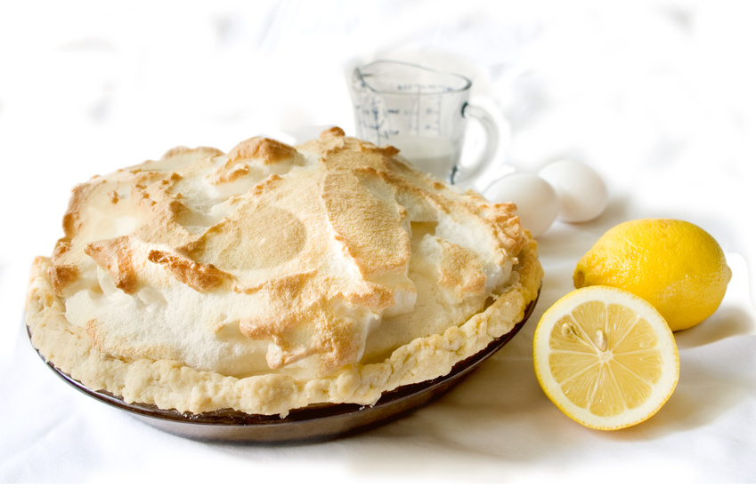
Reasons for Load Guides cont.
Ensure the purchase of ALL and ONLY the required ingredients for approved recipes
Notes:
Reasons for Load Guide cont……Your load guide also ensures the purchase of required ingredients for only the food items on your approved menu. On the smaller patrol boats you are less likely to order in bulk from vendors. Instead you need to know the exact amount of any one food item so that you will know the minimum amount that you need to purchase at the store.

Slide 6
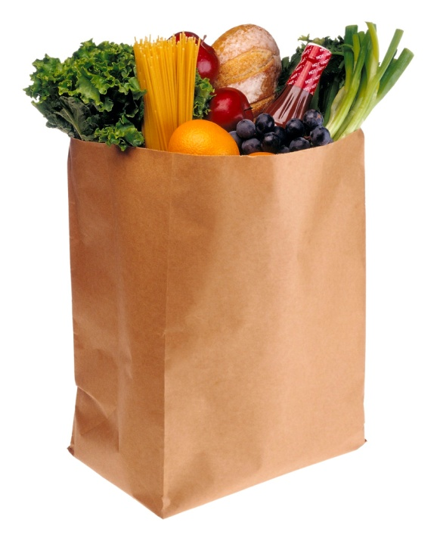
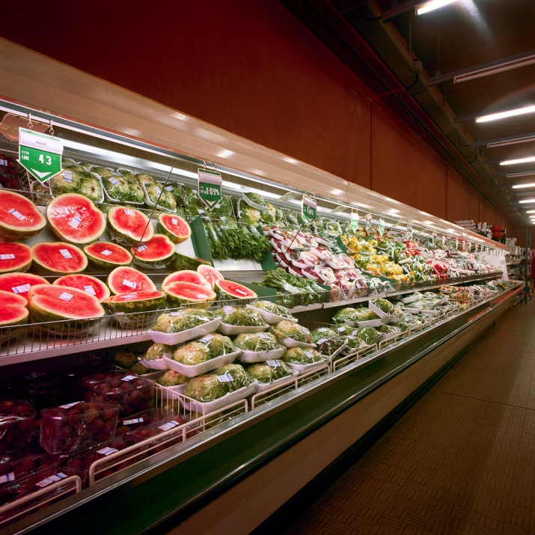
Reasons for Load Guides cont.
Plan WHAT to purchase
  Avoids return trips to store for missing items
  Avoids overspending
Plan WHERE to purchase
  Availability
  Quality
  Cost
Notes:
Reason for Load Guide cont. Planning What to purchase is the key reason for a load guide. Without it, you are more likely to miss ingredients for recipes thus resulting in return trips to the store or potentially overspending. Planning where to purchase ensure best availability, quality and cost.

Slide 7

Load Guide Formats
Chicken 5 lbs
Pork chop 15
Acorn Squash 7
Carrots 3 bch
Bottled Water 1 cs
Eggs 1 dz
Rice 3 ½ lbs
1% Milk 1 gal
Tomato Sauce 6 jars
Pizza 7
Notes:
Make a list of what you need with the exact amounts the recipe or recipes call for. Ensures that you buy enough, but does that mean you’ll buy exact amounts? Not always.
Example: Pork chops are on sale in packs of 10. How many packs would you buy? Given the list here, you would need to buy 2 packs and store the remaining 5 for another use.
Same with 3½ pounds of rice. Your grocery store carries it in 1 lb and 5 lb boxes. Which would you buy? (It’s typically Less expensive to buy the 5 lb box and you can store what’s left over.)

Slide 8
Load Guide Formats cont.
Produce
Unit
Meat
Category
Food
Acorn Squash 7
Carrots 3 bch
5 lbs
15
Chicken 5 lbs
Pork chop 15
Chicken
Pork chop
Meat
Acorn Squash
Carrots
7
3 bch
Produce
1% Milk
Eggs
1 gal
1 dz
Dairy
Dry Goods
Dairy
Tomato Sauce 6
Rice 3.5 lbs
Tomato Sauce
Rice
6 jars
3.5 lbs
1% Milk 1 gal
Eggs 1 dz
Dry
Goods
Pizzas 7
7
Frozen
Pizza
Bottled Water
5 cs
Drinks
Notes:
However, it could be more efficient to divide your list into categories, grouping what you need per store sections. If you are visually oriented you may chose to use a grid that looks something like the example on the right. Create and use what works best for you.

Slide 9
Continued in Part 2
Close this PowerPoint
Open Part 2 of U4L3 Load Guide Lesson
Notes:
Please direct any questions you may have to your instructors for further clarification.

