Slide 1


Unit 4: Culinary Plan
Lesson 3: Load Guides
Part 2
Notes:
HELLO AND WELCOME TO UNIT 4, Culinary Plan.
My name is Senior Chief Adam Shelton with the Food Service Assistance and Training Team here at Training Center Petaluma. I WILL BE YOUR INSTRUCTOR FOR THIS LESSON.
THE THIRD LESSON IN UNIT 4 IS “Load Guides”. LESSON 3 PROVIDES KNOWLEDGE AND A FOUNDATIONAL UNDERSTANDING OF LOADD GUIDES. The goal of this lesson is to ensure every FSO attending this course has foundational knowledge critical to completing a load guide for their dining facility.
ONCE THIS LESSON IS COMPLETE, YOU WILL PERFORM A PRACTICE IN WHICH YOU COMPLETE A LOAD GUIDE FOR SUBMISSION TO YOUR INSTRUCTOR, FOLLOWED BY AN ASSESSMENT WHERE YOU WILL ONCE AGAIN COMPLETE A DIFFERENT LOAD GUIDE FOR SUBMISSION TO YOUR INSTRUCTOR FOR APPROVAL. SUCCESSFUL COMPLETION OF THE ASSESSMENT LOAD GUIDE WILL RESULT IN YOU RECEIVING A “GO” FOR YOUR PERFOMANCE TEST CHEKCLIST OR PTC.

Slide 2
Continuation of Load Guides Lecture
This presentation is a continuation of
Unit 4, Lesson 3 Lecture.

Slide 3

Prepare a Load Guide
Scenario
IDFSO on CGC HAWKSBILL preparing to get underway for 3 days.
CO requests changes to the approved breakfast menus.
Planning for 15 portions, prepare a load guide for the 3 breakfasts.
Notes:
In the next 4 slides we will walk through an example of preparing a load guide for given sceanrio. READ slide………ON THE NEXT SLIDE, we will give you the amount of food you already have on hand.

Slide 4

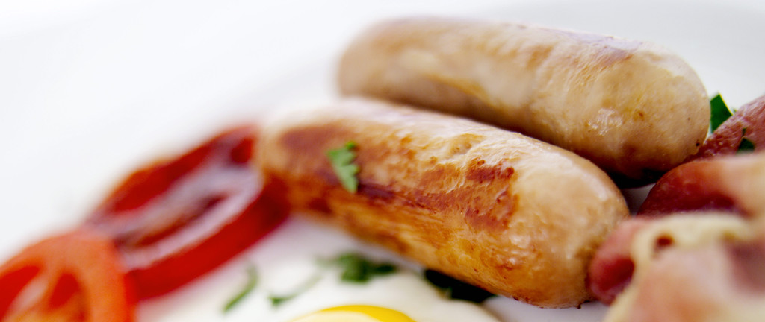
Prepare a Load Guide cont.
Food on Hand
  40 sausage links
  1 dz eggs
Notes:
On hand we already have, 40 sausage links and 1 dozen of eggs.

Slide 5
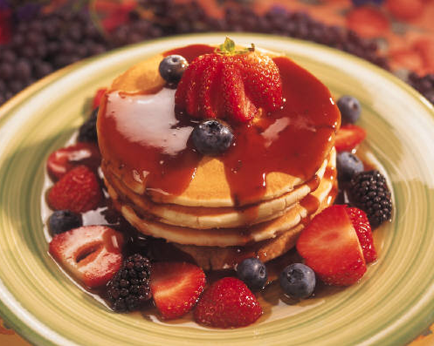
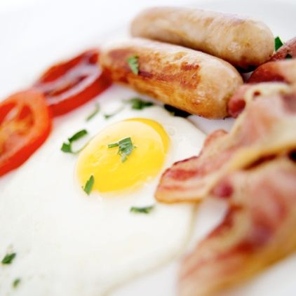
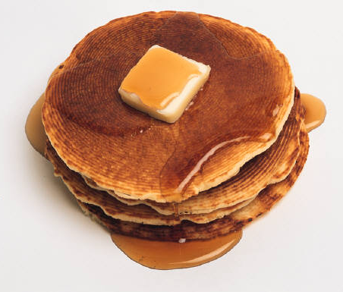
Prepare a Load Guide cont.
  Day 1
  Krusteauz Pancake mix
    15 servings per bag
  Sausage links
    2 per serving
  Hash Brown patties
    1 per serving
  Day 2
  Scrambled Eggs
    2 per serving
  Bacon
    2 strips per serving
    24 strips per lb
  Hash Brown patties
  Day 3
  Krusteauz Pancake mix
  Sausage links
    2 per serving
  Hash Brown patties
Notes:
On Day 1 we’re serving Krusteauz Pancake Mix, sausage links and hash brown patties. Take note of the serving sizes. Day 2 is scrambled eggs, bacon and hash brown patties with Day 3 being Krusteauz Pancake mix, sausage links and hash brown patties. ON THE NEXT SLIDE, using this menu and the previous food on hand, we will illustrate what your load guide for these 3 breakfasts for 15 portions will be.

Slide 6

Prepare a Load Guide cont.
Food
Unit
60 Links needed
- 40 Links on hand
= 20 Links
Category
Sausage links
20 links
30 strips
Meat
Bacon
30 Eggs needed
- 12 Eggs on hand
= 18 Eggs
Produce
Eggs
18 eggs
Dairy
Krusteauz Pancake mix
2 bags
Dry Goods
Hash Brown patties
45 patties
Frozen
Drinks
Notes:
The list on the left illustrates what we need to purchase or our load guide. The equations on the right illustrate the original need minus what we had on hand.

Slide 7
Summary and Review
Define a Load Guide
Reasons for a Load Guide
Load Guide Formats
Prepare a Load Guide
Notes:
In this Lesson we have covered:
The definition of a load guide
The reasons for a load guide
Load guide formats
How to prepare a load guide

Slide 8
Questions?
If you need clarification on this lesson, direct your questions to your instructor, CSCS Adam Shelton at TRACEN Petaluma.
  Email: Adam.C.Shelton @uscg.mil
Notes:
Please direct any questions you may have to your instructors for further clarification.

