Slide 1


Unit 5: Purchasing
Lesson 2. Process Receipts
Notes:
HELLO AND WELCOME TO UNIT 5, Purchasing.
My name is Senior Chief Adam Shelton with the Food Service Assistance and Training Team here at Training Center Petaluma. I WILL BE YOUR INSTRUCTOR FOR THIS LESSON.
THIS SECOND LESSON IN UNIT 5 IS “PROCESS RECEIPTS”. LESSON 2 PROVIDES KNOWLEDGE AND A FOUNDATIONAL UNDERSTANDING OF PROCESSING RECEIPTS. The goal of this lesson is to ensure every FSO attending this course has foundational knowledge critical to processing receipts for their dining facility.
ONCE THIS LESSON IS COMPLETE, YOU WILL PERFORM AN ACTIVITY IN WHICH YOU DEMONSTRATE YOUR KNOWLEDGE ON HOW TO PROPERLY PROCESS RECEIPTS.

Slide 2
Objective(s)
Once you have completed this lesson, you should be able to:
  Correctly record your receipts/invoices in your PVAISW
Notes:
AFTER completing this lesson, you should be able to…. (read objective on slide

Slide 3
Process Receipts Basics
All receipts/invoices must have a Third Party Signature containing the following:
  Members Name (cannot be the purchaser)
  Title
  Date
  Signature
  Unit Contact Phone Number
This Third Party Signature on each receipt/invoice satisfies the DHS requirement and negates having the Third Party Signature on the DHS-1501 form itself.
Signature must be on the actual receipt/invoice, not the paper it may be stapled to.
  Recommend the unit purchase a stamp with the 5 requirements for convenience.
Notes:
READ SLIDE

Slide 4
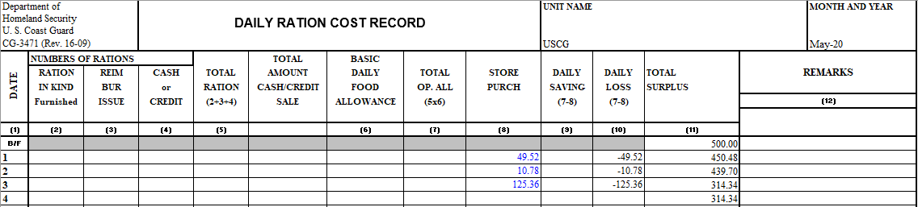
Process Receipts Basics cont.
All receipts must be listed on your monthly CG-3471, Daily Ration Cost Record, located within your PVAISW.
  Total receipt/invoice amount for each purchase is entered into column 8, Stores Purch
Notes:
READ SLIDE

Slide 5
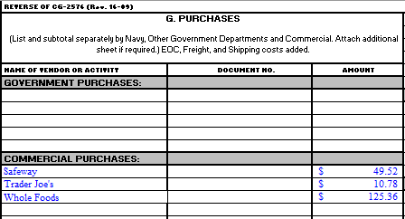
Process Receipts Basics cont.
All receipts/invoices must also be listed on your monthly CG-2576, CGDFOS, located within your PVAISW.
  Vendor name and the total receipt/invoice amount for each purchase is entered into Block G, Purchases
Notes:
READ SLIDE

Slide 6

Audit of Purchases
Supporting Documentation:
  Purchase receipt
  Menu
  PR
  DHS-1501
In the event of an audit, engage FINCEN CS liaison for guidance.
Notes:
AUDIT OF PURCHASES: If your purchase(s) are audited for any reason, provide the following to the agency performing the audit. Also, contact your FINCEN liaison for continued guidance.

Slide 7

Audit of Purchases cont.
Audit request sources:
  PCA
  FINCEN
  DHS
Notes:
The following agencies may request an audit on any or all of your monthly purchases.

Slide 8
Summary and Review
Must have a Third Party signature on each receipt/invoice with the five required items: name, title, signature, date & unit contact number
Enter the total amount of your purchase into
column 8 of the CG-3471
Enter the Vendor name and total amount into Block G of your CG-2576
Notes:
In this lesson you have learned that:
You must have a third-party signature on each receipt / invoice with the five required items: name, title, signature, date & unit contact number
You must enter the total from that receipt/invoice into column 8 of the CG-3471
You must enter the Vendor name and the total amount of the receipt/invoice into Block G of your CG-2576.

Slide 9
Questions?
If you need clarification on this lesson, direct your questions to your instructor, CSCS Adam Shelton at TRACEN Petaluma.
  Phone: 707-765-7427
  Email: Adam.C.Shelton @uscg.mil
Notes:
Please direct any questions you may have to your instructors for further clarification.

