Slide 1

Verify PCA
Demonstration
Job Aid: How to Verify Purchase Card Transactions (PC)
CLICK to move through this presentation

Slide 2
Job Aid: How to Verify Purchase Card Transactions (PC)
Step 1: Collect your receipts
Step 2: LOG IN to a CAC-enabled CG Workstation
Step 3: NAVIGATE to
https://cg.portal.uscg.mil/units/fincen/SitePages/PCA.aspx

Slide 3
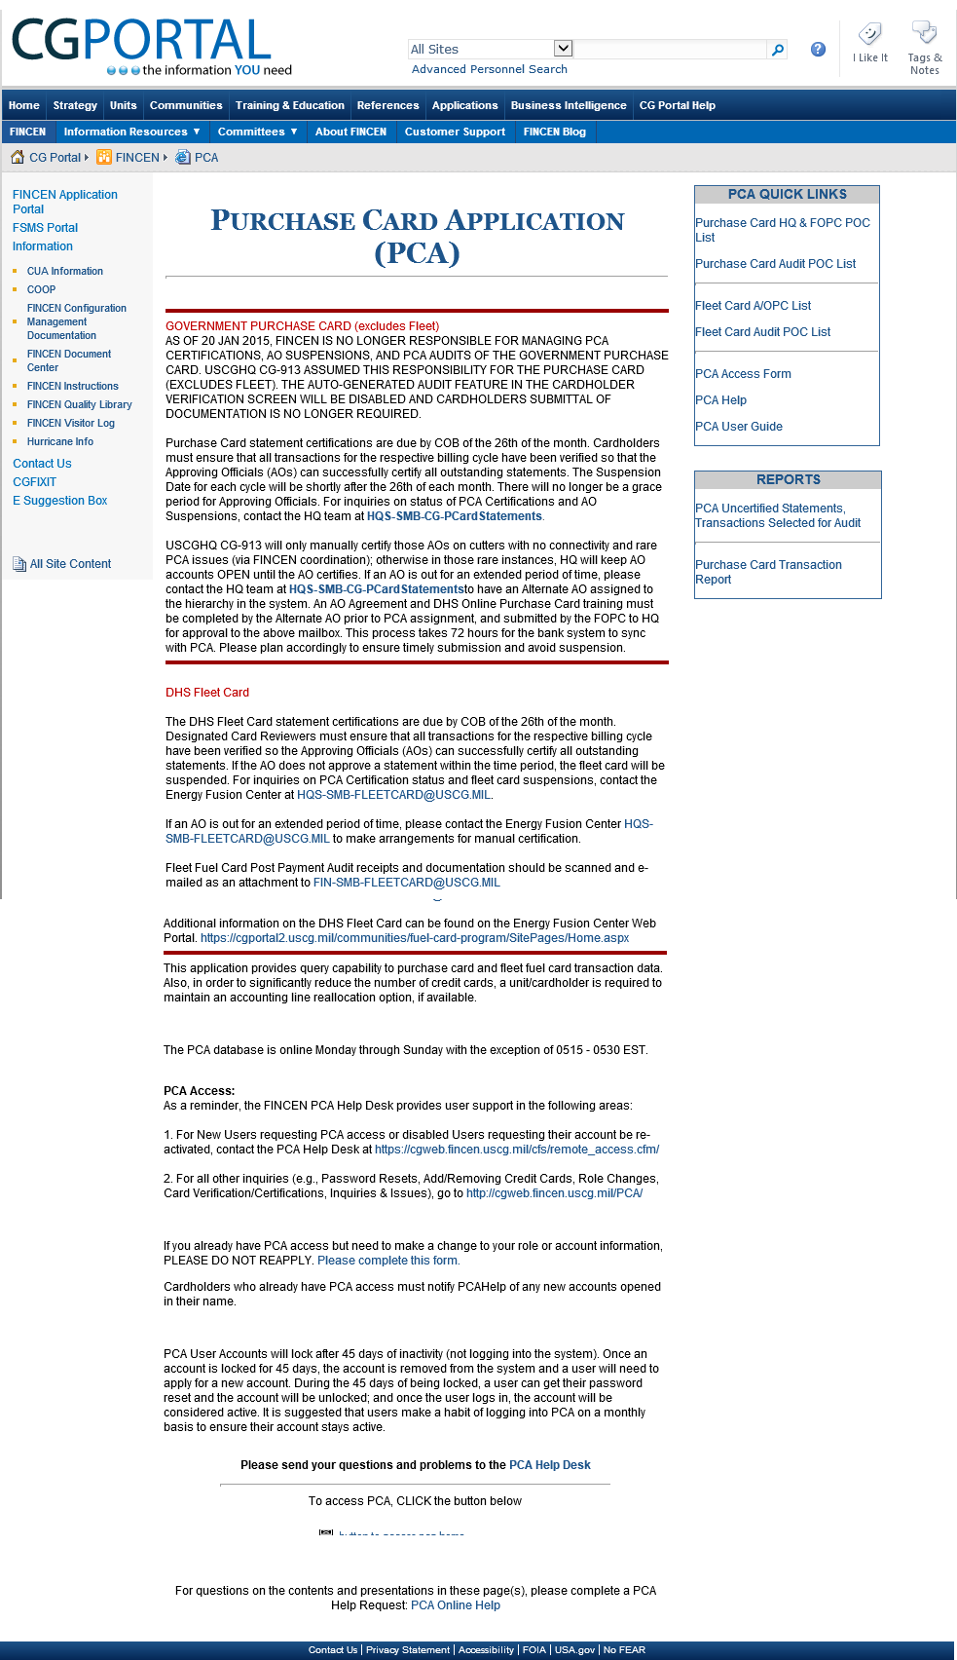
Top of first page
Step 4:
See Job Aid for bottom of page where you click the RED button

Slide 4
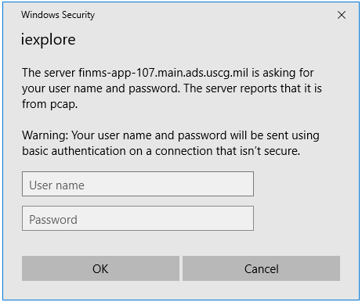
Step 5:
LOG IN to the PCA using your PCA log in credentials.
For this class, use:
User Name:
  First name and last initial
Password is the password
Click OK after entering your credentials

Slide 5
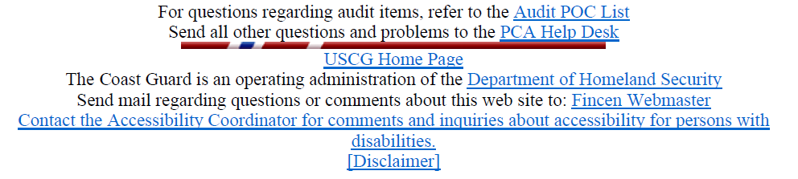
[Main Menu] [Approving Official Menu] [Cardholder Menu] [PCA Help Desk] [Reset Password] [Log Out]
User:
You end up on the Main Menu screen
PCA Main Menu
Approving Official Menu
Cardholder Menu
Query Menu
Audit Menu
Step 6:
Click on Cardholder Menu link

Slide 6
[Main Menu] [Approving Official Menu] [Cardholder Menu] [PCA Help Desk] [Reset Password] [Log Out]
User: Your User Name
You end up on the Cardholder Menu screen
Cardholder Menu
Transaction Verification and Reallocation – PE
Statements Not Verified
Print a Statement
Step 7:
Click on Transaction Verification and Reallocation – PE link

Slide 7
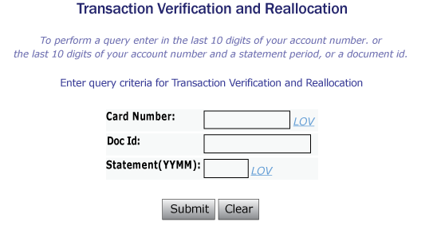
[Main Menu] [Approving Official Menu] [Cardholder Menu] [PCA Help Desk] [Reset Password] [Log Out]
User: Your User Name
Step 8:
Click the LOV link next to Card Number

Slide 8
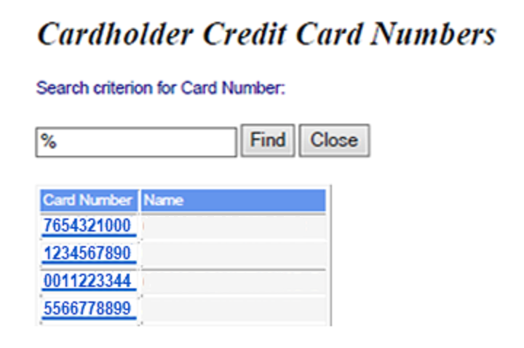
[Main Menu] [Approving Official Menu] [Cardholder Menu] [PCA Help Desk] [Reset Password] [Log Out]
User: Your User Name
Step 9:
Select your
card number from the list.
JONATHAN COOK
JOANN COASTIE
POLLY PURCHASE
JOE COASTIE

Slide 9
[Main Menu] [Approving Official Menu] [Cardholder Menu] [PCA Help Desk] [Reset Password] [Log Out]
User: Your User Name
Step 10:
Click the LOV link next to Statement (YYMM)
7654321000
Statement Dates
Purchase in November, 2020
20
Statement issued on December 12, 2020
December = 12
12

Slide 10
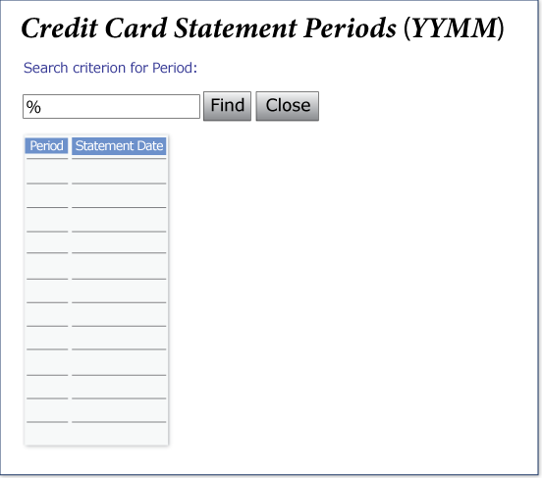
[Main Menu] [Approving Official Menu] [Cardholder Menu] [PCA Help Desk] [Reset Password] [Log Out]
User: Your User Name
2012 12-DEC-2020
2011 12-NOV-2020
2010 12-OCT-2020
2009 12-SEP-2020
2008 12-AUG-2020
2007 12-JUL-2020
2006 12-JUN-2020
2005 12-MAY-2020
2004 12-APR-2020
2003 12-MAR-2020
2002 12-FEB-2020
2001 12-JAN-2020
Step 11:
Select the statement period you are working with.
0001234567

Slide 11
[Main Menu] [Approving Official Menu] [Cardholder Menu] [PCA Help Desk] [Reset Password] [Log Out]
User: Your User Name
Step 12:
Click Submit.
7654321000
2005

Slide 12
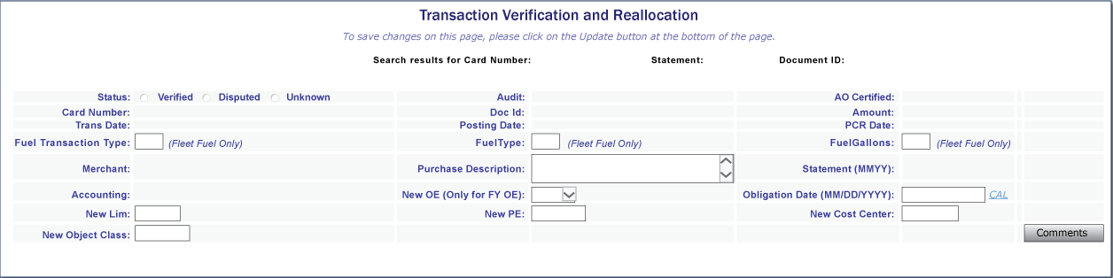

[Main Menu] [Approving Official Menu] [Cardholder Menu] [PCA Help Desk] [Reset Password] [Log Out]
User: Your User Name
Transaction Verification and Reallocation
To save changes on this page, please click on the update button at the bottom of the page.
Search results for: Card Number: 7654321000 Statement: 2005 Document Id: 0004
.
0 of 2 transactions Verified/Disputed
7654321000
32201350B1010004
$123.92
4/12/2020
4/16/2020
Safeway
Spokane, WA
2005
2/D/X56/174/30/0/82/2645
Step 13:
This is where you see how many transactions you need to verify

Slide 13
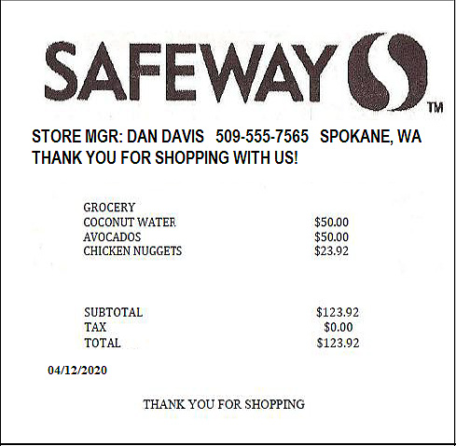
[Main Menu] [Approving Official Menu] [Cardholder Menu] [PCA Help Desk] [Reset Password] [Log Out]
Step 14:
  Verify the Card number is yours
.
7654321000
32191350B1010004
$123.92
4/12/2020
a
4/16/2020
Safeway
Spokane, WA
b
b
2005
2/D/X56/174/30/0/82/2645
Step 14a and 14b:
Compare the receipt to the onscreen data
  a. Transaction Date
  b. Merchant name and address
a

Slide 14
[Main Menu] [Approving Official Menu] [Cardholder Menu] [PCA Help Desk] [Reset Password] [Log Out]
User: Your User Name
Transaction Verification and Reallocation
To save changes on this page, please click on the update button at the bottom of the page.
Search results for: Card Number: 7654321000 Statement: 2005 Document Id: 0004
.
7654321000
32191350B1010004
$123.92
4/12/2020
4/16/2020
Safeway
Spokane, WA
Salad dressings, cheese and soda bibs
2005
2/D/X56/174/30/0/82/2645
Step 15:
  Enter a Purchase Description in the middle column

Slide 15
[Main Menu] [Approving Official Menu] [Cardholder Menu] [PCA Help Desk] [Reset Password] [Log Out]
User: Your User Name
Transaction Verification and Reallocation
To save changes on this page, please click on the update button at the bottom of the page.
Search results for: Card Number: 7654321000 Statement: 2005 Document Id: 0004
.
7654321000
32191350B1010004
$123.92
4/12/2020
4/16/2020
Safeway
Spokane, WA
2005
2/D/X56/174/30/0/82/2645
Step 16:
  Verify the Amount of the transaction
zzzzzzzzzzzzzzzzzzzz

Slide 16
[Main Menu] [Approving Official Menu] [Cardholder Menu] [PCA Help Desk] [Reset Password] [Log Out]
Step 17:
If there are no errors, click Verified button
Steps 18-20:
If there ARE errors, contact the merchant and click Disputed button. Add comments about why the purchase is being disputed.
.
7654321000
32201350B1010004
$123.92
4/12/2020
4/16/2020
Safeway
Spokane, WA
2005
2/D/X56/174/30/0/82/2645

Slide 17
[Main Menu] [Approving Official Menu] [Cardholder Menu] [PCA Help Desk] [Reset Password] [Log Out]
Steps 21 - 22:
When you are finished verifying all transactions, click the Update button to save your changes.
.
7654321000
32201350B1010004
$123.92
4/12/2020
4/16/2020
Safeway
Spokane, WA
2005
2/D/X56/174/30/0/82/2645

Slide 18
[Main Menu] [Approving Official Menu] [Cardholder Menu] [PCA Help Desk] [Reset Password] [Log Out]
User: Your User Name
Transaction Verification and Reallocation
To save changes on this page, please click on the update button at the bottom of the page.
Search results for: Card Number: 7654321000 Statement: 2005 Document Id: 0004
.
7654321000
32201350B1010004
$123.92
4/12/2020
4/16/2020
Safeway
Spokane, WA
2005
2/D/X56/174/30/0/82/2645
Step 23:
When you are ready to print your PCA statement, click the Cardholder Menu link.

Slide 19
[Main Menu] [Approving Official Menu] [Cardholder Menu] [PCA Help Desk] [Reset Password] [Log Out]
User: Your User Name
Step 24:
On the Cardholder Menu screen, click the Print a Statement link.
Cardholder Menu
Transaction Verification and Reallocation – PE
Statements Not Verified
Print a Statement

Slide 20
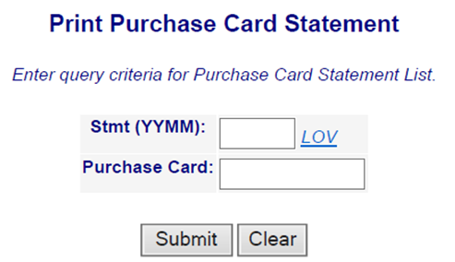
[Main Menu] [Approving Official Menu] [Cardholder Menu] [PCA Help Desk] [Reset Password] [Log Out]
User: Your User Name
Step 25a:
On the Print Purchase Card Statement screen, click the LOV link to locate your Statement period and Purchase Card number

Slide 21
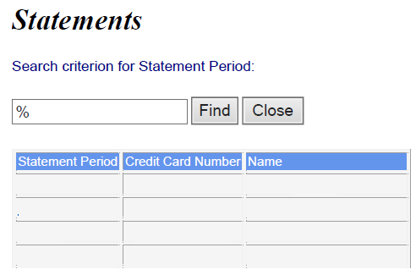
[Main Menu] [Approving Official Menu] [Cardholder Menu] [PCA Help Desk] [Reset Password] [Log Out]
Step 25b.
Click on the Statement Period you want to print.
User: Your User Name
2005
2005
2004
2004
7654321000 JONATHAN COOK
0001122334 JOANN COASTIE
0004433221 POLLY PURCHASE
0005533220 JOE COASTIE

Slide 22
[Main Menu] [Approving Official Menu] [Cardholder Menu] [PCA Help Desk] [Reset Password] [Log Out]
User: Your User Name
2005
7654321000
Step 26
Click on the Submit button

Slide 23
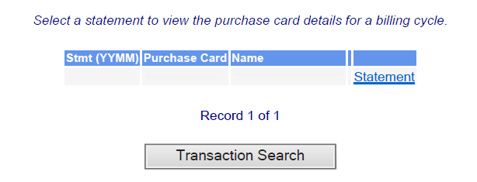
[Main Menu] [Approving Official Menu] [Cardholder Menu] [PCA Help Desk] [Reset Password] [Log Out]
User: Your User Name
2005
7654321000 JONATHAN COOK
Step 27
Click on the Statement link which will present the statement you have selected

Slide 24
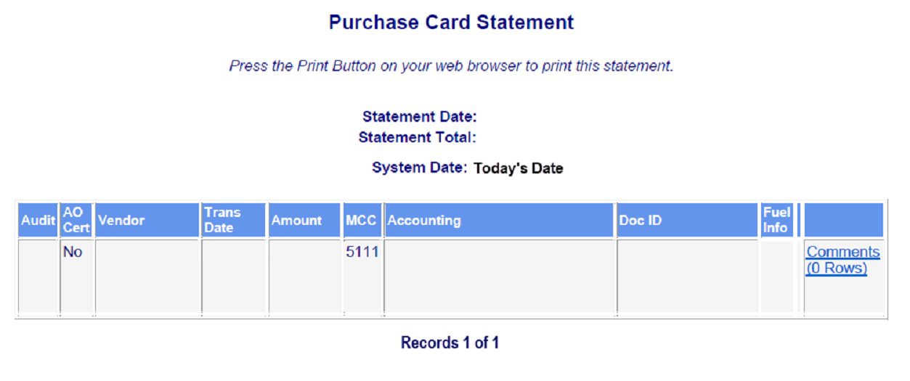
[Main Menu] [Approving Official Menu] [Cardholder Menu] [PCA Help Desk] [Reset Password] [Log Out]
Step 28
Verify that the following information is correct on statement:
  Name
  Purchase Card number
  Statement Date
User: Your User Name
JONATHAN COOK 7654321000
05/12/2020
$123.92
NOTE: If any information is incorrect, either return to the Cardholder Menu and start over OR contact your AO.
SAFEWAY
Spokane, WA
5/01/2020
$123.92
2/D/X56/174/30/0/82/2645
32201350B1010004

Slide 25
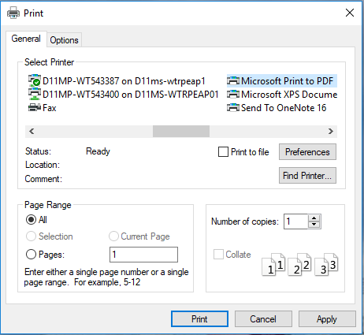
[Main Menu] [Approving Official Menu] [Cardholder Menu] [PCA Help Desk] [Reset Password] [Log Out]
Step 29
Print the statement to pdf using your browser’s print function.
User: Your User Name
5
Step 30:
When you’re done printing, click Log Out.
If your CGDF requires a printed copy, you can also use this function to print to your printer.
1
JONATHAN COOK 7654321000
2
05/12/2020
$123.92
SAFEWAY
Spokane, WA
5/01/2020
$123.92
2/D/X56/174/30/0/82/2645
32201350B1010004
3
Ex: JCookGPStatement.pdf
4

Slide 26
Questions?
Contact your instructor if you have any questions about the material in this presentation.

