Slide 1


Unit 6. SIK Rations
Lesson 1.
Claim SIK Rations
Click Anywhere on Slide to go to next slide
Notes:
HELLO AND WELCOME TO UNIT 6, Claim Rations
My name is Senior Chief Anthony Ciurlino with the Food Service Assistance and Training Team here at Training Center Petaluma. I WILL BE YOUR INSTRUCTOR FOR THIS LESSON.
THIS FIRST LESSON IN UNIT 7 IS “Document a Sale of Meal”. This lesson discusses how the FSO Claims SIK Rations including the the paperwork that the FSO fills out to document that the Dining Facility is selling a meal to an authorized patron. It does not talk about payment methods, only the daily PVA paperwork.

Slide 2
Before you begin…
Refer to U6L1 USER GUIDE for lesson details.
Access paper “FSO-PVA Forms Packet” for PVAISW forms discussed in this lecture.
Reminder: throughout this LECTURE, click anywhere on a slide to go to the next slide.

Slide 3
Objective(s)
Claim an SIK Ration

Slide 4
Lecture Agenda
Subsistence-In-Kind
How to Determine Rations to Claim
Personnel Tracker
Documenting SIK
Review

Slide 5
Subsistence-In-Kind
Subsistence-in-Kind (SIK) is one day’s legal allowance of food furnished at Government expense, no charge to the member. The FSO claims a daily ration for all members on SIK. A daily ration is breakfast, lunch, and supper.
SIK is the traditional means to provide food service support for all:
  ENLISTED MEMBERS attached to cutters
  Academy cadets
  Reservists who are not receiving BAS
  Officer Candidate School (OCS) students
  Class “A” School students
  Recruits
  Students attending educational enrichment programs
Notes:
Numbers from Meal Sign-In Sheet should be entered exactly the same onto Meal Sign In – Data Entry Sheet.

Slide 6

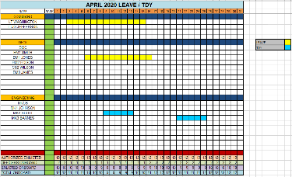
How does an FSO Determine how many
Unit Members to Claim as SIK?
Sent to FSO at start of month.
FSO receives updates throughout month.
XO/XPO
(or designated Personnel Officer)
FSO
“Personnel Tracker”
Since the FSO does not claim SIK for members on Leave or TDY, the FSO uses the Personnel Tracker to remove SIK claims for SIK members on leave or TDY.
Unit members on Leave?
Unit members on TDY?
Notes:
Leave and TDY will be provided to the Command before the new month starts, usually by the 15th of the Prior Month

Slide 7
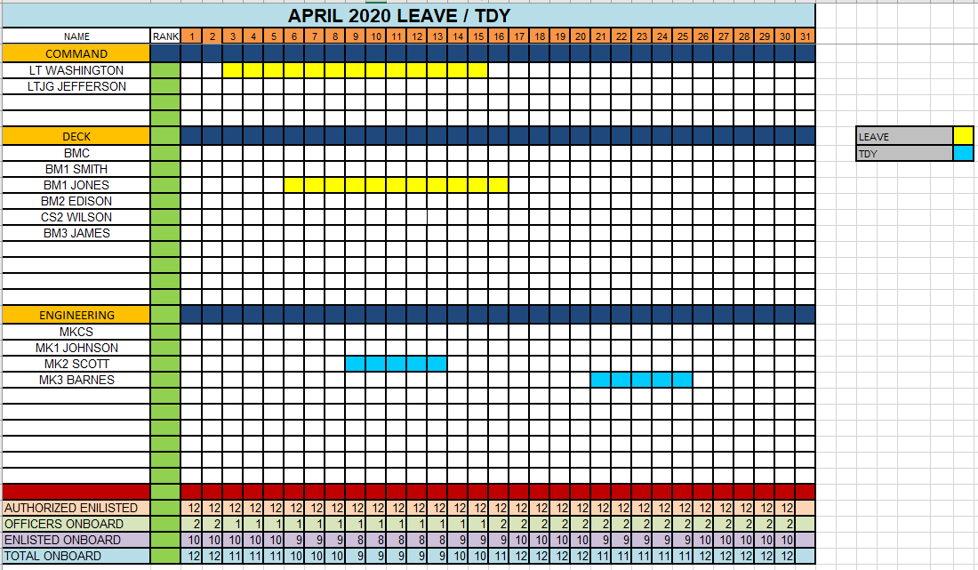
Sample Personnel Tracker
(Shows Leave/TDY Status per Unit Member)

Slide 8
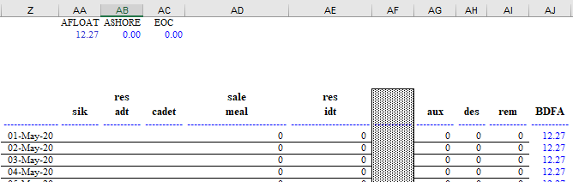
Document SIK in Form CG-3123
(PVAISW “Ration Memorandum” Form CG-3123, Columns Z through AJ)
3.
Enter number of SIK claims per category
1.
Enter BDFA rate under type of unit
2.
Copy BDFA rate into lines for each day of the month
The “SIK” column in CG-3123 is typically used for Enlisted Members Attached to a Cutter
(SIK Categories)
Best Practice: Enter SIK number at start of month, referring to Personnel Tracker, and update SIK numbers throughout month as needed.

Slide 9
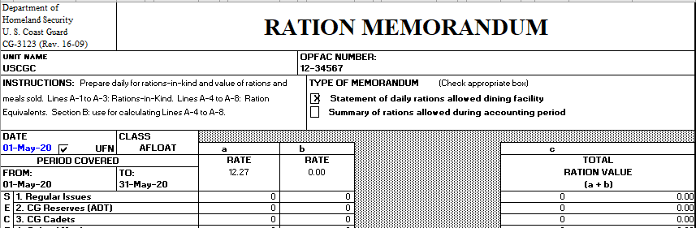
Documenting SIK, continued
Note that “Daily” box is checked to designate Daily “Ration Memorandum” (For “summary” Ration Memorandum, the “Summary” box would be checked.)
The numbers in this section of the CG-3123 are auto-populated by the system.

Slide 10
Summary and Review
Subsistence-In-Kind
How to Determine Rations to Claim
Personnel Tracker
Documenting SIK
Questions?
Notes:
This concludes the LECTURE module for Unit 6, Lesson 1. Claim SIK Rations. You are now ready to move on to the video demonstration module. Please refer to your User Guide for further instructions and then return to milSuite to begin your video demonstration with the Job Aid, “How to Claim SIK Rations.”

Slide 11
Congratulations!
You have completed the LECTURE for Unit 6. Lesson 1. SIK Rations
Next Steps: Go to milSuite….
Access USER GUIDE for U6 Lesson 1. SIK Rations. This provides instructions for Lesson 1 completion.
Access JA Booklet for Job Aid “How to Claim SIK Rations”.
View video Demonstration “Claim SIK Rations.”
Complete PRACTICE, submit, receive instructor feedback.
Complete ASSSESSMENT, submit, receive Go/No Go.
Notes:
HELLO AND WELCOME TO UNIT 7, Manage Sale of Meals
My name is Senior Chief Anthony Ciurlino with the Food Service Assistance and Training Team here at Training Center Petaluma. I WILL BE YOUR INSTRUCTOR FOR THIS LESSON.
THIS FIRST LESSON IN UNIT 7 IS “Document a Sale of Meal”. This lesson discusses the paperwork that the FSO fills out to document that the Dining Facility is selling a meal to an authorized patron. It does not talk about payment methods, only the daily PVA paperwork.

