Slide 1


Unit 7. Manage Sale of Meals
Lesson 1.
Document a Sale of Meal
Notes:
HELLO AND WELCOME TO UNIT 7, Manage Sale of Meals
My name is Senior Chief Anthony Ciurlino with the Food Service Assistance and Training Team here at Training Center Petaluma. I WILL BE YOUR INSTRUCTOR FOR THIS LESSON.
THIS FIRST LESSON IN UNIT 7 IS “Document a Sale of Meal”. This lesson discusses the paperwork that the FSO fills out to document that the Dining Facility is selling a meal to an authorized patron. It does not talk about payment methods, only the daily PVA paperwork.

Slide 2
Objective(s)
Given a computer with CS Portal access, a Purchase vs. Allowance Inventory System Workbook (PVAISW), an Individual Credit Account (ICA) Workbook, meal rates, and Job Aid “How to Document a Sale of Meal”, DOCUMENT a sale of meal with 100% accuracy. (TPO)

Slide 3
Agenda
Daily Paperwork Requirements
Meal Sign-In Sheet (CG-4901)
Daily Ration Memorandum (CG-3123)
Meal Sign In – Data Entry Sheet
Individual Credit Account (ICA) Workbook
Review

Slide 4
Daily Paperwork Requirements
  What CGDF paperwork is required daily for sale of meals?
  *This lesson only discusses Meals Sold, not Subsistence-In-Kind (SIK)
    Meal Sign-In Sheet (CG-4901):Patrons sign themselves up for meals
    Daily Ration Memorandum (CG-3123): Ration equivalents of daily meals served
    Meal Sign In - Data Entry Sheet: Electronic version of CG-4901
      Totals from each meal’s CG-4901 are entered into appropriate columns
    Individual Credit Account (ICA) (CG-3476): Credit sales
      This will be in it’s own workbook
      Tracks credit sales and auto-computes an end-of-month bill
Notes:
Numbers from Meal Sign-In Sheet should be entered exactly the same onto Meal Sign In – Data Entry Sheet.

Slide 5
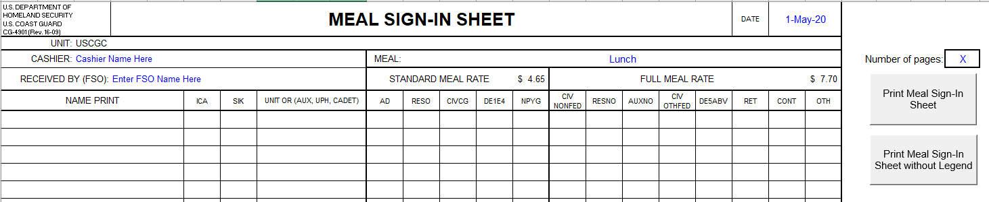
Meal Sign-In Sheet (CG-4901)
FSOs Fills out the following:
FSO’s Name
Date of Sale
Print a meal sign in sheet for each meal of each day
Cashier’s Name
Meal

Slide 6
Meal Sign-In Sheet, cont.
Patron fills out the following, at time of Meal Sale:
List Patron’s Names
*Check ICA if utilizing a Credit Account
Patron’s Unit
Enter number of meals sold to patron, in correct category and meal rate (found on the legend)

Slide 7
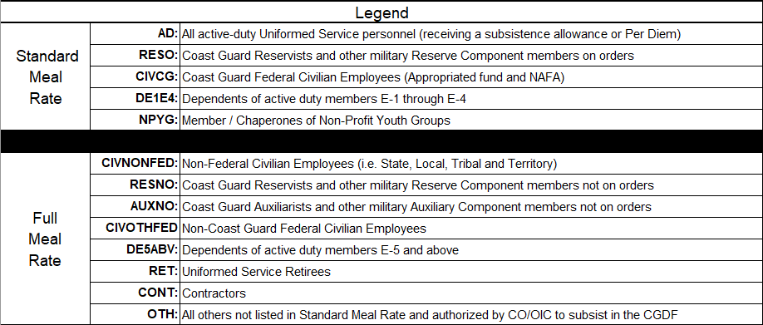
Meal Sign-In Sheet, cont.
  Meal Sign-In Sheet Legend
    Defines each patron category acronym
    Page 2 of the Meal Sign-In Sheet
Notes:
For other guests, refer students to the following reference Food Service Manual 7.C.3.e.1.h
For a list of who is authorized each meal rate, refer students to the Food Service Manual pg 7-11

Slide 8
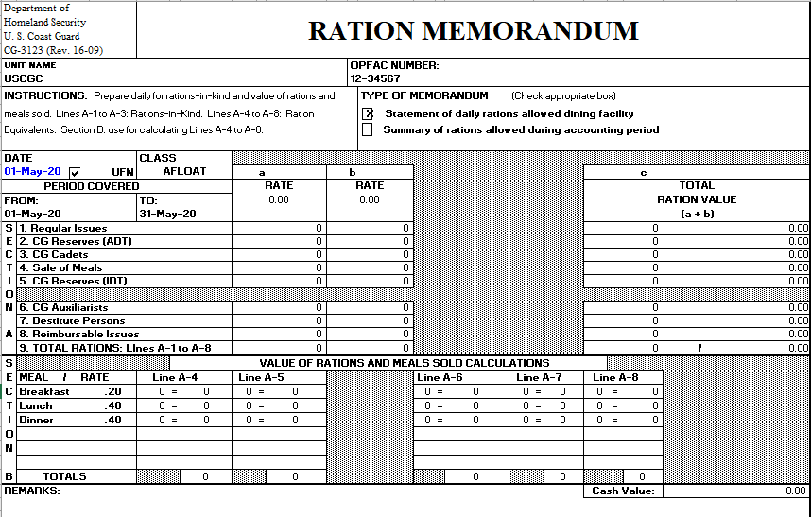
Daily Ration Memorandum (CG-3123)
Daily Ration Memorandum is Auto-populated from the numbers entered into the appropriate category section
Notes:
Possibly refer to this as the main page of form cg-3123?
The DRM tracks rations for each day of the month. This includes rations claimed for SIK, cadets, reservists, as well as meals sold. This form is auto-populated from the numbers entered into additional columns inside the CG-3123 tab. This is the first place an FSO will type in numbers to track the meals that were sold for each meal.

Slide 9
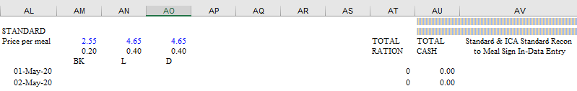



Daily Ration Memorandum, cont.
Meal totals are entered into the appropriate Category in the
CG-3123 Excel Sheet
Standard and Full are for Cash Sales
ICA Standard and ICA Full are for Credit Sales
*These are found in the CG-3123 Excel Sheet if you scroll to the right to Column “AL”
Notes:
Subtitle: Key Sections
Recommend putting this slide after introducing the slide form in full, and then say “This line is autopopulated from data the FSO enters into other sections of the CG-3123. Next I will show those sections of the CG-3123 showing where the FSO enters this data for autopopulation into the main page.

Slide 10
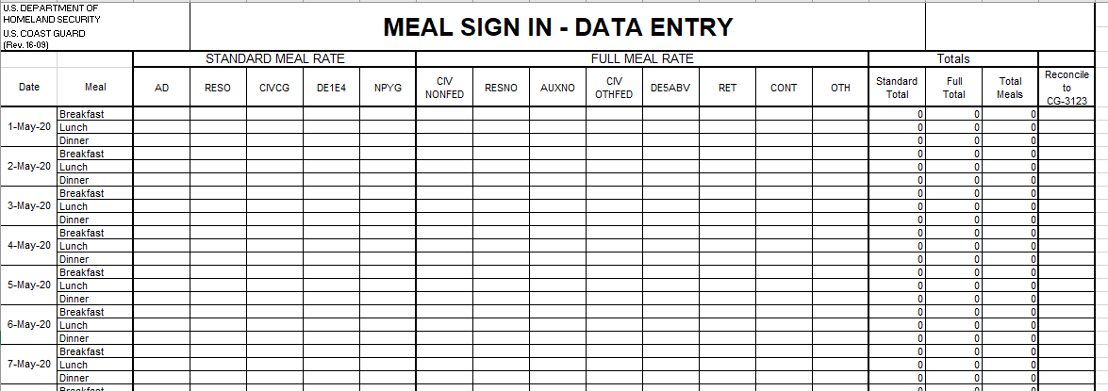
Meal Sign In – Data Entry Sheet
Boxes will turn GREEN if numbers match CG-3123, if not boxes will be RED
Enter totals sold for each category, based off Meal Sign-In Sheet
Notes:
FSO enters total number of patrons who bought meals that day into the appropriate columns (e.g., 14 Standard AD).
If the total in the far right column is red, this means this total does not equal the CG-3123 amount.
If the total in the far right column is GREEN, this means this total DOESequal the CG-3123 amount

Slide 11

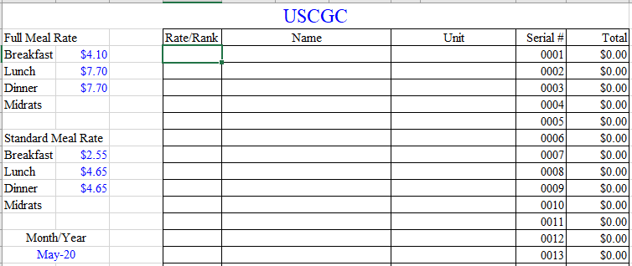
ICA Workbook
Data Tab
Billing information is entered into the ICA Workbook using the Data Tab.
Unit Name
Meal Rates and Month/Year
Patron’s information
Notes:
FSO types all data into the DATA form (patron name) and SIGN IN FORM (number of meals and meal types eaten throughout the month.)
Then this data from DATA form and SIGN IN form autopopulates the individual ICA patron bills (e.g., ICA 1, ICA 2, etc.) for the month.

Slide 12
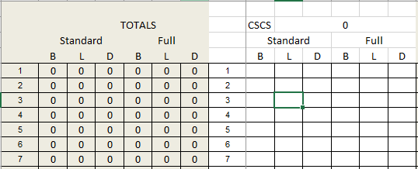
ICA Workbook
Sign-In Tab
Meals Sold are entered into the ICA Workbook using the Sign-In Tab.
Totals numbers are entered for each meal consumed under the appropriate meal and meal rate.
Notes:
FSO types all data into the DATA form (patron name) and SIGN IN FORM (number of meals and meal types eaten throughout the month.)
Then this data from DATA form and SIGN IN form autopopulates the individual ICA patron bills (e.g., ICA 1, ICA 2, etc.) for the month.

Slide 13
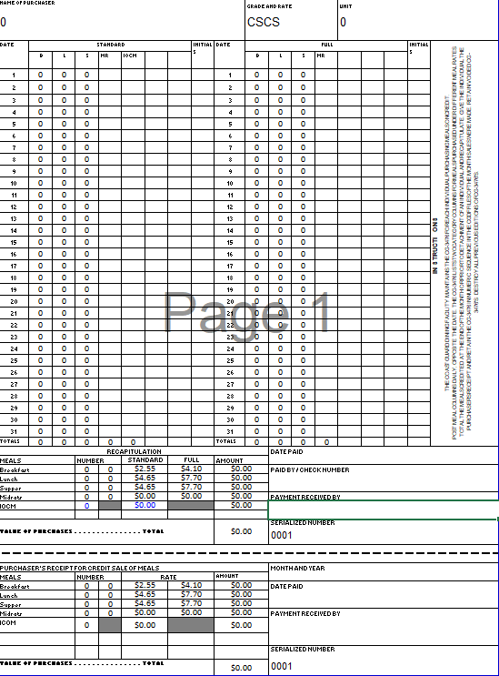
Individual Credit Account (CG-3476)
Individual Credit Accounts are Auto-populated from the numbers entered into the ICA Sign-In Tab
*ICAs are used as a bill for Patron’s at the end of the month

Slide 14
Summary and Review
Daily Paperwork Requirements
Meal Sign-In Sheet (CG-4901)
Daily Ration Memorandum (CG-3123)
Meal Sign In – Data Entry Sheet
Individual Credit Account (ICA) Workbook
Questions?
Notes:
This concludes Lesson 1, Document a Sale of Meal.
Congratulations for completing this lesson.
If you have any questions please do not hesitate to ask you instructors.
You are now ready to complete Lesson 2. which is Complete a Sale of Meals with Pay.gov.

Slide 15
Congratulations!
You have completed the LECTURE for Unit 7. Lesson 1. Document Sale of Meals.
Next Steps:
Access USER GUIDE for U7 Lesson 1 for instructions on lesson completion.
Access paper Job Aid “How To Document Sale of Meals” in Job Aid Booklet.
View video Demonstration “How to Document Sale of Meals.”
Complete PRACTICE, then submit and receive instructor feedback.
Complete ASSSESSMENT, then submit and receive instructor evaluation.
Notes:
HELLO AND WELCOME TO UNIT 7, Manage Sale of Meals
My name is Senior Chief Anthony Ciurlino with the Food Service Assistance and Training Team here at Training Center Petaluma. I WILL BE YOUR INSTRUCTOR FOR THIS LESSON.
THIS FIRST LESSON IN UNIT 7 IS “Document a Sale of Meal”. This lesson discusses the paperwork that the FSO fills out to document that the Dining Facility is selling a meal to an authorized patron. It does not talk about payment methods, only the daily PVA paperwork.

