Slide 1


Unit 7. Manage Sale of Meals
Lesson 2.
Complete a Sale of Meals with Pay.gov

Slide 2
Objective(s)
Given an authorized patron paying with Pay.gov for an Individual Credit Account (ICA), a computer with CS Portal access, a Purchase vs. Allowance Inventory System Workbook (PVAISW), an ICA (CG-3476), and Job Aid “How to Complete a Sale of Meals with Pay.gov”, COMPLETE a sale of meal with Pay.gov with 100% accuracy. (TPO)

Slide 3
Agenda
About Pay.gov
How to Pay using Pay.gov
Pay.gov Log
OGD Receipt recorded on CG-2576
Review

Slide 4
About Pay.gov
  Pay.gov is a United States Government website that allows Coast Guard Dining Facility Patrons on Individual Credit Accounts (ICAs) to pay their bill using a Credit Card.
    Link will be sent to Patrons from the FSO with their ICA
      https://www.pay.gov/public/form/start/70133200
    Patron logs into Pay.gov and pays bill
    Payment goes directly to the USCG Finance Center (FINCEN)
Notes:
Numbers from Meal Sign-In Sheet should be entered exactly the same onto Meal Sign In – Data Entry Sheet.

Slide 5
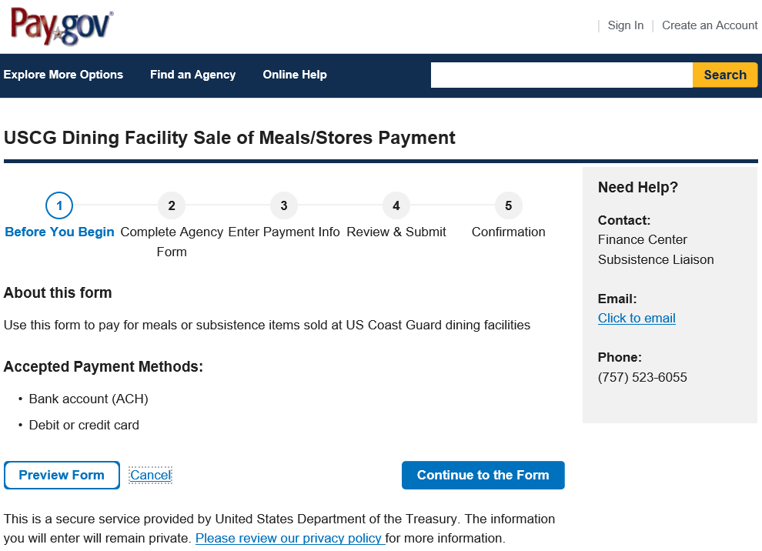
How to Pay using Pay.gov
From the Home Screen
select
“Continue to the Form”.

Slide 6
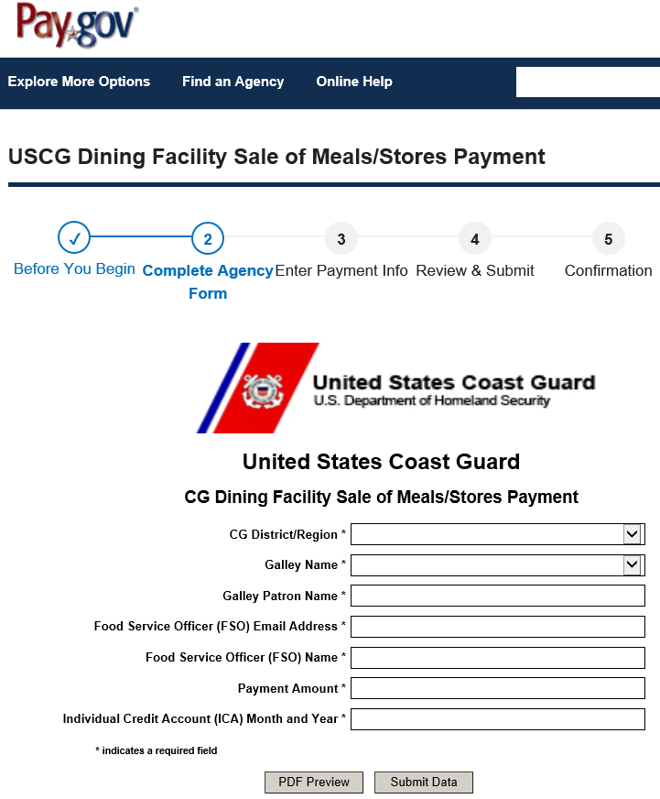
How to Pay using Pay.gov
Patron enters appropriate data into the blank fields

Slide 7
How to Pay using Pay.gov
Pay.gov will ask the Patron to Verify the Amount
Pay.gov will also ask the Patron to Verify the Date
Patron then enters their Credit Card information
Patron Selects “Review and Submit Payment”
The final screen, before selecting the final “Submit Payment”, the Patron should enter the FSO’s email address.
  Entering the FSO’s email address will ensure the FSO receives a copy of the payment confirmation.

Slide 8
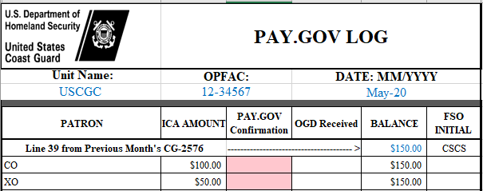
Pay.gov Log
For a Unit utilizing only Pay.gov, the Pay.gov Log is authorized instead of the Cash Log
FSO records the amount the Patrons were billed

Slide 9
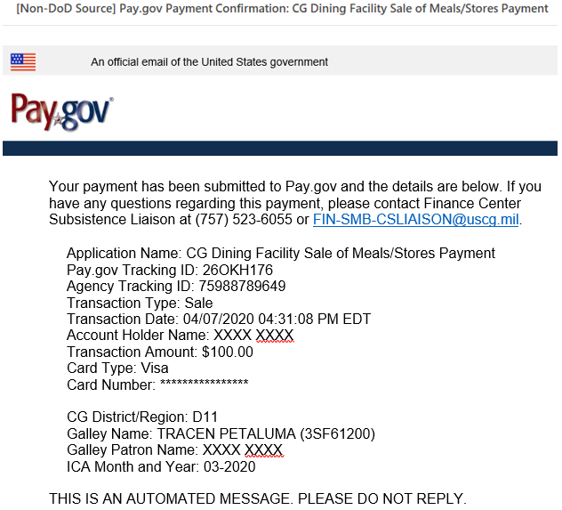
Pay.gov Payment Email Confirmation
FSO will:
Print this email
Enter this information into the Pay.gov Log
Staple to Patron’s ICA
File in Left Side of Monthly Folder

Slide 10
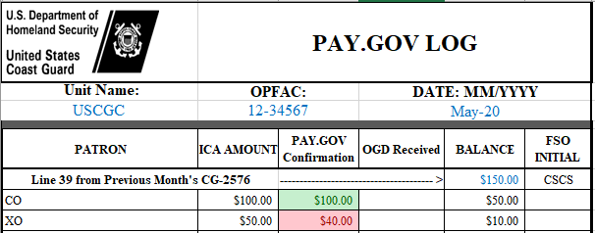
Pay.gov Log, continued
FSO records the amount paid on Pay.gov
(from email confirmation)
*Box turns GREEN if correct amount was paid, stays RED if not

Slide 11
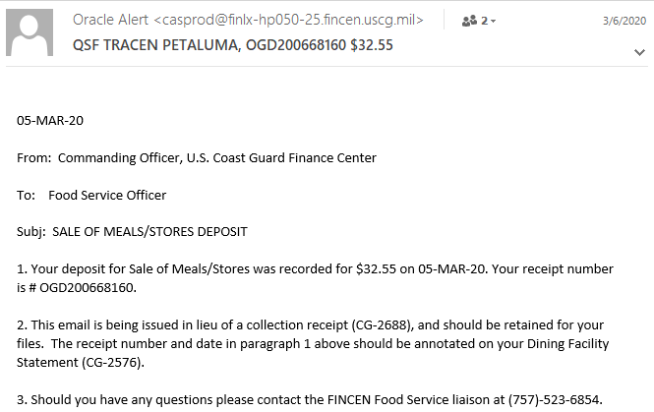
OGD from FINCEN
Operations General Accounting Division
FSO will:
Print this email
Enter this information into the Pay.gov Log
Enter this information on the CG-2576
File in Left Side of Monthly Folder

Slide 12
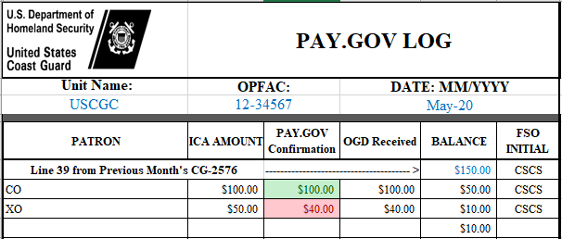
Pay.gov Log, continued
FSO initials after the OGD is received
FSO records the amount on the OGD Receipts received from FINCEN
If any amount does not add up, the Balance will have an outstanding amount

Slide 13
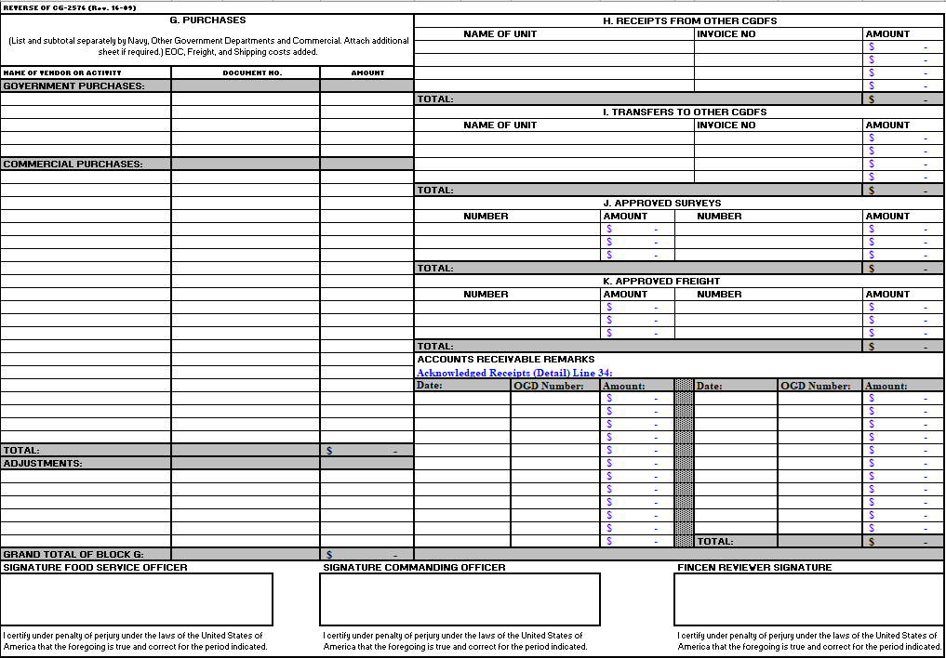
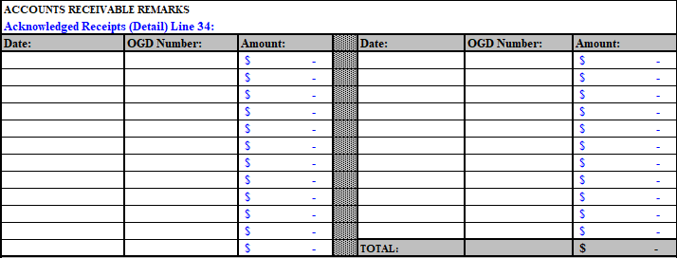
OGD Receipt Recorded on CG-2576
OGD Receipts are recorded on Page 2 of the CG-2576, bottom right, above the signature blocks
Recorded in the order received from FINCEN
Total auto-populates Line 34 on Page 1

Slide 14
Summary and Review
About Pay.gov
How to Pay using Pay.gov
Pay.gov Log
OGD Receipt recorded on CG-2576
Questions?

Slide 15
Congratulations!
You have completed the LECTURE for Unit 7. Lesson 2. Complete a Sale of Meals with Pay.gov.
Next Steps:
Access USER GUIDE for U7 Lesson 2 for instructions on lesson completion.
On milSuite “Knowledge Development” section for U7L2, download the digital Job Aid “How To Complete a Sale of Meals with Pay.gov” .
View video Demonstration “How to Complete Sale of Meals with Pay.gov.”
Complete PRACTICE, then submit and receive instructor feedback.
Complete ASSSESSMENT, then submit and receive instructor evaluation.
Notes:
HELLO AND WELCOME TO UNIT 7, Manage Sale of Meals
My name is Senior Chief Anthony Ciurlino with the Food Service Assistance and Training Team here at Training Center Petaluma. I WILL BE YOUR INSTRUCTOR FOR THIS LESSON.
THIS FIRST LESSON IN UNIT 7 IS “Document a Sale of Meal”. This lesson discusses the paperwork that the FSO fills out to document that the Dining Facility is selling a meal to an authorized patron. It does not talk about payment methods, only the daily PVA paperwork.

