Slide 1


Unit 7. Manage Sale of Meals
Lesson 4.
Transmit CGDF Funds

Slide 2
Objective(s)
Given funds for deposit, a computer with CS Portal access, a Purchase vs. Allowance Inventory System Workbook (PVAISW), U.S. Postal Services, and Job Aid “How to Transmit CGDF Funds for Deposit”, TRANSMIT CGDF Funds with 100% accuracy. (TPO)

Slide 3
Agenda
Handling Cash
Documenting Money Order Fees
Transmittal Letter
Cash Log for Transmittal
Transmittal Recorded on CG-2576
OGD Receipt Recorded on CG-2576
Review

Slide 4
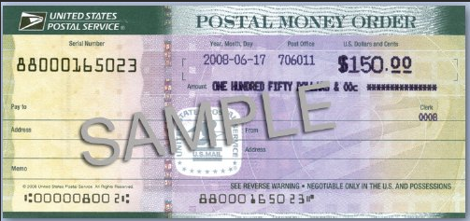
Handling Cash
Always Convert Cash into a Money Order
  The money order amount will be the total of all cash minus the money order cost.

Slide 5
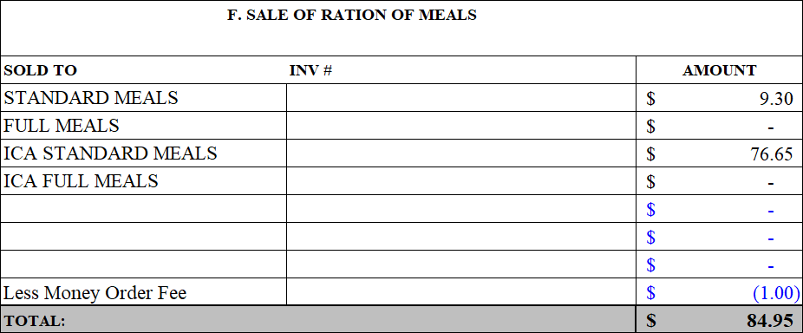
Documenting Money Order Fees
Log money order fee in Block-F
  Use parentheses to create a negative amount
Notes:
MAX COH $5,000
MAX CMF $500
Class 5 GSA approved Safe

Slide 6
Transmittal Letter
Memorandum that list all Funds being sent to the Finance Center
  Checks
    50 or Fewer per batch
  Money Orders
FSO makes copies of Memorandum and Checks/Money Orders before mailing via U.S. Postal Service
Mail to Sale of Meals Lock Box
  USCG Sale of Meals
  P.O. Box 979124
  St. Louis, MO 63197-9000

Slide 7
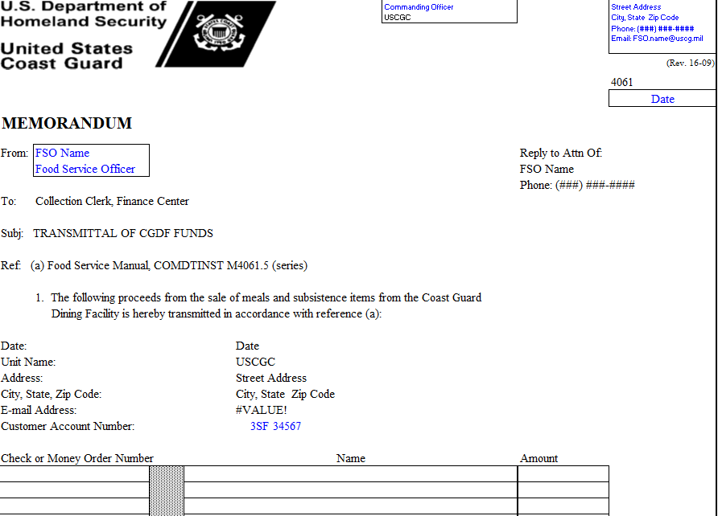
Transmittal Letter (top)
FSO inputs information in BLUE
FSO inputs Check or Money Order information

Slide 8
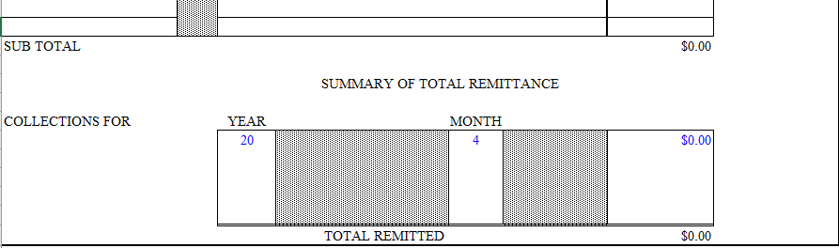
Transmittal Letter (bottom)
Year the payment is to be made for
Month the payment is to be made for (If payment is made in May for April bills, 04 for April should be here)
Total for that months’ payments
*Can have payments for multiple months. Must be separate lines.

Slide 9
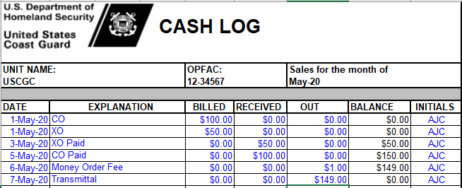
Cash Log for Transmittal
(with Money Order Fee)

Slide 10
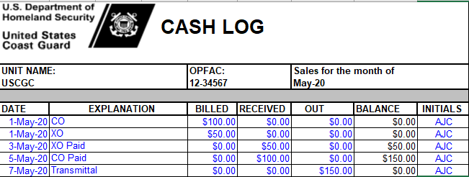
Cash Log for Transmittal
(without Money Order Fee)

Slide 11
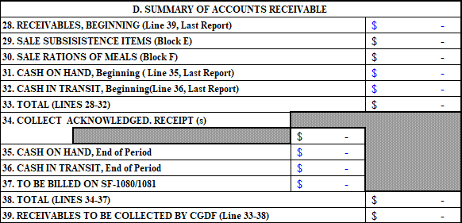
Transmittal Recorded on CG-2576
CASH ON HAND - Before Transmittal is mailed out (funds still in safe)
CASH IN TRANSIT - After Transmittal is mailed out, but no OGD has been received yet

Slide 12
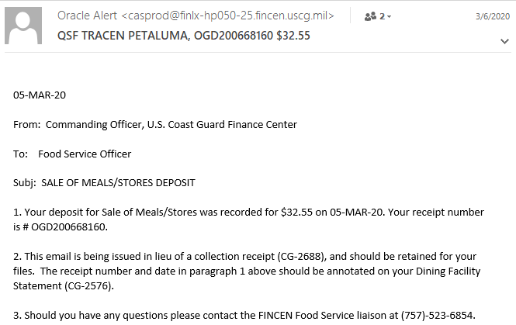
Sample OGD

Slide 13
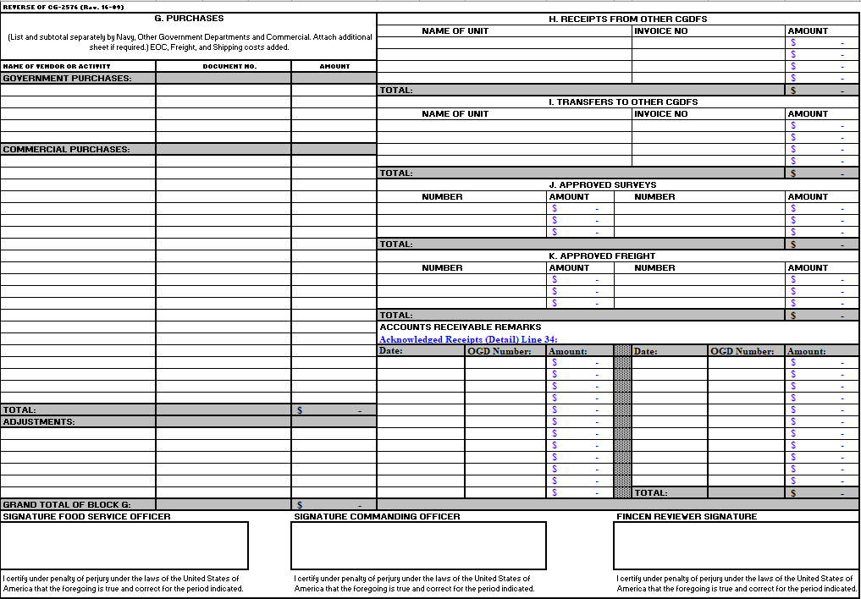
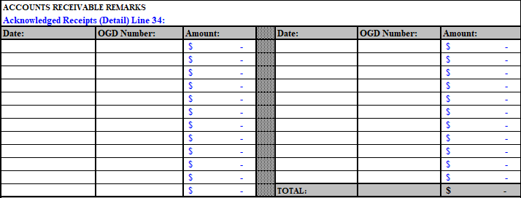
OGD Receipt Recorded on CG-2576
OGD Receipts are recorded on Page 2 of the CG-2576, bottom right, above the signature blocks
Recorded in the order received from FINCEN
Total auto-populates Line 34 on Page 1

Slide 14
Summary and Review
Handling Cash
Documenting Money Order Fees
Transmittal Letter
Cash Log for Transmittal
Transmittal Recorded on CG-2576
OGD Receipt Recorded on CG-2576
Questions?

Slide 15
Congratulations!
You have completed the LECTURE for Unit 7. Lesson 4. Transmit CGDF Funds.
Next Steps:
Access USER GUIDE for U7 Lesson 4 for instructions on lesson completion.
Access paper Job Aid “How To Transmit CGDF Funds” in Job Aid Booklet.
View video Demonstration “How to Transmit CGDF Funds.”
Complete PRACTICE, then submit and receive instructor feedback.
Complete ASSSESSMENT, then submit and receive instructor evaluation.
Notes:
HELLO AND WELCOME TO UNIT 7, Manage Sale of Meals
My name is Senior Chief Anthony Ciurlino with the Food Service Assistance and Training Team here at Training Center Petaluma. I WILL BE YOUR INSTRUCTOR FOR THIS LESSON.
THIS FIRST LESSON IN UNIT 7 IS “Document a Sale of Meal”. This lesson discusses the paperwork that the FSO fills out to document that the Dining Facility is selling a meal to an authorized patron. It does not talk about payment methods, only the daily PVA paperwork.

