Slide 1


Unit 8: Manage Stores
Lesson 1. Physical Inventory
CG-4261
Notes:
HELLO AND WELCOME TO UNIT 8, Manage Stores.
My name is Senior Chief Adam Shelton with the Food Service Assistance and Training Team here at Training Center Petaluma. I WILL BE YOUR INSTRUCTOR FOR THIS LESSON.
THIS FIRST LESSON IN UNIT 8 IS PHYSICAL INVENTORY CG-4261. LESSON 1 PROVIDES KNOWLEDGE AND A FOUNDATIONAL UNDERSTANDING OF PHYSICAL INVENTORY CG-4261. The goal of this lesson is to ensure every FSO attending this course has foundational knowledge critical to completing a end of the month physical inventory CG-4261 for their dining facility.
ONCE THIS LESSON IS COMPLETE, YOU WILL PERFORM A PRACTICE IN WHICH YOU COMPLETE A CG-4261 FOR SUBMISSION TO YOUR INSTRUCTOR, FOLLOWED BY AN ASSESSMENT WHERE YOU WILL ONCE AGAIN COMPLETE A DIFFERENT CG-4261 FOR SUBMISSION TO YOUR INSTRUCTOR FOR APPROVAL. SUCCESSFUL COMPLETION OF THE ASSESSMENT CG-4261 WILL RESULT IN YOU RECEIVING A “GO” FOR YOUR PERFOMANCE TEST CHEKCLIST OR PTC.

Slide 2
Objectives
Given an Inventory Management Workbook for Purchase vs. Allowance (IMWPVA) a Purchase vs. Allowance Inventory Systems Workbook (PVAISW), related job aids, and appropriate reference materials, COMPLETE a CGDF End of the Month Physical Inventory, CG-4261 with 100% accuracy.
Notes:
AFTER completing this lesson, you should be able to complete the following…. (read objective on slide)

Slide 3
Inventory Types
Regular
  End of Month
Relief
  Required to relieve an outgoing FSO
Verification
  Annual Audit
Notes:
There are three types of inventory you’ll do – and each has a different purpose.
The Regular inventory is the regular one you do at the end of every month
The Relief inventory is done when one FSO is transferring and another is coming in
The Verification audit is the one the auditors will do for you at least once every 12 months. You’re not involved in counting the stores for this inventory.
Be sure to check the correct box at the top of the CG-4261 to indicate what type of inventory you’re performing.
The process for the first two – the regular and relief inventories are essentially the same, but the signatures on the CG-4261 will be different.

Slide 4
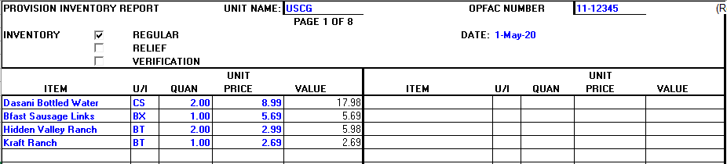
Conducting Inventory
Inventory must be conducted on the last day of every month.
Fill in the header information and check inventory type.
Do not count OPENED subsistence items.
Count different brands of food items separately, e.g. Hidden Valley Ranch and Kraft Ranch.
Record the item(s) name, unit of issue, quantity and price for each unopened item(s) on hand onto your CG-4261, Provision Inventory Report.
Notes:
A few rules about conducting an inventory:
READ SLIDE
Bullet 4: Do not price average two different brands of the same product.

Slide 5
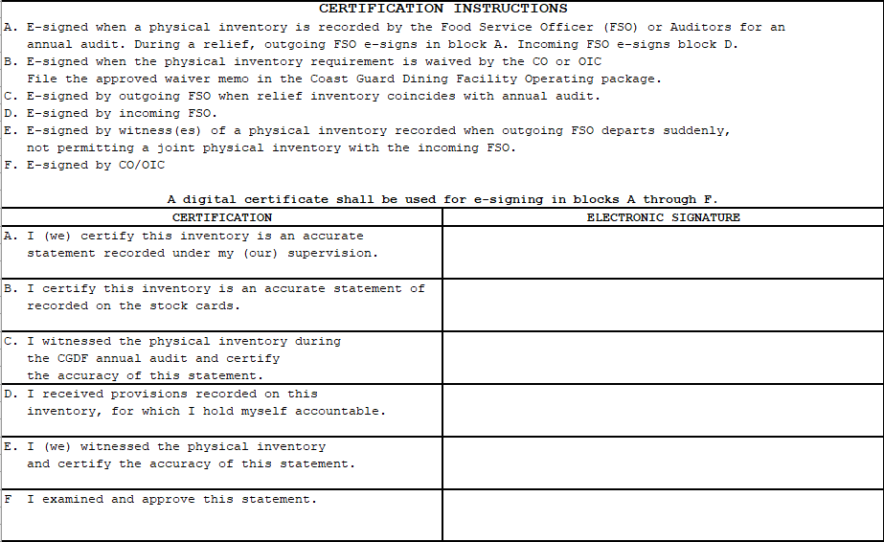
Inventory Certification
Notes:
When you’ve finished the counting, a couple of people need to certify – or digitally sign the CG-4261. The signature boxes are at the bottom of the last page.
On this screen, you can see the Certification Instructions which tell you who is supposed to sign where under certain conditions.
Typically, you. The FSO will sign in box A – but not always. Your CO or OIC will sign in box F when you submit your monthly folder containing your inventory.
These steps are also laid out in your Job Aid, “How to Complete a Physical Inventory, CG-4261, Provision Inventory Report”.

Slide 6
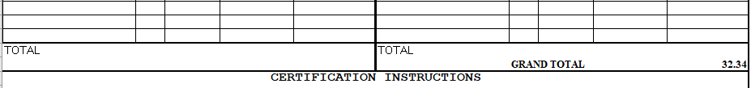

Document in CGDFOS
Notes:
After completing your inventory, you need to copy the total value amount calculated on your CG-4261 into your operating statement or CG-2576. You enter the Total from your CG-4261 (on the bottom of the page – just above the signature boxes) into Block A, Line 8 of your CG-2576.

Slide 7
Submit and File
Once completed and signed by the FSO, submit to your CO/OIC with your monthly folder for signature approval.
File your approved inventory in the right side of your monthly folder.
Notes:
Once you’ve completed these steps, you’ll submit the inventory documentation along with your monthly folder to your CO/OIC for signature approval.
This paperwork gets filed on the right side of your monthly folder.

Slide 8
Summary and Review
Regular Inventory must be conducted on the last day of every month.
Record the item(s) name, unit of issue, quantity and price for each unopened item(s) on hand onto your CG-4261, Provision Inventory Report.
Do not count OPENED subsistence items.
Count different brands of food items separately, e.g. Hidden Valley Ranch and Kraft Ranch.
Make sure to check the correct TYPE of inventory on the CG-4261
Notes:
In this lesson you have learned:
That a regular inventory must be completed at the end of every month.
That you record the item name, unit of issue, quantity and price for each unopened item onto your CG-4261, Provision Inventory Report.
Do NOT count opened items.
Count different brands of the same food items separately.
And finally, make sure to check the correct type of inventory on the CG-4261.

Slide 9
Questions?
If you need clarification on this lesson, direct your questions to your instructor, CSCS Adam Shelton at TRACEN Petaluma.
  Phone: 707-765-7427
  Email: Adam.C.Shelton @uscg.mil
Notes:
please direct any questions you may have to your instructors for further clarification.

