Slide 1


Unit 8: Manage Stores
Lesson 3. Transfer of Stores
Notes:
HELLO AND WELCOME TO UNIT 8, Manage Stores.
My name is Senior Chief Adam Shelton with the Food Service Assistance and Training Team here at Training Center Petaluma. I WILL BE YOUR INSTRUCTOR FOR THIS LESSON.
THIS THIRD ND FINAL LESSON IN UNIT 8 IS TRANSFER OF STORES CG-2581. LESSON 2 PROVIDES KNOWLEDGE AND A FOUNDATIONAL UNDERSTANDING OF TRANSFER OF STORES CG-2581. The goal of this lesson is to ensure every FSO attending this course has foundational knowledge critical to completing a Transfer of Stores CG-2581 for their dining facility.
ONCE THIS LESSON IS COMPLETE, YOU WILL PERFORM A PRACTICE IN WHICH YOU COMPLETE A CG-2581 FOR SUBMISSION TO YOUR INSTRUCTOR, FOLLOWED BY AN ASSESSMENT WHERE YOU WILL ONCE AGAIN COMPLETE A DIFFERENT CG-2581 FOR SUBMISSION TO YOUR INSTRUCTOR FOR APPROVAL. SUCCESSFUL COMPLETION OF THE ASSESSMENT CG-2581 WILL RESULT IN YOU RECEIVING A “GO” FOR YOUR PERFOMANCE TEST CHEKCLIST OR PTC.

Slide 2
Objectives
Given a computer with access to the CS Portal, milSuite and DCS, a Purchase vs. Allowance Inventory Systems Workbook (PVAISW), a need for the transfer of stores, related job aids, and any additional applicable references, COMPLETE a Transfer of Stores CG-2581 with 100% accuracy.
Notes:
AFTER completing this lesson, you should be able to complete the following…. (read objective on slide)

Slide 3
Transfer of Stores
Transfer of Stores are the transfer of subsistence items from your CGDF to another CGDF.
Obtain CO/OIC approval before initiating Transfer of Stores.
Transfer to non-Coast Guard dining facilities is prohibited.
No funds are exchanged between the two CGDFs.
Notes:
READ SLIDE

Slide 4
Documentation for Transfer of Stores
CG-2581 – Transfer of Stores
CG-2576 – Block I (Transfers to other CGDFs)
CG-2576 – Block C (remarks)
Notes:
After you’ve received approval for the transfer, you’ll document the transfers you’re about to make in three places in your PVAISW.
First is on the CG-2581 Transfer of Stores form
Second is on the Operating Statement – in Block I which covers Transfers to other CGDFs.
And the third is adding comments about the Transfer in Block C of the operating statement.

Slide 5
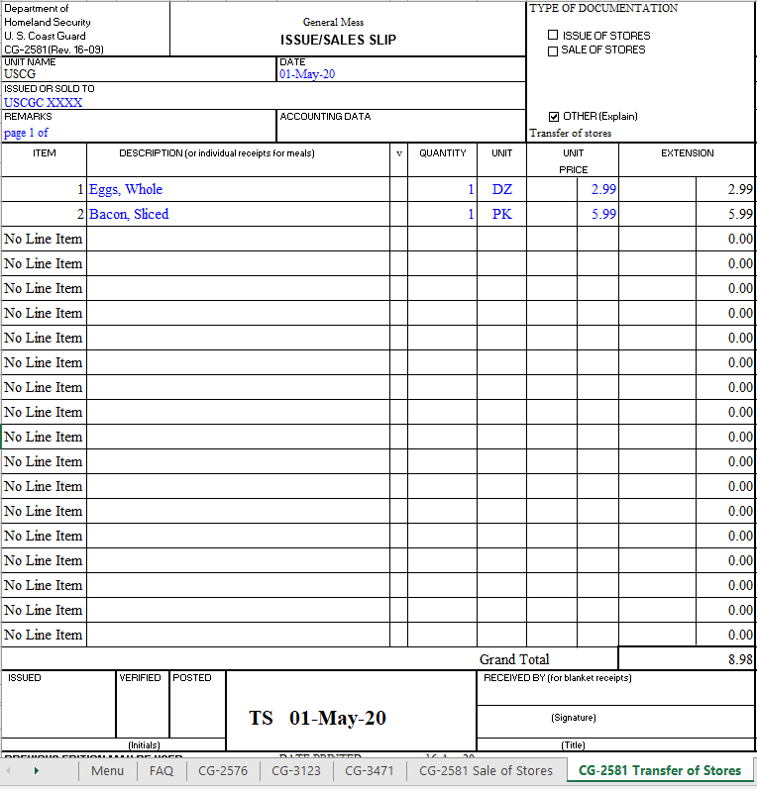
Transfer of Stores cont.
Before Delivery:
Notes:
After you’ve received permission to transfer the items, open the CG-2581 Transfer of Stores tab in your PVAISW.
You start by filling out the information in the header – the Unit you’re transferring to and the date. Make sure the “Other” box is checked under Type of Documentation.

Slide 6
Transfer of Stores cont.
Before Delivery:
Notes:
Next fill in the Description of the items that will you will be transferring, the quantity, the unit, and the Unit Price.
Once this the 2581 is filled out, print the form to pdf – and print out three copies. You can now remove the items from your inventory.

Slide 7
Transfer of Stores cont.
After you remove items from Inventory:
FSO FSO FSO
When you deliver the Inventory:
Notes:
After you have removed the subsistence items, you as the FSO, initial in the “Issued” “Verified” and “Posted” blocks on the bottom left corner of all three forms.
When you deliver the items, the authorized Dining Facility representative will sign in the “Received by” box at the bottom right of the three forms.
You leave two copies for the recipient and you file the third one on the left side of your monthly folder.

Slide 8
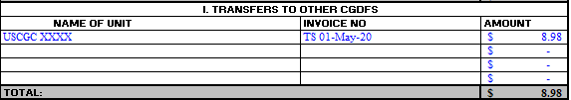
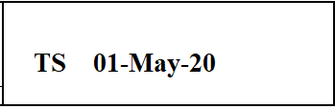
Document in CGDFOS
Document the Transfer of Stores in Block I of the CG-2576, listing the Sold To, the invoice # and the total amount. The invoice # can be found at the bottom of the CG-2581.
CG-2581-Sale of Stores (bottom of page)
Notes:
The second place you document the transfer of stores is on the CG-2576 – Block I.
You put the Name of Unit in the first column.
The invoice number comes from the bottom of the 2581.
Then add the total value the of the transfer in the third column.

Slide 9
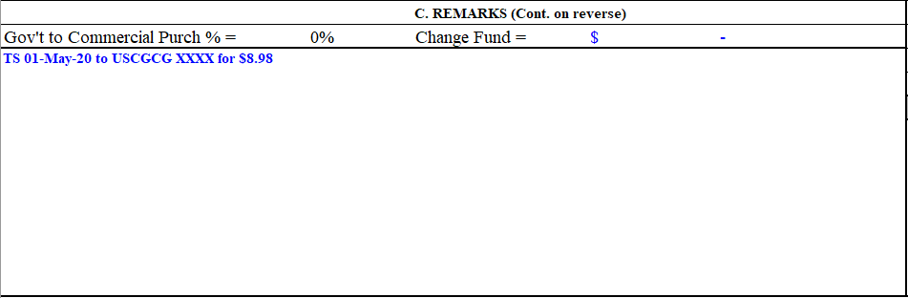
Document in CGDFOS cont.
Document the Transfer of Stores in Block C “Remarks” of your G-2576.
Notes:
And the third and final place you document your transfer is in the “Remarks” section of your CG-2576, Block C.
List the invoice number, the unit you transferred to and the total value of the transfer.

Slide 10
Summary and Review
Obtain approval from your CO/OIC for all Transfer of Stores.
Transfer only to other CGDFs.
Document Transfer on an itemized Transfer of Stores, CG-2581
Ensure you initial and have the receiver sign.
Provide receiver two copies for their records.
Document transfer in PVAISW (3 places)
Submit to FINCEN with CGDFOS for examination at the end of the month.
Notes:
In this lesson you have learned you must:
Obtain approval from your CO/OIC for all Transfer of Stores.
Transfer only to other CGDFs.
Document Transfer on an itemized Transfer of Stores, CG-2581
Ensure you initial and have the receiver sign.
Provide receiver two copies for their records.
Document transfer in PVAISW (3 places)
Submit to FINCEN with CGDFOS for examination at the end of the month.

Slide 11
Questions?
If you need clarification on this lesson, direct your questions to your instructor, CSCS Adam Shelton at TRACEN Petaluma.
  Email: Adam.C.Shelton @uscg.mil
Notes:
please direct any questions you may have to your instructors for further clarification.

