Slide 1


Unit 9. Monthly Report
Lesson 1.
Account Status Detail Report (ASDR)

Slide 2
Objective(s)
RECOGNIZE when to contact FINCEN in regards to the Account Status Detail Report (ASDR).

Slide 3
Agenda
What is the ASDR?
How to access the ASDR
The ASDR
How the ASDR relates to the CGDFOS (CG-2576)
ASDR Discrepancies
Review

Slide 4
Account Status Detail Report (ASDR)
  The ASDR is a FINCEN-generated and FINCEN-managed online report that tracks Receivables (Bills) to be collected by the FSO’s Dining Facility, and the monetary values that are actually paid by the patrons to the CGDF.
  This allows the FSO to see if the Dining Facility’s account is in good standing with FINCEN.
  The ASDR directly relates to the CG-2576 (Blocks D, E, and F).
Notes:
Numbers from Meal Sign-In Sheet should be entered exactly the same onto Meal Sign In – Data Entry Sheet.
Bills = any money owed to galley for meals sold, stores sold.
FSO checks ASDR to find out if there are any errors. For example, a member might pay the wrong amount or pay the wrong unit.
ASDR tracks what was billed, vs. what was paid to the galley.

Slide 5
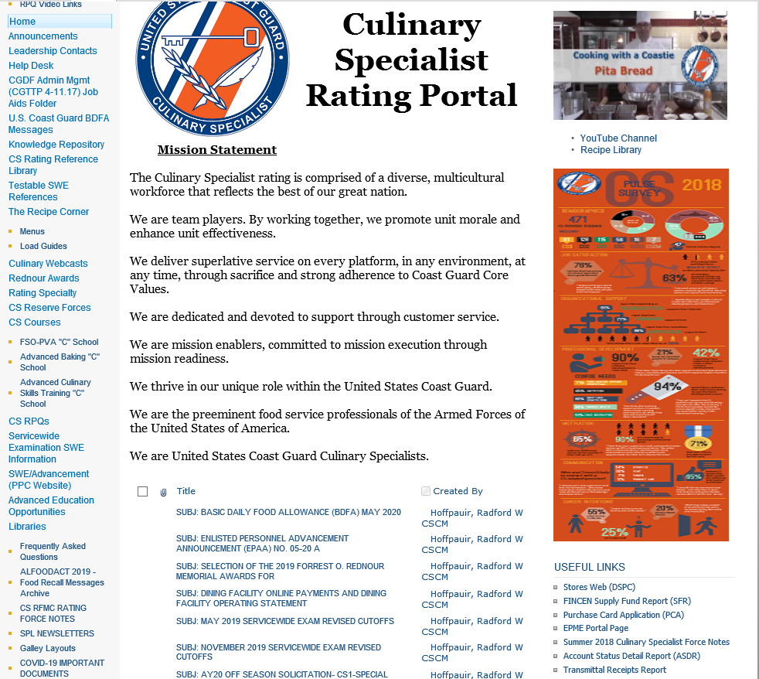
How to Access the ASDR from the CS Portal
Link on bottom right of Homepage
Notes:
Numbers from Meal Sign-In Sheet should be entered exactly the same onto Meal Sign In – Data Entry Sheet.

Slide 6
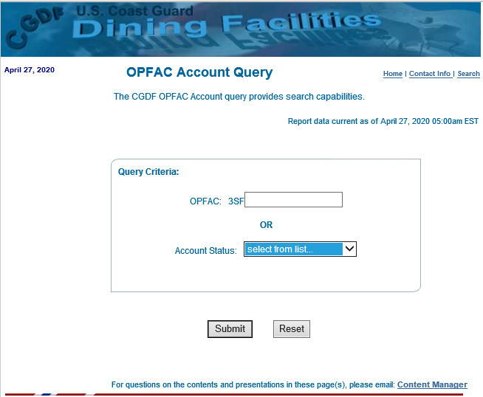
How to Access the ASDR from the CS Portal, continued
1. Enter Last 5 Digits of Unit’s OPFAC
2. Click Submit
Notes:
Numbers from Meal Sign-In Sheet should be entered exactly the same onto Meal Sign In – Data Entry Sheet.

Slide 7
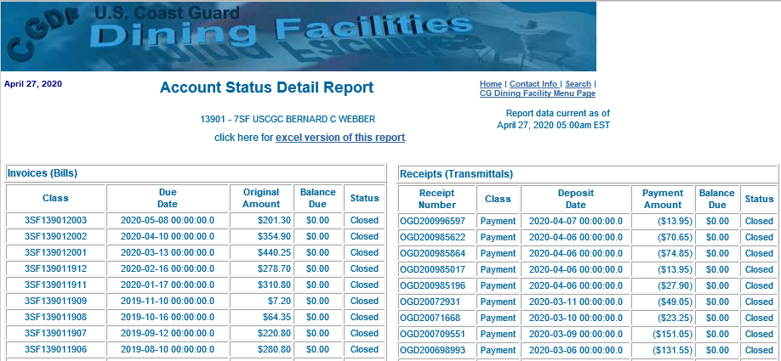
The ASDR
Monthly Receivables to be Collected (Line 39 from CG-2576)
Payments made to the Dining Facility
Left Side ASDR
Right Side ASDR
These 5 payments total $201.30 (so total bill has been paid and the status is “Closed”)
Example:
Total Bill Due above is $201.30
Left Side: Bills to be collected by CGDF
Right Side: Payments made towards bills thus far.
Notes:
Numbers from Meal Sign-In Sheet should be entered exactly the same onto Meal Sign In – Data Entry Sheet.

Slide 8
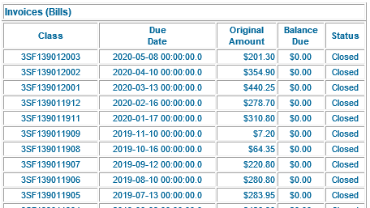
The ASDR, continued
Left Side
Monthly Receivables to be Collected (Line 39 from CG-2576)
One bill per month
Row will be RED if there is a discrepancy (Example featured later in this module)
Each line is one month’s billing.
Last four digits = Year and Month
Example above: 1905 means 2019 May
Example: This amount - $283.95 - is the total bill to be collected by the CGDF that month.
How did the ASDR get this $283.95 amount?
The ASDR is managed by FINCEN. FINCEN copied $283.95 from the FSO’s CG-2576 Line 39 (“Receivables to be collected by the CGDF”) and FINCEN put this $283.95 into the ASDR for that month. (Example featured later in this module.)
Notes:
Numbers from Meal Sign-In Sheet should be entered exactly the same onto Meal Sign In – Data Entry Sheet.

Slide 9
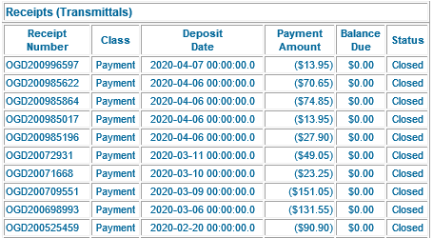
The ASDR, continued
Right Side
Payments processed by FINCEN for the Dining Facility
  Pay.gov
  Transmittal
Important to pay for correct month
Row will be RED if there is a discrepancy
(Example featured later in
this module)
Each line represents a payment
Each payment receives a serialized receipt number.
Payments come in several forms (e.g., Pay.gov payments, funds transmitted to lockbox, OTCnet deposits, etc.)
Notes:
Numbers from Meal Sign-In Sheet should be entered exactly the same onto Meal Sign In – Data Entry Sheet.

Slide 10
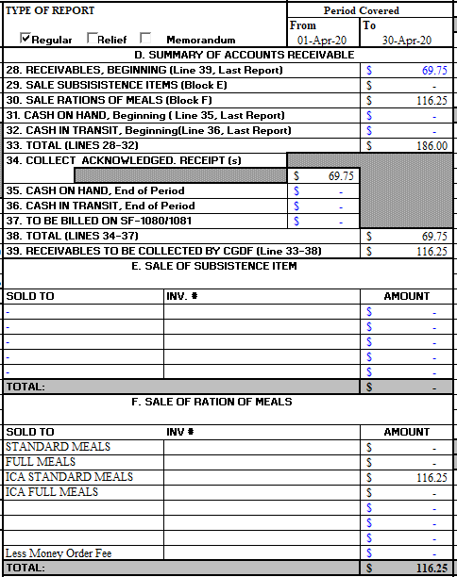
How the ASDR relates to the CG-2576
FINCEN takes amount from FSO’s CG-2576 Line 39 and posts this amount to the ASDR (left side) for that month.
Notes:
Numbers from Meal Sign-In Sheet should be entered exactly the same onto Meal Sign In – Data Entry Sheet.
FSO sends the CG-2576 to FINCEN for auditing at end of month, FINCEN signs off, FINCEN enter the amount of Line 39 into ASDR (Account Status Detail Report); FINCEN returns 2576 to FSO. We recommend checking it once a month, you have to do it a few times a month.
Note: Line 39 is the accumulation of Block E and F.

Slide 11
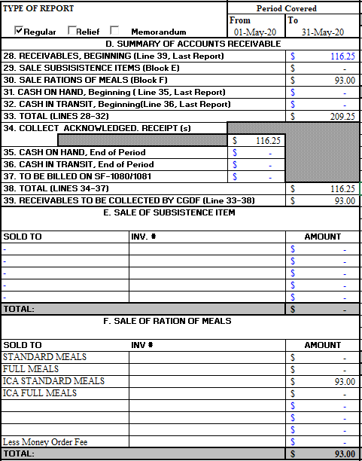
How the ASDR relates to the CG-2576, continued
Line 28 is the amount that should be collected in the new month
Line 34 is what is actually paid to the CGDF (should match Line 28) *
*If these numbers do not match, there will be a discrepancy on the ASDR
Notes:
Numbers from Meal Sign-In Sheet should be entered exactly the same onto Meal Sign In – Data Entry Sheet.
NOTE LINDA -
Line 28 is 39 from previous month.
OGD is a DEPT in the Finance Center.

Slide 12
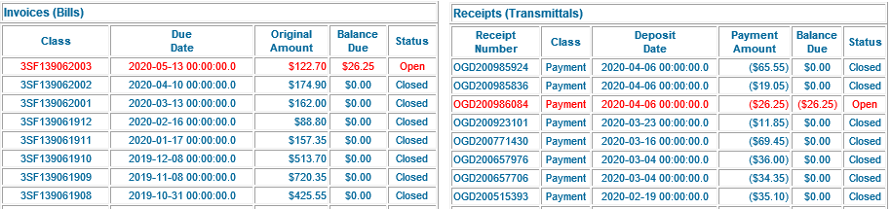
ASDR Discrepancies
Note: An “OPEN” Status is always red (indicating a discrepancy.)
Discrepancies on the ASDR show up in RED. If an FSO sees red on their ASDR they must contact their FINCEN CS Liason. The FINCEN CS Liason will help the FSO correct any discrepancies.
Notes:
Numbers from Meal Sign-In Sheet should be entered exactly the same onto Meal Sign In – Data Entry Sheet.
LINDA – 45 DAYS AFTER YOUR CG-2576 IS AUDITED, LINE 39 VALUES (TOTAL E.G., 122.70) WILL POST ON THE LEFT SIDE OF asdR UNDER INVOICES.
ALSO, MULTIPLE BILLS REPRESENT ONE LINE ON THE LEFT SIDE.
If you have one lump total on left you

Slide 13
Knowledge Check: ASDR
Instructions: Click on the answer you believe is correct.
1. What does the ASDR provide?
A. The ASDR provides the total bill due that month, which the FSO copies into the CG-2576.
B. The ASDR shows the FSO bills due to be collected by the CGDF and the status of payments.
2. When does the FSO contact their FINCEN liaison about an ASDR?
A. When the FSO finishes their CG-2576 for that month.
B. When an “ERROR” message window pops-up in the ASDR.
C. When the FSO sees red in the ASDR.
3. How is the ASDR generated?
A. The FSO generates the ASDR by entering billing data into the ASDR from CG-2576 Line 39 “Receivables due to be collected by the CGDF.”
B. FINCEN generates the ASDR and pulls CGDF billing data from the FSO’s CG-2576 Line 39 “Receivables due to be collected by the CGDF.”

Slide 14
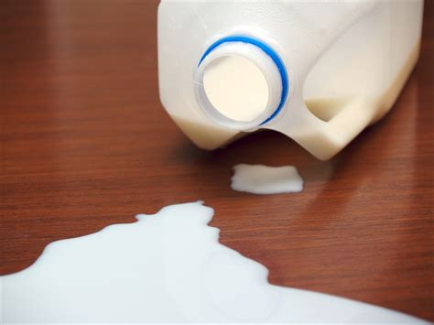
That is not correct.
Please try again.
No, the ASDR does not provide data the FSO must enter into the CG-2576. It is the other way around. Remember – FINCEN owns the ASDR, and FINCEN pulls data from the FSO’s CG-2576 to create ASDR data about bills due to the CGDF (specifically, CG-2576 Line 39, “Receivables due to be collected by the CGDF.”)
The reason the FSO checks the ASDR both during the month and at the end of the month is to see if bills due to the CGDF have been paid (status is displayed on the right side of the ASDR.)
Try again…

Slide 15
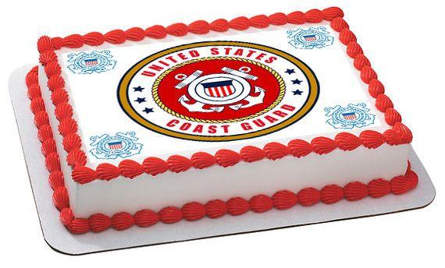
That’s right!
Congratulations! !
The ASDR is a FINCEN-generated and FINCEN-managed online report that tracks Receivables (Bills) to be collected by the FSO’s Dining Facility, and the monetary values that are actually paid.
This allows the FSO to see if the Dining Facility’s account is in good standing with FINCEN.
Return to complete the Knowledge Check

Slide 16

That is not correct.
Please try again.
Try again…

Slide 17

Yes, that’s right!
If the FSO sees red line(s) in the ASDR (example above), contact the FINCEN Liaison for guidance.
Return to complete the Knowledge Check

Slide 18

That is not correct.
Please try again.
Remember that the FSO does not create the ASDR. FINCEN creates and manages the ASDR using the FSO’s CG-2576 data (line 39) for the amount (bills) to be collected by the CGDF.
The FSO refers to the ASDR throughout the month and at the end of the month to track billing and payment status for that month.
Try again…

Slide 19

Yes, that’s right!
The ASDR lets the FSO see if the Dining Facility’s account is in good standing with FINCEN (e.g., whether all bills due have been paid to the CGDF.)
The ASDR tracks Receivables (Bills) to be collected by the FSO’s Dining Facility, and the monetary values that are actually paid.

Slide 20
Summary and Review
What is the ASDR?
How to access the ASDR
The ASDR
How the ASDR relates to the CGDFOS (CG-2576)
ASDR Discrepancies
Questions?

Slide 21
Congratulations!
You have finished Lesson 1. ASDR!
Accomplishments:
You recognize when to contact FINCEN in regards to the Account Status Detail Report (ASDR).
Next Steps:
Return to milSuite to begin Unit 9’s Lesson 2. SFR.

