Slide 1


Unit 9. Monthly Report
Lesson 2.
Supply Fund Report (SFR)
Click anywhere on slide to progress to the next slide
Notes:
HELLO AND WELCOME TO UNIT 9 MONTHLY REPORT, LESSON 2 SUPPLY FUND REPORT.

Slide 2
Objective(s)
PROCESS Supply Fund Report (SFR) at end of month for FINCEN submission with 100% accuracy.
Notes:
Open up SFR at month’s end to get document ID number for each purchase.

Slide 3
Agenda
What is the SFR?
How to access the SFR
Important Fields to Look at on the SFR
How the SFR relates to the CG-2576
Submission Process
Review

Slide 4
Supply Fund Report (SFR)
  The SFR is a FINCEN-generated report that tracks Purchases made by all cardholders that are charged to the Unit’s Dining Facility. It is generated from PCA. Any information entered into PCA (item descriptions) will appear on the SFR.
  FSO uses the SFR to populate the Document Numbers in Block G of the CG-2576.
Notes:
LINDA’S NOTES: Anything you enter into PCA (Purchase Card Application) it later at end of month generates an SFR.
The SFR is FINCEN-generated report FSO entries into the PCA (Purchase Card Application).

Slide 5
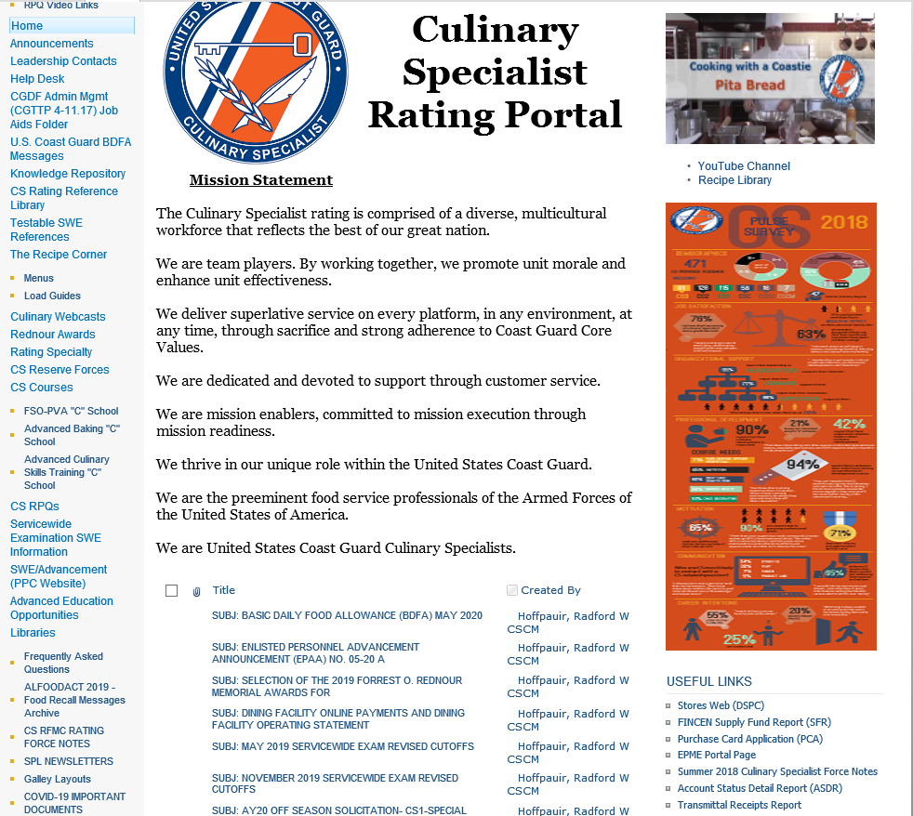
How to Access the SFR from the CS Portal
Link on bottom right of Homepage
Notes:
LINDA’S NOTES: THE SFR IS A FINCEN-GENERATED, FINCEN-MANAGED REPORT, AND MUST BE ACCESSED THROUGH THE FINCEN INTRANET. THE FINCEN INTRANET IS LOCATED ON THE CS PORTAL IN THE LOWER RIGHT COLUMN.

Slide 6
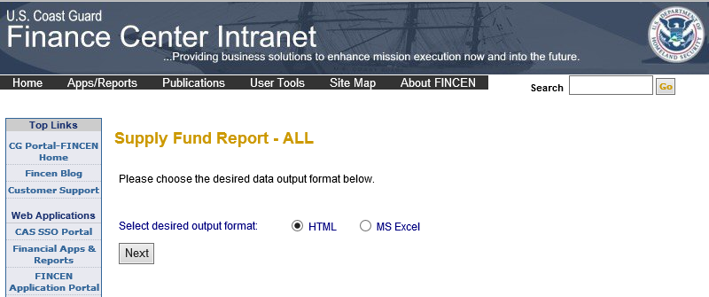
How to Access the SFR
CLICK Next

Slide 7
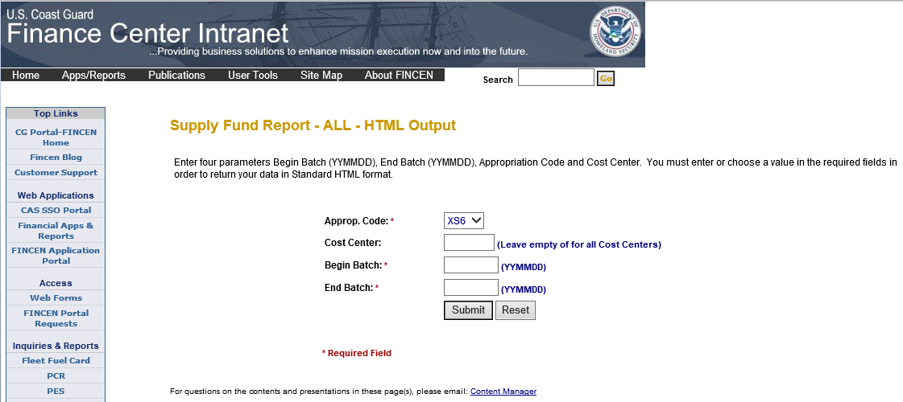
How to Access the SFR
FSO enters:
Cost Center (last 5 digits of OPFAC)
Begin Batch (first day of Month running the report for)
End Batch (last day of Month running the report for)
Clicks Submit
Notes:
LINDA’S NOTES: AT THE END OF THE MONTH, THE FSO LOGS INTO THE SFR AT THE FINCEN WEB SITE TO ACCESS THE SFR. THE FSO NEEDS TO REVIEW AND PRINT THIS SFR AS THE SFR WILL BE INCLUDED IN THE FSO’S MONTHLY REPORT AND EMAILED TO FINCEN.

Slide 8
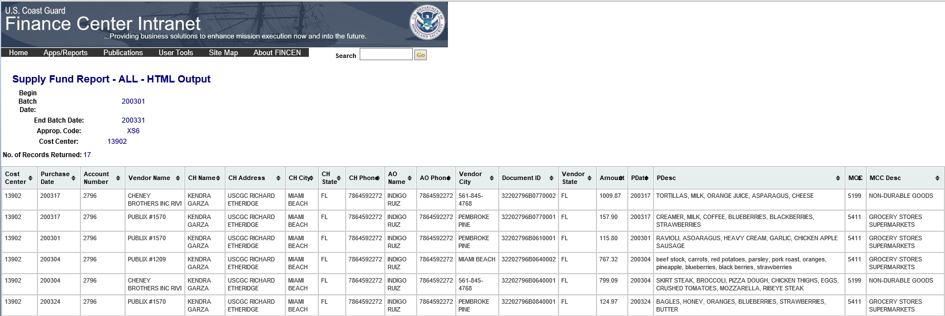
The SFR
The next slides will ZOOM in to show the SFR fields
Notes:
LINDA’S NOTE – THIS IS A SCREEN SHOT OF AN ACTUAL SFR. IT IS A LONG SPREADSHEET WITH SEVERAL COLUMNS

Slide 9
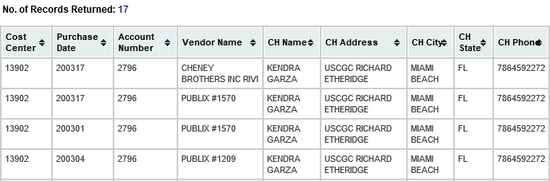
Important Fields to Look at on the SFR
Purchase Date
Vendor Name
Cardholder’s Information
FSO
FSO
FSO
FSO
Notes:
FSO REVIEWS SFR TO CONFIRM ACCURATE PURCHASE DATE, VENDOR NAME, AND CARDHOLDER INFO.

Slide 10
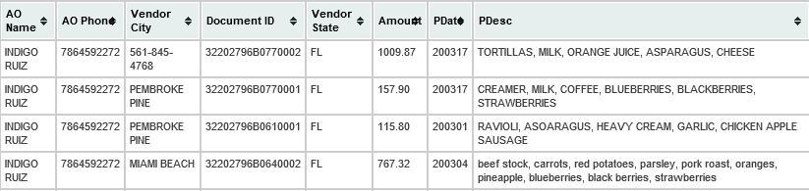
Important Fields to Look at on the SFR, continued
Document ID Number
Amount
Purchase Description
AO
AO
AO
AO

Slide 11
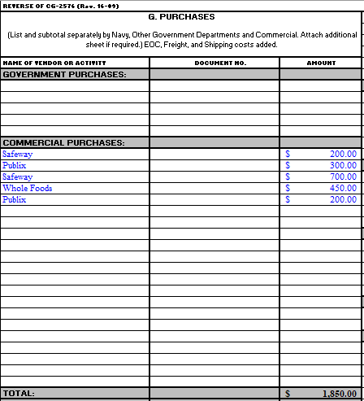
How the SFR relates to the CG-2576
At the end of the Month, the FSO:
Compares the SFR to the CG-2576 Block G. Purchases
  Looks for Price Discrepancies
Uses the SFR to get Document ID Numbers to populate Block G
Notes:
LINDA’s NOTE – THE FSO COPIES THE VENDOR’S ID NUMBER LISTED ON THE SFR, ACCESSES THE PVAISW CG-2576 BLOCK G “PURCHASES”, AND TYPES THE VENDOR’S ID NUMBER ON THE SFR INTO THE CG-2576 BLOCK G’S MIDDLE COLUMN “DOCUMENT NUMBER”. THE FSO ALSO REVIEWS THE VENDORS LISTED IN BLOCK G FOR ACCURACY.

Slide 12
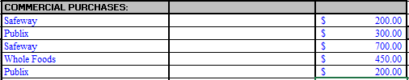
How the SFR relates to the CG-2576, continued
If the FSO has a Purchase on the CG-2576 that does not show up on the SFR, the FSO creates the Document Number:
For example – UN201234B3650001
UN – for Undocumented Purchase (not on SFR)
20 – for Fiscal Year
1234 – for Last 4 Digits of Credit Card
B – for a Purchase Card
365 – for Julian Date (Calendar date from 1-365)
0001 – for which purchase it was that day
Notes:
LINDA’s NOTE – THE FSO COPIES THE VENDOR’S ID NUMBER LISTED ON THE SFR, ACCESSES THE PVAISW CG-2576 BLOCK G “PURCHASES”, AND TYPES THE VENDOR’S ID NUMBER ON THE SFR INTO THE CG-2576 BLOCK G’S MIDDLE COLUMN “DOCUMENT NUMBER”. THE FSO ALSO REVIEWS THE VENDORS LISTED IN BLOCK G FOR ACCURACY.

Slide 13

SFR Submission Process
FSO saves SFR as PDF
  Landscape – Best practice
Who reviews and signs?
  FSO
  CO/OIC
    Wet or Electronic signature
Print paper copy of SFR
Submit to FINCEN with Monthly Report

Slide 14
Summary and Review
What is the SFR?
How to access the SFR
Important Fields to Look at on the SFR
How the SFR relates to the CG-2576
Submission Process
Questions?

Slide 15
Congratulations!
You have completed the LECTURE for Unit 9. Lesson 2. Supply Fund Report (SFR)
Next Steps:
Access USER GUIDE for U9 Lesson 1 for instructions on lesson completion.
Access Job Aid “How To Use SFR to Complete CG-2576 Block G” in Job Aid Booklet WEEK 2 posted on milSuite.
View video Demonstration “How to Use SFR to Complete CG-2576 Block G”
Complete PRACTICE, then submit and receive instructor feedback.
Complete ASSSESSMENT, then submit and receive instructor evaluation.
Notes:
HELLO AND WELCOME TO UNIT 7, Manage Sale of Meals
My name is Senior Chief Anthony Ciurlino with the Food Service Assistance and Training Team here at Training Center Petaluma. I WILL BE YOUR INSTRUCTOR FOR THIS LESSON.
THIS FIRST LESSON IN UNIT 7 IS “Document a Sale of Meal”. This lesson discusses the paperwork that the FSO fills out to document that the Dining Facility is selling a meal to an authorized patron. It does not talk about payment methods, only the daily PVA paperwork.

