Slide 1


Unit 9. Monthly Report
Lesson 3.
Submit Monthly Report
Notes:
HELLO AND WELCOME TO UNIT 7, Manage Sale of Meals
My name is Senior Chief Anthony Ciurlino with the Food Service Assistance and Training Team here at Training Center Petaluma. I WILL BE YOUR INSTRUCTOR FOR THIS LESSON.
THIS FIRST LESSON IN UNIT 7 IS “Document a Sale of Meal”. This lesson discusses the paperwork that the FSO fills out to document that the Dining Facility is selling a meal to an authorized patron. It does not talk about payment methods, only the daily PVA paperwork.

Slide 2
Objective(s)
IDENTIFY the elements of a Monthly Report required for submission to FINCEN

Slide 3
Agenda
Inventory Management Workbook (IMWPVA)
Purchase vs. Allowance Inventory System Workbook (PVAISW)
Forms Requiring Signatures
Submission to FINCEN
Review

Slide 4
Inventory Management Workbook (IMWPVA) Form CG-
At the end of the month,
  The FSO takes a full Physical Inventory of all food items on hand and enters this inventory (food item, unit of issue, quantity, and unit price) into the IMWPVA.
  The FSO enters the total amount of ending inventory into the PVAISW CG-2576’s Line 8 (“Ending Inventory”).
  The FSO signs and submits the IMWPVA (Form CG-4261) to the CO/OIC for signature.

Slide 5
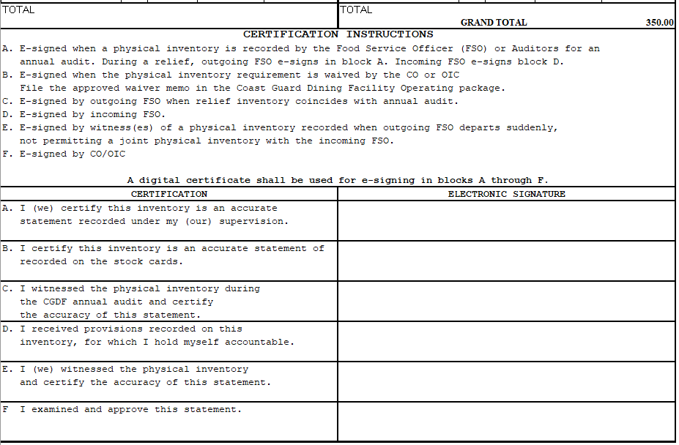
Inventory Management Workbook (IMWPVA)
Grand Total entered in Line 8 of CG-2576
FSO signs
CO/OIC signs
Notes:
Other signatures may be required if it is under other circumstances (ie. Relief, Annual Audit, etc.)

Slide 6
Purchase vs. Allowance Inventory System Workbook
(PVAISW)
On the final day of the Month, the FSO completes all entries into that month’s PVAISW
  Inventory
  Rations and Meals Sold
  Purchases
  Completes CG-2576 Block C. REMARKS
  Double checks all additional information entered throughout the month
    Sale of Stores CG-2581
    Transfer of Stores CG-2581
Notes:
Numbers from Meal Sign-In Sheet should be entered exactly the same onto Meal Sign In – Data Entry Sheet.

Slide 7
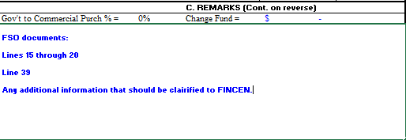
CG-2576 Block C. REMARKS
Notes:
Numbers from Meal Sign-In Sheet should be entered exactly the same onto Meal Sign In – Data Entry Sheet.

Slide 8


PVAISW Ready for Submission
When the PVAISW is complete. The FSO clicks on the Red Box on the CG-2576. The report runs an internal check. If there are any errors or questions with the PVAISW, it will let FSO know. When complete with no errors, the PVAISW will turn into a PDF with a Green Box.
Notes:
Numbers from Meal Sign-In Sheet should be entered exactly the same onto Meal Sign In – Data Entry Sheet.

Slide 9
Forms Requiring Signatures
The FSO secures required signature(s) on the forms listed below and submits the forms to FINCEN at the end of the month:
  CG-2576 – Signatures of FSO and CO/OIC
  CG-3123 Summary – Signature of XO/XPO
  SFR – Signatures of FSO and CO/OIC
  ICA Data Page
  Sale of Stores CG-2581 (if applicable)– Signature of FSO
  Transfer of Stores CG-2581 (if applicable) – Signature of FSO
  Transmittal Letter (if Cash in Transit) – Signature of FSO
  Supporting Memorandums (Relief, Annual Audit, Deficit, Survey) (if applicable) – Signatures of FSO, CO/OIC, Designated Auditor
  DD-1149 (if applicable) – XO

Slide 10
Submission to FINCEN
FSO organizes all files to submit to FINCEN and emails them to:
FIN-SMB-CGDF
*Report must be emailed to FINCEN by the 10th of the next month.

Slide 11
Submission to FINCEN, continued
The FSO then waits to receive back an email from FINCEN with their audited report.
It will either be good to go or have remarks from their FINCEN Auditor.
*FSO may have to make corrections and re-submit.

Slide 12
Knowledge Check: Submit a Monthly Report
Instructions: Click on the answer you believe is correct.
1. At month’s end, what sections in the PVAISW’s CG-2576 does the FSO complete?
A. The Daily Ration Memorandum, Transmittal letter, and CG-2581.
B. Block G “Purchases”, Block C “Remarks”, and Block A Line 8 “Ending Inventory”.
2. After preparing the PVAISW for submission to FINCEN, the FSO clicks on the RED “ready to sign and submit” button. What happens if the button does not turn GREEN?
A. The PVAISW will automatically send a message to FINCEN alerting FINCEN there is an issue with the FSO’s PVAISW, so FINCEN can assist.
B. The PVAISW will generate error alerts letting the FSO know what is wrong, and guiding the FSO to fix the issue(s) in the PVAISW.

Slide 13

That’s right!
Congratulations! !
Return to complete the Knowledge Check

Slide 14

That is not correct.
Please try again.
Try again…

Slide 15


Yes, that’s right!
Complete lesson

Slide 16
Summary and Review
Inventory Management Workbook (IMWPVA)
Purchase vs. Allowance Inventory System Workbook (PVAISW)
Forms Requiring Signatures
Submission to FINCEN
Questions?

Slide 17
Congratulations!
You have finished Lesson 3. Submit Monthly Report
Accomplishments:
You are able to identify the elements of a Monthly Report submitted to FINCEN at the end of the month.
Next Steps:
Return to milSuite to begin Unit 9’s Lesson 4. File Monthly Report

