Slide 1


Unit 11. FSO Responsibilities
Lesson 1.
FSO Relief
Notes:
HELLO AND WELCOME TO UNIT 7, Manage Sale of Meals
My name is Senior Chief Anthony Ciurlino with the Food Service Assistance and Training Team here at Training Center Petaluma. I WILL BE YOUR INSTRUCTOR FOR THIS LESSON.
THIS FIRST LESSON IN UNIT 7 IS “Document a Sale of Meal”. This lesson discusses the process and paperwork that the incoming FSO completes to document the relief.

Slide 2
Objective(s)
Given a designation for your new FSO assignment, computer with CS Portal access, a Purchase vs. Allowance Inventory System Workbook (PVAISW), an FSO Relief Memorandum template, an FSO Designation Memorandum template, and Job Aid “How to Document Relief of an Food Service Officer (FSO), DOCUMENT an FSO Relief with 100% accuracy. (TPO)
Notes:
NOTE: I added the “FSO Relief Memorandum template” in the conditions, because we’ll be giving them this template during assessment.

Slide 3
Agenda
Types of Relief
Relief Paperwork
Verifying Documents
Physical Inventory
Cash Count
Vendor Verification
Purchase Cards
Relief Memorandum
Designation Memorandum
Review
Note: In this lecture, you are the new “incoming” FSO relieving the departing “outgoing” FSO.
Notes:
NOTE: I ADDED A CLARIFICATION AT BOTTOM THAT THIS LECTURE FEATURES INCOMING FSO ACTION FOR THE MOST PART, ALTHOUGH THERE ARE A FEW COMMENTS ABOUT WHAT THE DEPARTING “OUTGOING” FSO SHOULD ALSO DO.

Slide 4
Types of Relief
    Informal Relief
      Temporary (temporary = incoming FSO will be in role 30 days or less)
      CO/OIC designates FSO in writing specifying duties and responsibilities.
    Formal Relief
      Permanent Relief of FSO
      Must be a Commissioned Officer or Culinary Specialist (CS) in paygrade E5 or above
Notes:
NOTE: I ADDED ALL ITEMS IN PARENTHESIS – PLEASE CHECK TO CONFIRM ACCURACY. Also check accuracy of #3 under INFORMAL RELIEF.

Slide 5
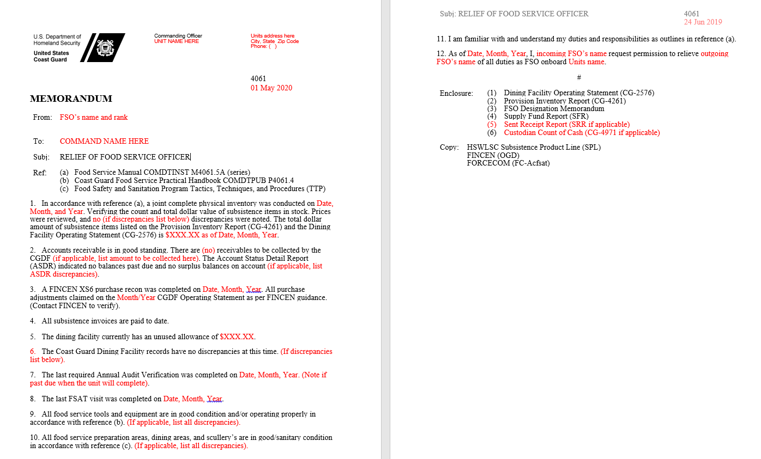
FSO Relief Memorandum
Notes:
THIS IS A TEMPLATE OF AN FSO RELIEF MEMORANDUM. THE INCOMING FSO MUST CREATE AN FSO RELIEF MEMORANDUM WHEN RELIEVING AN OUTGOING FSO. THE NEXT FEW SLIDES WILL EXPLAIN THE INFORMATION AN INCOMING FSO MUST GATHER TO CREATE THIS FSO RELIEF MEMORANDUM.

Slide 6
Relief Paperwork
(Performed by Incoming FSO)
    Relief at End-of-Month
      Normal Monthly Paperwork can be submitted to FINCEN
      Incoming and Outgoing FSOs both sign IMWPVA (in corresponding rows)
    Relief Mid-Month
      Paperwork must be completed up to that date (ie. 15 May Report)
      Incoming and Outgoing FSOs both sign IMWPVA (in corresponding rows)
      End-of-Month Paperwork must also be completed by the new FSO
Notes:
Now on this slide are we talking about what the departing FSO does?

Slide 7
Verifying Documents
(Performed by Incoming FSO)
FSO should review 06 months of the Unit’s Dining Facility Monthly Reports.
This includes the FINCEN audited copies of all CG-2576s.
Notes:
Make sure folders are completed, all printed out, left/right side accuracy, searching for discrepancies.

Slide 8
Physical Inventory
(Performed by Incoming FSO)
Incoming FSO should complete a Full Physical Inventory with the outgoing FSO.
FSO looks for:
  What food is on hand
  Why? Accountability!
Notes:
Perhaps always use adjectives in this slide show. Incoming or outgoing (departing)

Slide 9
Accounts Receivable
(Performed by Incoming FSO)
FSO should review:
  The Unit’s ASDR
FSO should Physically Count all Cash on Hand at the Unit.
FSO should look for:
  Where are funds kept?
  How much is there?
  When was last Transmittal?
  Do OGD Receipts match Transmittal?
  Does all this match the Cash Log?
Notes:
Incoming/outgoing?

Slide 10
Vendor Verification
(Performed by incoming FSO)
FSO should Verify the Account Standings with Vendors:
  Don’t allow vendors to file purchase card information
  Check for pending charges
  Check for recurring charges
Notes:
Incoming/outgoing?

Slide 11
Purchase Cards
Outgoing FSO shall give Purchase Card cancellation notice 2 weeks prior to relief
Prior to reporting, the Incoming FSO shall contact Approving Official (AO) at new Unit to start the process for obtaining a Purchase Card
Notes:
Numbers from Meal Sign-In Sheet should be entered exactly the same onto Meal Sign In – Data Entry Sheet.

Slide 12
FSO Relief Memorandum
Notes:
IN THE PREVIOUS SLIDES WE WALKED THROUGH EVERYTHING AN INCOMING FSO MUST DO TO CREATE THIS MEMO – THE FSO RELIEF MEMORANDUM. NOW WE WILL TAKE A CLOSER LOOK AT THE SECTIONS OF THIS FSO RELIEF MEMORANDUM.

Slide 13
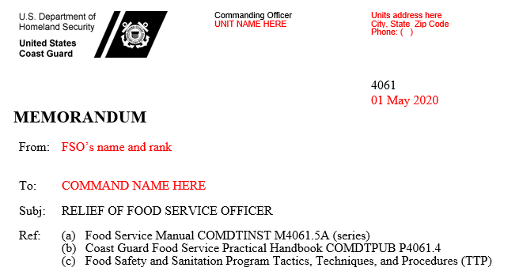
FSO Relief Memorandum, continued
Notes:
THE TOP SECTION OF THE FSO RELIEF MEMORANDUM INCLUDES STANDARD UNIT AND PROFILE INFORMATION, SUCH AS UNIT NAME, UNIT ADDRESS AND PHONE, DATE, YOUR NAME AND RANK AS THE INCOMING FSO, AND THE COMMANDER’S NAME OF YOUR NEW UNIT.

Slide 14
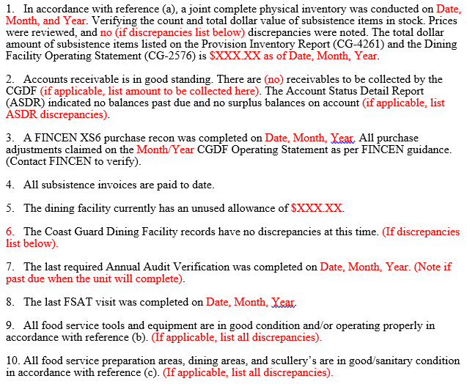
FSO Relief Memorandum, continued
Notes:
THE BODY OF THE FSO RELIEF MEMORANDUM IS WHERE YOU WILL INSERT THE DATA FROM ALL THE ACTIONS YOU TOOK EARLIER TO PREPARE TO CREATE THIS MEMO. FOR EXAMPLE:
THE DATE, MONTH, YEAR YOU COMPLETED THE PHYSICAL INVENTORY. WHETHER YOU FOUND DISCREPANCIES, AND FINALLY THE TOTAL AMOUNT OF SUBSISTENCE ITEMS IN THE PROVISION INVENTORY REPORT CG-4261 AND CG-2576, ALONG WITH THE DATE, MONTH, YEAR.
IN STEP 2. YOU STATE WHETHER ANY RECEIVABLES WERE COLLECTED, AND WHETHER THE ASDR HAD ANY DISCREPANCIES.
IN STEP 3, YOU’LL ENTER THE DATE, MONTH, AND YEAR THE FINCEN XS6 WAS COMPLETED.
NO DATA ENTRY IS NEEDED IN STEP 4.
STEP 5 REQUIRES ENTERING THE UNUSUED ALLOWANCE FROM YOUR DINING FACILITY.
STEP 6 CONFIRMS NO DISCREPANCIES IN RECORDS. IF THERE ARE, YOU MUST LIST THEM HERE.
STEP 7 REQUIRES DATA OF ANNUAL AUDIT VERIFICATION.
STEP 8 REQUIRES DATE OF LAST FASAT VISIT.
STEP 9 REQUIRES NO DATA ENTRY UNLESS YOU DISCOVER EQUIPMENT DISCREPANCIES.
STEP 10 REQUIRES NO DATA ENTRY UNLESS YOU DISCOVER SANITATION DISCREPANCIES

Slide 15
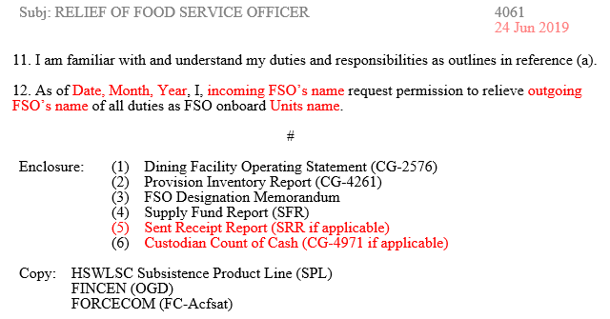
FSO Relief Memorandum, continued
Notes:
THE LAST SECTION OF THE FSO RELIEF MEMORANDUM CLOSES WITH:
(11) STEP 11, WHICH JUST STATES YOU UNDERSTANDING OF DUTIES AND RESPONSIBILITIES,
(12) STEP 12, WHERE YOU ENTER THE DATE, MONTH, YEAR YOU ARE RELIEVING THE OUTGOING FSO. YOU WILL ADD YOUR NAME AS INCOMING FSO, AND THE UNIT’S NAME AS WELL.
ENCLOSURE: IF SRR APPLIES TO YOUR SITUATION, YOU WILL NEED TO ADD A STEP 5 ENCLOSURE FOR SRR. IF YOU HAVE CUSTODIUAM COUNT OF CASH, CG-4901, YOU’LL NEED TO ADD THIS AS THE #6 ENCLOSURE.

Slide 16
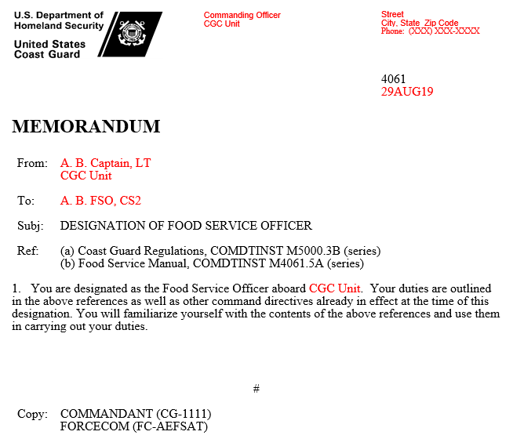
FSO Designation Memorandum
Notes:
AFTER COMPLETING THE FSO RELIEF MEMORANDUM, PER USCG POLICY THE COMMAND WILL CREATE AND SIGN AN FSO DESIGNATION MEMO THAT YOU WILL ALSO SIGN. HOWEVER, SOMETIMES THE INCOMING FSO WILL CREATE THIS DESIGNATION MEMO ON THE COMMAND’S BEHALF, SECURE COMMAND SIGNATURE, AND THEN YOUR SIGNATURE AS INCOMING FSO.

Slide 17
Summary and Review
Types of Relief
Relief Paperwork
Verifying Documents
Physical Inventory
Cash Count
Vendor Verification
Purchase Cards
Relief Memorandum
Designation Memorandum
Questions?

Slide 18
Congratulations!
You have completed the LECTURE for Unit 11. Lesson 1. FSO RELIEF
Next Steps:
Refer to User Guide (Unit 11, Lesson 1) for instructions on how to complete PRACTICE.
Access milSuite U11,L1 “PRACTICE” section to complete Practice.
Submit your practice to instructor for feedback.
After successful completion of your practice activity, access User Guide and milSuite to complete ASSESSMENT, then submit for instructor evaluation.

