Slide 1


Unit 11. FSO Responsibilities
Lesson 2.
Standard Operating Procedures
Notes:
HELLO AND WELCOME TO UNIT 7, Manage Sale of Meals
My name is Senior Chief Anthony Ciurlino with the Food Service Assistance and Training Team here at Training Center Petaluma. I WILL BE YOUR INSTRUCTOR FOR THIS LESSON.
THIS FIRST LESSON IN UNIT 7 IS “Document a Sale of Meal”. This lesson discusses what is required for an SOP and how the FSO prepares one.

Slide 2
Objective(s)
Given designation as an FSO, Coast Guard Dining Facility (CGDF) files, a computer with CS Portal access, and Job Aid “How to create a CGDF Standing Operating Procedures (SOP)”, CREATE the Unit’s CGDF SOP with 100% accuracy. (TPO)

Slide 3
Agenda
SOP Requirements
How to access SOP Template from CS Portal
SOP Template
Review

Slide 4
SOP Requirements
Unit specific written instructions on personnel duties and responsibilities
Maintaining refrigerated spaces’ temperature logs
On-the-job training for the CO’s or OINC’s approval to guide CGDF personnel
Equipment operation, safety, and sanitation
Break out and sales procedures
Notes:
Numbers from Meal Sign-In Sheet should be entered exactly the same onto Meal Sign In – Data Entry Sheet.

Slide 5
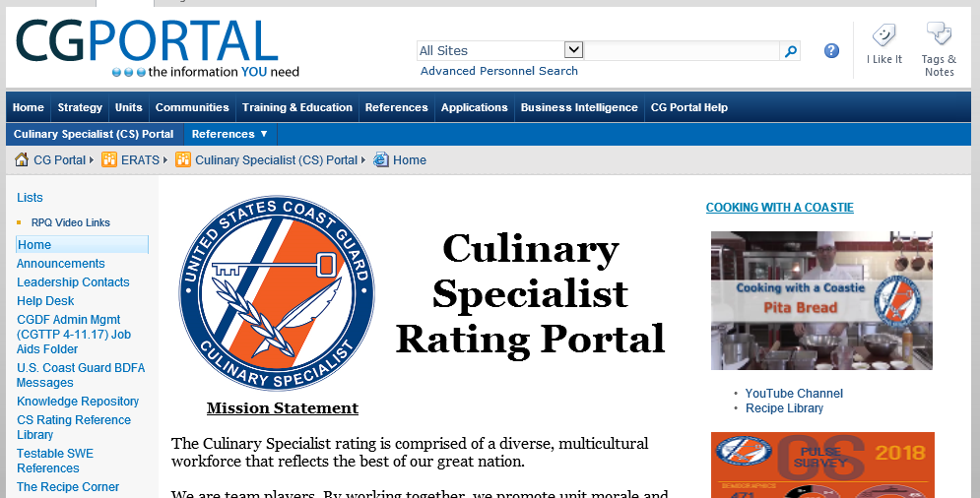
How to access SOP Template from CS Portal
Click “Knowledge Repository”
Notes:
Numbers from Meal Sign-In Sheet should be entered exactly the same onto Meal Sign In – Data Entry Sheet.

Slide 6
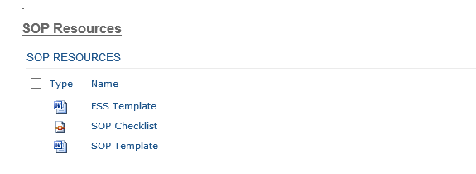
How to access SOP Template from CS Portal, continued
SCROLL DOWN and Click
“SOP Template”
Notes:
Numbers from Meal Sign-In Sheet should be entered exactly the same onto Meal Sign In – Data Entry Sheet.

Slide 7
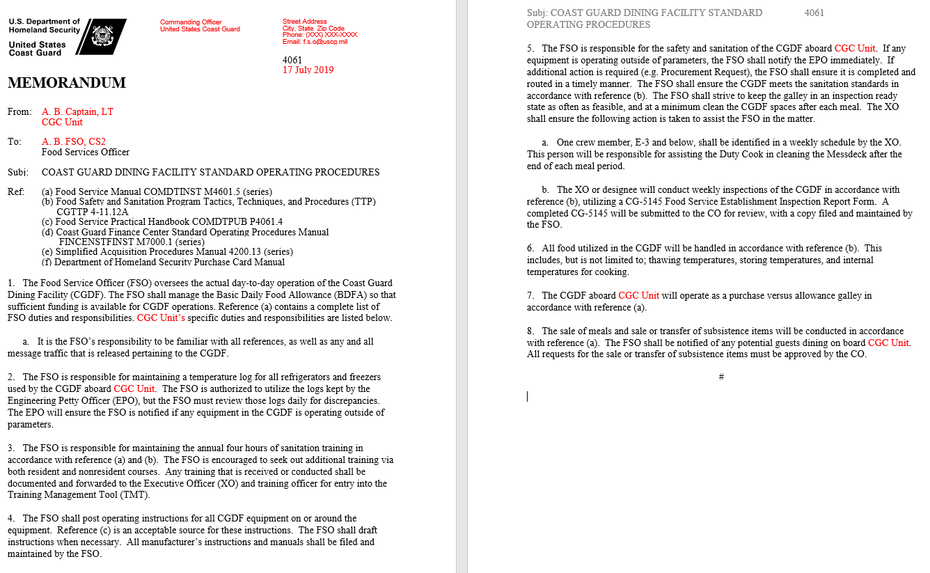
SOP Template
Notes:
Numbers from Meal Sign-In Sheet should be entered exactly the same onto Meal Sign In – Data Entry Sheet.

Slide 8
Summary and Review
SOP Requirements
How to access SOP Template from CS Portal
SOP Template
Questions?

Slide 9
Congratulations!
You have completed the LECTURE for Unit 11. Lesson 2. SOP
Next Steps:
Refer to User Guide (Unit 11, Lesson 2) for instructions on how to complete PRACTICE.
Access milSuite U11,L2 “PRACTICE” section to complete Practice.
Submit your practice to instructor for feedback.
After successful completion of your practice activity, access User Guide and milSuite to complete ASSESSMENT, then submit for instructor evaluation.

