Slide 1


Unit 11. FSO Responsibilities
Lesson 3.
Food Safety and Sanitation Program
Notes:
HELLO AND WELCOME TO UNIT 7, Manage Sale of Meals
My name is Senior Chief Anthony Ciurlino with the Food Service Assistance and Training Team here at Training Center Petaluma. I WILL BE YOUR INSTRUCTOR FOR THIS LESSON.
THIS FIRST LESSON IN UNIT 7 IS “Document a Sale of Meal”. This lesson discusses the paperwork that the FSO fills out to document that the Dining Facility is selling a meal to an authorized patron. It does not talk about payment methods, only the daily PVA paperwork.

Slide 2
Objective(s)
Given designation as an FSO, Coast Guard Dining Facility (CGDF) files, a computer with CS Portal access, and Job Aid “How to create a CGDF Food Safety and Sanitation (FSS) Program”, CREATE the Unit’s CGDF FSS Program with 100% accuracy. (TPO)

Slide 3
Agenda
FSS Program Requirements
How to access FSS Program Template from CS Portal
FSS Program Template
Review

Slide 4
FSS Program Requirements
Appoint an FSO
Perform weekly food service facilities inspections
  Inspections can be conducted by the Medical Department Representative (MDR) or other personnel designated by the CO/OIC
Complete and submit Food Service Establishment Inspection Report (CG-5145)
Conduct a daily walk-through inspection
  Observe employee practices, cleanliness, and signs of illness
Notes:
Numbers from Meal Sign-In Sheet should be entered exactly the same onto Meal Sign In – Data Entry Sheet.

Slide 5
FSS Program Requirements, continued
Inspect and acquire food from approved sources, and properly handle food
Ensure food service equipment bears the NSF seal
Follow cleaning and disinfection procedures
Report foodborne diseases
Provide annual training on food service sanitation requirements and procedures
REVIEWED ANNUALLY
Notes:
Numbers from Meal Sign-In Sheet should be entered exactly the same onto Meal Sign In – Data Entry Sheet.

Slide 6
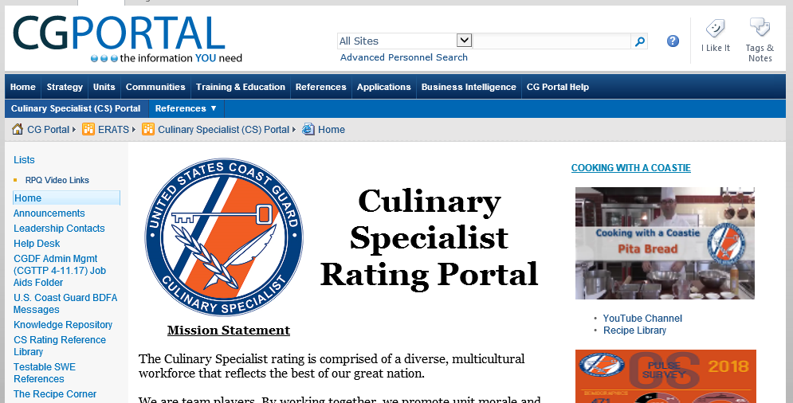
How to access FSS Program Template from CS Portal
Click “Knowledge Repository”
Notes:
Numbers from Meal Sign-In Sheet should be entered exactly the same onto Meal Sign In – Data Entry Sheet.

Slide 7
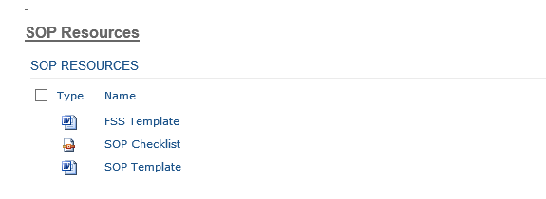
How to access SOP Template from CS Portal, continued
SCROLL DOWN and Click
“FSS Template”
Notes:
Numbers from Meal Sign-In Sheet should be entered exactly the same onto Meal Sign In – Data Entry Sheet.

Slide 8
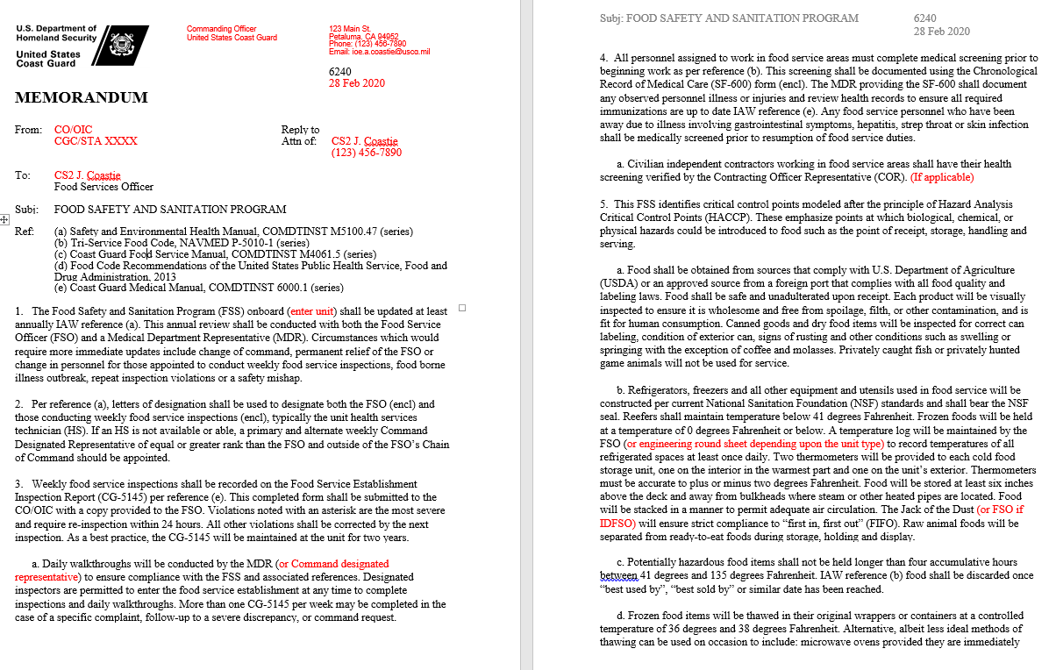
FSS Template
Notes:
Numbers from Meal Sign-In Sheet should be entered exactly the same onto Meal Sign In – Data Entry Sheet.

Slide 9
Summary and Review
FSS Program Requirements
How to access FSS Program Template from CS Portal
FSS Program Template
Questions?

Slide 10
Congratulations!
You have completed the LECTURE for Unit 11. Lesson 3. FSS
Next Steps:
Refer to User Guide (Unit 11, Lesson 3) for instructions on how to complete PRACTICE.
Access milSuite U11,L3 “PRACTICE” section to complete Practice.
Submit your practice to instructor for feedback.
After successful completion of your practice activity, access User Guide and milSuite to complete ASSESSMENT, then submit for instructor evaluation.

