Slide 1


Unit 11. FSO Responsibilities
Lesson 4.
Disestablish and Reestablish
Notes:
HELLO AND WELCOME TO UNIT 7, Manage Sale of Meals
My name is Senior Chief Anthony Ciurlino with the Food Service Assistance and Training Team here at Training Center Petaluma. I WILL BE YOUR INSTRUCTOR FOR THIS LESSON.
THIS FIRST LESSON IN UNIT 7 IS “Document a Sale of Meal”. This lesson discusses the paperwork that the FSO fills out to document that the Dining Facility is selling a meal to an authorized patron. It does not talk about payment methods, only the daily PVA paperwork.

Slide 2
Objective(s)
Disestablish a CGDF
Reestablish a CGDF

Slide 3
Agenda
Notification Process
Managing Inventory
Alternate Messing
Documenting on CG-2576
Gleaning Program
Review

Slide 4
Notification Process
Who do you need to notify?
  FINCEN CS Liasons
  FSAT Representative
Best method of notification?
  Email
What are you notifying them of?
  Dates of disestablishment
    Can be an estimate
  Date of reestablishment
Notes:
Numbers from Meal Sign-In Sheet should be entered exactly the same onto Meal Sign In – Data Entry Sheet.

Slide 5
Managing Inventory - Disestablish
Reduce by Use Prior to Disestablishment
  Plan menu to reduce inventory
  Avoid purchasing excess perishables
  Store non-perishable items
Transfer Inventory to another CGDF
Commercial storage (paid for by unit)
  FSO must monitor stored food
Coast Guard Gleaning Program
  Discussed in later slides
Notes:
Numbers from Meal Sign-In Sheet should be entered exactly the same onto Meal Sign In – Data Entry Sheet.

Slide 6
Managing Inventory - Reestablish
Reverse the process
Retrieve any stored items
Purchase and re-stock food items
Notes:
Numbers from Meal Sign-In Sheet should be entered exactly the same onto Meal Sign In – Data Entry Sheet.

Slide 7
Alternate Messing
Transfer SIK to another CGDF
  Local CG galley
Activate BAS
  Members eat on the economy
Contract Messing
  Food Trucks
  Local Restaurants
Decision is processed by the Command
Notes:
Numbers from Meal Sign-In Sheet should be entered exactly the same onto Meal Sign In – Data Entry Sheet.

Slide 8
Documenting on CG-2576
Dates of Disestablishment or Reestablishment are documented in Block C. REMARKS section
10% does not apply if CGDF was not open for 30 consecutive days
Ensure correct numbers are carried over from date of disestablishment when reestablishing the CGDF
Notes:
Numbers from Meal Sign-In Sheet should be entered exactly the same onto Meal Sign In – Data Entry Sheet.

Slide 9
CG Gleaning Program
Allows the CG to donate excess food
Who can we donate to?
  Non-Profit Organizations
    Congressional
    State
    Local
      For example: Salvation Army, local homeless or battered women’s shelters
Notes:
Numbers from Meal Sign-In Sheet should be entered exactly the same onto Meal Sign In – Data Entry Sheet.

Slide 10
CG Gleaning Program, continued
CGDF can donate any wholesome food that will not be utilized, consumed, or sold prior to expired date
Wholesome cooked or uncooked food items from picnics or morale events
Food items from Disestablished CGDF that cannot be sold or transferred to another government food service operation
Situations where sale or transfer of food items is not possible and immediate disposition is necessary
Notes:
Numbers from Meal Sign-In Sheet should be entered exactly the same onto Meal Sign In – Data Entry Sheet.

Slide 11
CG Gleaning Program, continued
List of donated items kept on Right side of Monthly Folder
  No specific form required (CG-2581 recommended)
Release of Liability signed
  Kept on file at CGDF
  Template on CS Portal
Receiving Agency pays for any Pick-up costs
Notes:
Numbers from Meal Sign-In Sheet should be entered exactly the same onto Meal Sign In – Data Entry Sheet.

Slide 12
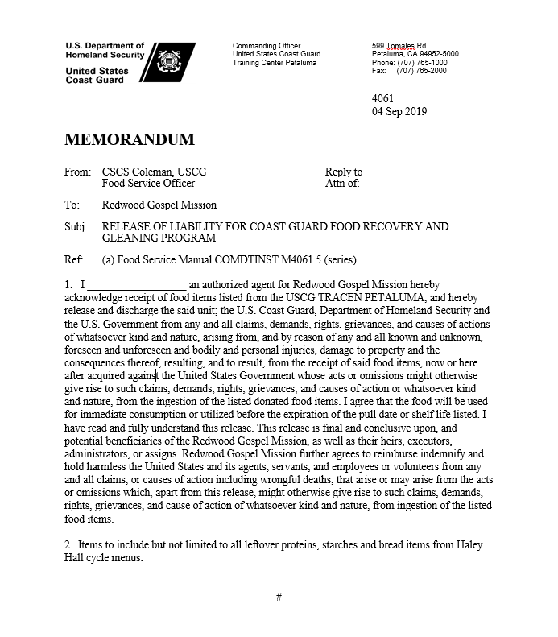
CG Gleaning Program, continued
Release of Liability
Notes:
Numbers from Meal Sign-In Sheet should be entered exactly the same onto Meal Sign In – Data Entry Sheet.

Slide 13
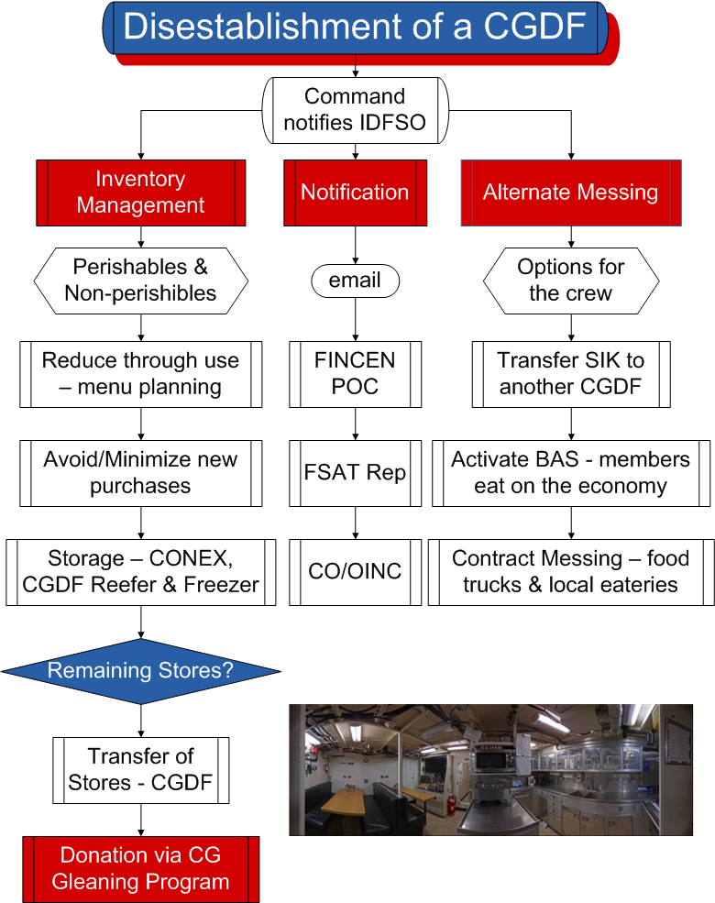
Notes:
Numbers from Meal Sign-In Sheet should be entered exactly the same onto Meal Sign In – Data Entry Sheet.

Slide 14
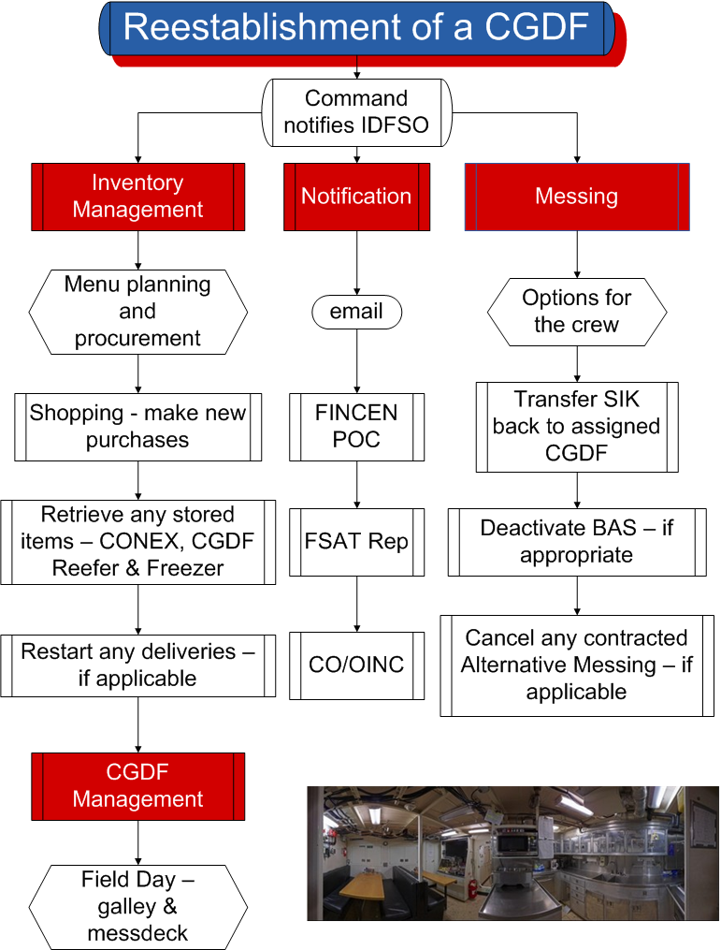
Notes:
Numbers from Meal Sign-In Sheet should be entered exactly the same onto Meal Sign In – Data Entry Sheet.

Slide 15
Summary and Review
Notification Process
Managing Inventory
Alternate Messing
Documenting on CG-2576
Gleaning Program
Questions?

Slide 16
Congratulations!
You have completed the LECTURE for Unit 11. Lesson 4. Disestablish and Reestablish
Next Steps:
Refer to User Guide (Unit 11, Lesson 4) for instructions on how to complete PRACTICE.
Access milSuite U11,L4 “PRACTICE” section to complete Practice.
Submit your practice to instructor for feedback.
After successful completion of your practice activity, access User Guide and milSuite to complete ASSESSMENT, then submit for instructor evaluation.

