Slide 1


Unit 12: Annual Audit
Lesson 2.
Verify an Annual Audit
Notes:
HELLO AND WELCOME TO UNIT 12, Annual Audit.
My name is Senior Chief Adam Shelton with the Food Service Assistance and Training Team here at Training Center Petaluma. I WILL BE YOUR INSTRUCTOR FOR THIS LESSON.
THIS SECOND LESSON IN UNIT 12 IS VERIFY AN ANNUAL AUDIT. LESSON 2 PROVIDES KNOWLEDGE AND A FOUNDATIONAL UNDERSTANDING OF VERIFYING AN ANNUAL AUDIT FOR SUBMISSION. The goal of this lesson is to ensure every FSO attending this course has foundational knowledge critical to verifying an Annual Audit for their dining facility.
ONCE THIS LESSON IS COMPLETE, YOU WILL PERFORM AN ACTIVITY OR KNOWLEDGE CHECK IN WHICH YOU DEMOSTRATE YOUR UNDERSTADNING OF VERIFYING AN ANNUAL AUDIT FOR YOUR COAST GUARD DINING FACILITY.

Slide 2
Objective(s)
After this lesson, you will be prepared to:
  Verify paperwork from a completed annual audit
Notes:
READ SLIDE

Slide 3
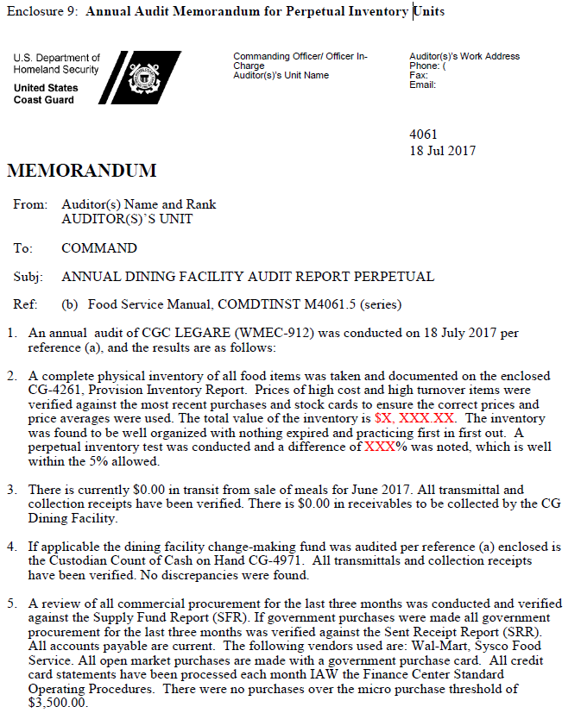

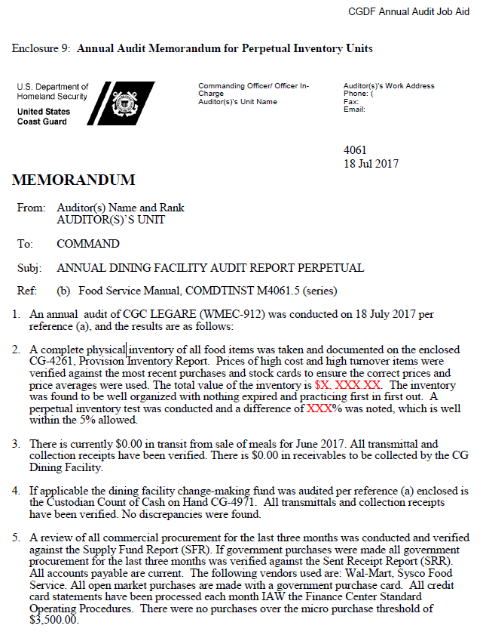
Annual Audit (Report) Memorandum
Auditor
To Command
To FSO
Notes:
The Annual Audit memo is routed from the auditor(s) to the Command. Once the Command reviews the memo, the report is then forwarded to the FSO for submission.

Slide 4

Annual Audit VS End of Month
Three differences in submitting EOM and Annual reports:
  Type of Reports you mark on CG-2576 and CG-4261 are different
  Signatures on CG-4261 are different
  For an Annual Audit you add the two Annual Audit memos along with the other files you deliver
Notes:
The difference in submission of your normal end of the month report and submission that coincides with an Annual Audit is….READ SLIDE

Slide 5
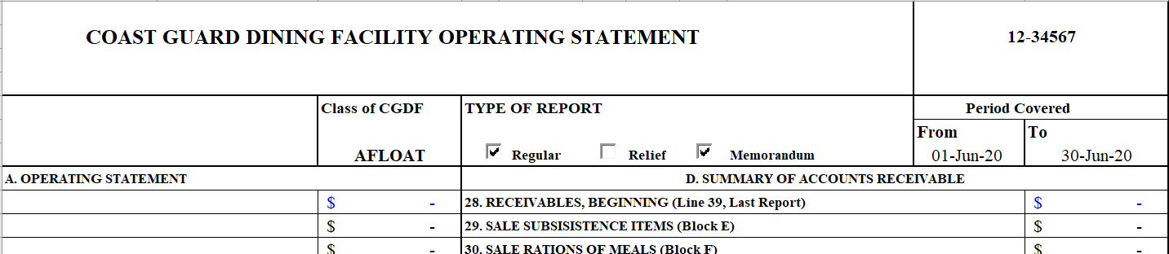
Type of Report (CG-2576)
aa
End of Month Report
Annual Audit Report
For an Annual Audit Report, check the box marked: Memorandum on your CG-2576
If you are submitting your Annual Audit along with your EOM report, also check the Regular box. Note: if you are submitting the Annual report along with your Monthly report, you do NOT have to send two copies.
Notes:
When submitting a end of the month report with the Annual Audit you will check the regular and memorandum boxes on the CG-2576.

Slide 6
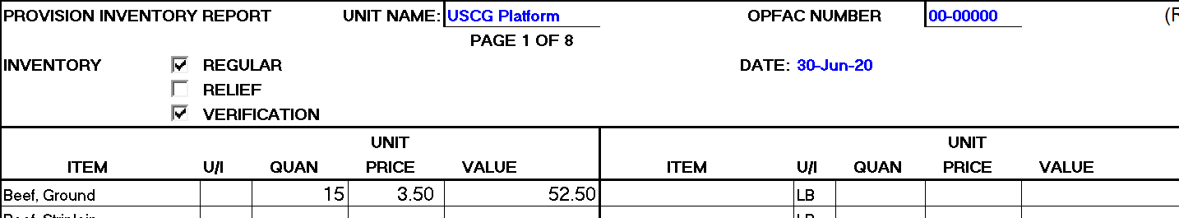
Type of Report (CG-4261)
End of Month Report
Annual Audit Report
For an Annual Audit Report, check the box marked:
Verification on your CG-4261
If you are submitting your Annual Audit along with your EOM report, also check the Regular box. Note: Again, if you are submitting the Annual report along with your Monthly report, you do NOT have to send two copies.
Notes:
You will also check the regular and verification boxes on the CG-4261.

Slide 7
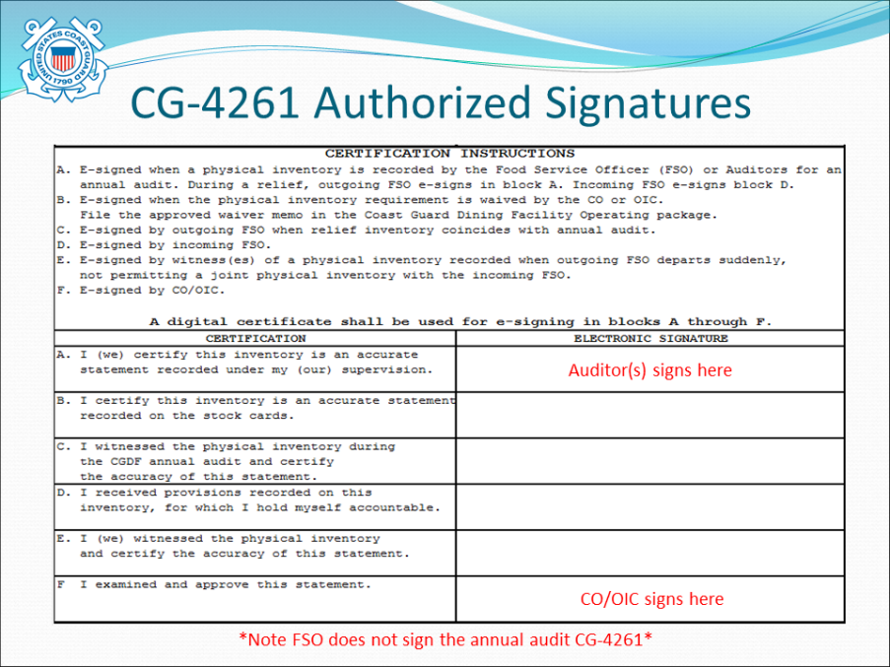
Check Signatures (CG-4261)
Auditor(s) signed Certification Box A.
CO/OIC signed in Box F
Remember:
The CG-4261 is NOT signed by the FSO this time because the FSO was not involved in the physical audit.
Notes:
When completing the inventory CG-4261 for the Annual Audit, the auditor will sign in Block A and the CO/OIC will sign in Block F. The FSO will not sign the CG-4261.

Slide 8
Converting Documents into PDFs
Once everything is verified, turn the following documents into PDFs.
Annual Audit Designation Memorandum
CG-2576 (PVAISW)
CG-4261 (IMWPVA)
Auditor’s CG-4971 (if your unit takes cash)
Annual Audit Memorandum (final report)
Notes:
The following documents need to be converted into PDFs for submission…..READ SLIDE

Slide 9
Where to email your Audit
FINCEN
SPL (Subsistence Product Line)
Notes:
Your Annual Audit with corresponding end of month report should be submitted to the FINCEN and the Subsistence Product Line or SPL.

Slide 10
Summary and Review
In this lesson, you learned the steps involved in verifying your Annual Audit Report, including:
  Proper report types to use
  Proper signature requirements
  How to prepare your files for submission
  Where to send your Annual Audit
Questions?
Next steps: Follow instructions in your User Guide to do the Practice exercise.
Notes:
In this lesson you have learned the steps involved in verifying an Annual Audit for submission including….READ SLIDE

